Slide 1

MMA Adhesives: Benefits and Industrial Applications
Mélissa Thorelle
Lijm Event November 2024

Slide 2
MMA Adhesives: Benefits and Industrial Applications
IPS Adhesives
Introduction to MMA Adhesives
Advantages over traditional joining methods
Structural Adhesives: MMA vs Epoxy vs PU
Benefits of MMA and ‘’next generation’’
Industrial Applications

Slide 3
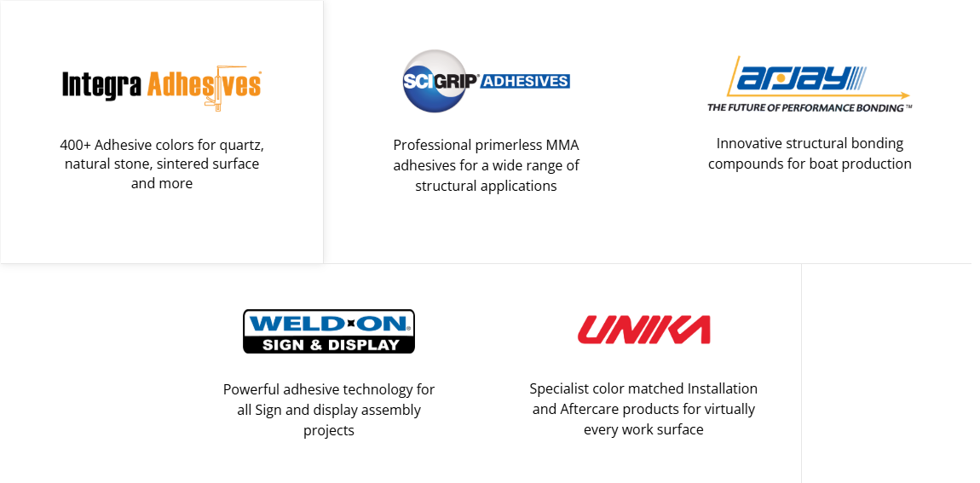
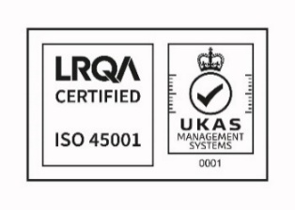
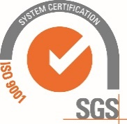
IPS Adhesives, part of IPS Corporation
Notes:
Brands in the market – structural, sign & display, surfacing

Slide 4

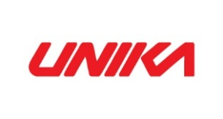

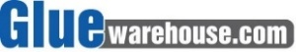




IPS Adhesives, part of IPS Corporation
2010: IPS Corporation acquires Holdtite
Adhesives
2011: WELD-ON and Holdtite rebranded under the name SCIGRIP
2014: SCIGRIP acquires GlueWarehouse
2016: SCIGRIP acquires Integra Adhesives
Feb 2020: IPSA acquires Unika
2011 2012 2014 2016 2017 2020 2022
2010
2012: Began license manufacturing in India
2011: Adhesives manufacturing in US is consolidated into Durham, NC facility from CA
2017: SCIGRIP acquires GlueBoss Adhesives
2016: SCIGRIP acquires Arjay
Notes:
Accent strength in how we’ve grown as company and diversified in the marketplace

Slide 5

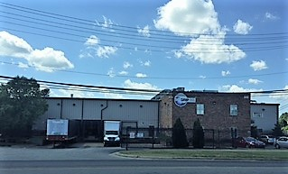

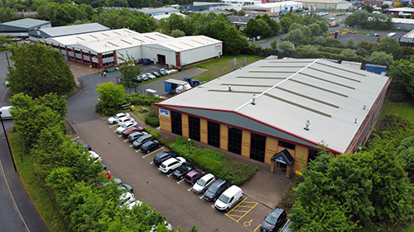



IPS Adhesives: SCIGRIP
Durham, NC
MMA technology
1:1 and 10:1 ratio
Industrial, BTR, Marine
Plastic, Composite, Metal bonding
Cartridge & Bulk
SCIGRIP, Integra and
MooGloo Adhesives
Newcastle upon Tyne, UK
SCIGRIP, Unika, Integra and
MooGloo Adhesives

Slide 6
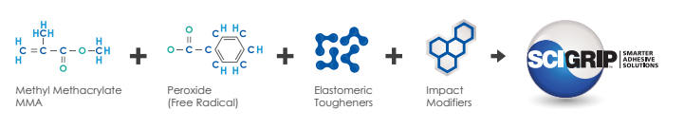
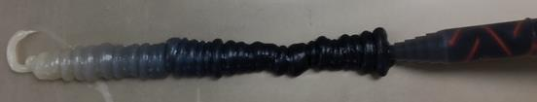
Introduction to MMA Adhesives
What is an adhesive ?
SUBSTRATE
Adhesion to the substrate
Adhesives are polymer-based materials that allows two or more substrates to be joined together without mechanical fastening, welding, or clipping.
ADHESIVE
Cohesion within the adhesive
MMA Adhesives
SUBSTRATE
Two-parts acrylic adhesives that consist of :
Adhesive Resin composed of methacrylate monomers, amines + rubbers and toughening agents
Peroxide-based Activator

Slide 7
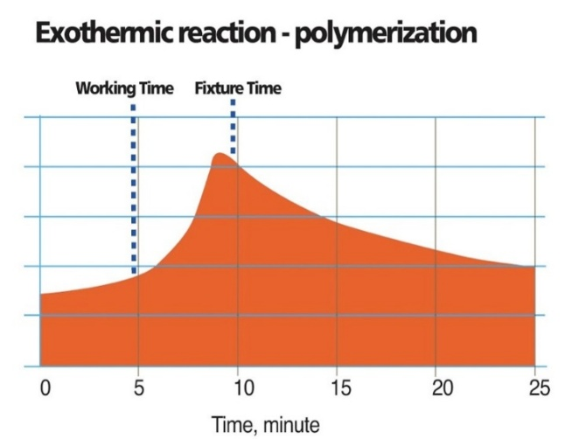
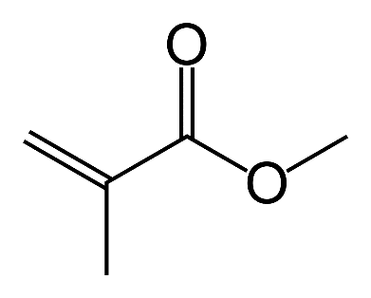
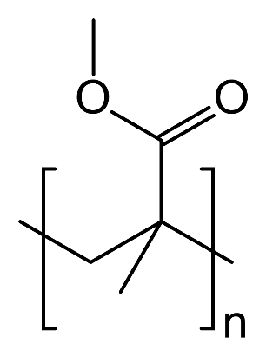
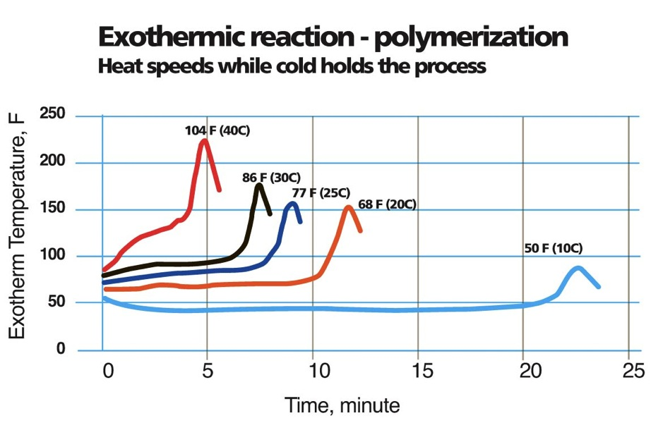
Introduction to MMA Adhesives
MMA Adhesives
From a technical perspective these adhesives work by creating an exothermic polymerization reaction. Polymerization is the process of reacting monomer molecules together, in a chemical reaction, to form polymer chains.
Key properties:
✔ Toughness ✔ Surface adhesion ✔ Cure speed control

Slide 8

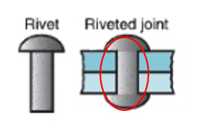
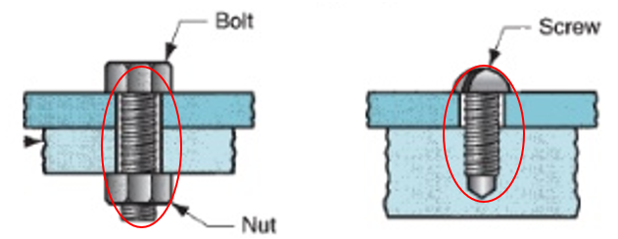
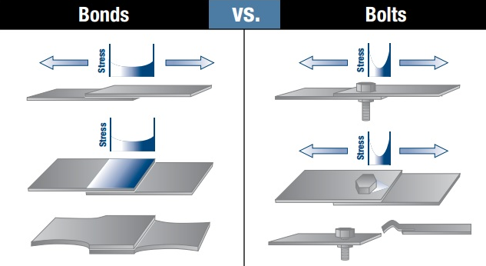
Advantages of MMA vs Rivets/Bolts
Uniform distribution of stress over the bond area
Eliminate damage to the structure
The bonded joint remains flexible to allow movements and reduce noise
Good fatigue resistance
Sealing and bonding in one step
Bolts, screws and rivets can become loose, fatigue and break.

Slide 9
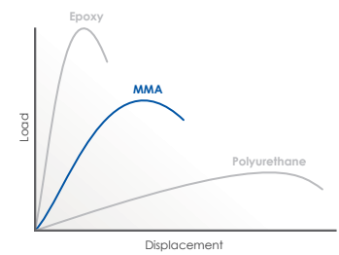
Epoxy VS MMA VS Polyurethane
 | Epoxy | MMA | PU (2K)
+ | Very high Strength (>30 MPa) Χ and T° resistance Weathering resistance | Adhesion on Plastic + Metal and Composite Min. surface prep. Easy to use Fast curing time Fatigue and impact resist. | Flexibility No odour Adhesion to plastic/wood Impact resistance
- | Surface Prep.required Can be brittle Longer curing time | Exothermic reaction (shrinkage) Odour T° and X resist. <Epoxy | Low strength Surface prep. H&S (iso) Longer curing time T° and X resist. <Epoxy

Slide 10
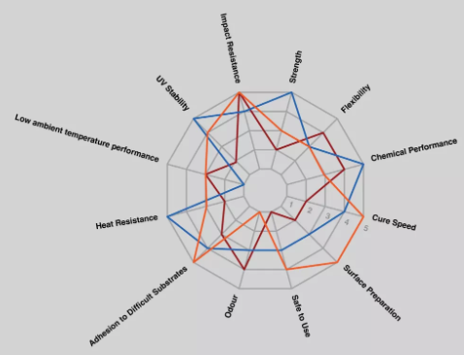
Epoxy VS MMA VS Polyurethane
Epoxy
PU
MMA
Navigating Structural Adhesive Choices: Comparing Epoxy v Acrylic v Polyurethane Adhesive Formulations - Forgeway Ltd

Slide 11






Benefits of MMA Adhesives
Minimal surface preparation
Only cleaning on most substrates to enhance productivity
Room Temperature curing
No heating or post cure required
Variable cure time and fast strength build up
From few minutes to hours
Bonding dissimilar materials
High elongation suitable for diff. expansion coefficient
Variable Rheology
High for large structure to lower for small gaps
High peel and Impact Resistance
Reduce product failure
better performance for applications with mixed-mode stresses

Slide 12

“Next-Generation” of Acrylate Adhesive
Low Odor Formulation and Non-Flammable Classification
Improved formulation for enhanced workplace safety and productivity.
Nylon and LSE bonding
No flame or plasma pre-treatment
Reduce costs and production time
Galvanized Steel Bonding
No primer required
Resistance to E-coat and Paint Bake Cycle
bonding parts won’t shift/separate during bake

Slide 13

MARKET SECTORS
Maritime
Transportation (BTR)
Building & Construction
Automotive
Agricultural Vehicles
Wind Energy
Aquaculture
Sub-sea
Sign & Display
Infrastructure

Slide 14

Thank you for your attention

