Slide 1

MMA Adhesives in Marine Manufacturing

Slide 2
MMA Adhesives in Marine Manufacturing
IPS Adhesives
Advantages over traditional joining methods
Introduction to Marine Manufacturing
Applications
Products

Slide 3



IPS Adhesives, part of IPS Corporation
Notes:
Brands in the market – structural, sign & display, surfacing

Slide 4








IPS Adhesives, part of IPS Corporation
2010: IPS Corporation acquires Holdtite
Adhesives
2011: WELD-ON and Holdtite rebranded under the name SCIGRIP
2014: SCIGRIP acquires GlueWarehouse
2016: SCIGRIP acquires Integra Adhesives
Feb 2020: IPSA acquires Unika
2011 2012 2014 2016 2017 2020 2022
2010
2012: Began license manufacturing in India
2011: Adhesives manufacturing in US is consolidated into Durham, NC facility from CA
2017: SCIGRIP acquires GlueBoss Adhesives
2016: SCIGRIP acquires Arjay
Notes:
Accent strength in how we’ve grown as company and diversified in the marketplace

Slide 5



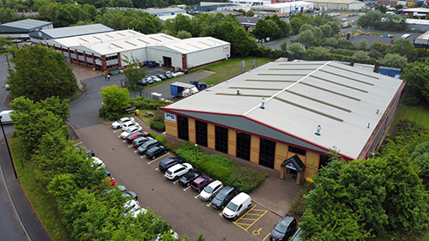



IPS Adhesives: SCIGRIP
Durham, NC
MMA technology
1:1 and 10:1 ratio
Industrial, BTR, Marine
Plastic, Composite, Metal bonding
Cartridge & Bulk
SCIGRIP, Integra and
MooGloo Adhesives
Newcastle upon Tyne, UK
SCIGRIP, Unika, Integra and
MooGloo Adhesives

Slide 6

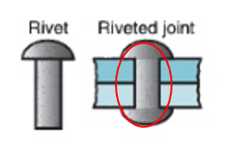
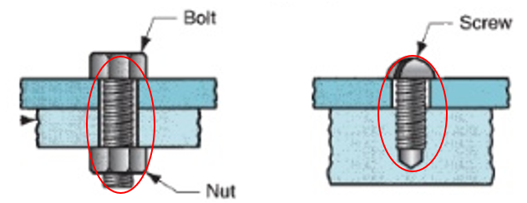
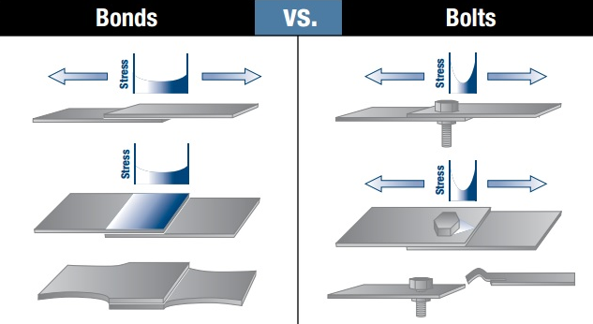
Advantages of MMA vs Rivets/Bolts
Uniform distribution of stress over the bond area
Eliminate damage to the structure
The bonded joint remains flexible to allow movements and reduce noise
Good fatigue resistance
Sealing and bonding in one step
Bolts, screws and rivets can become loose, fatigue and break.

Slide 7
Intro to Marine Manufacturing
What is the Marine Mfg Industry
  Ship and Boat building, repairing and metal fabrication for maritime structures
Marine Manufacturing Standards in Europe
  Recreational Craft Directive (RCD)
# of Marine Mfg companies in Europe
  3,600 Boatbuilders
  5,000 Shipbuilders
Top Marine Manufacturers in Europe
  Amel Yachts – Perigny, France
  Smartliner/Southwest Yachts – Plymouth, UK
  Jeanneau – Les Herbiers, France
  Ferretti Yachts – Ancona, Italy
  Beneteau – Saint-Gilles-Croix-de-Vie, France

Slide 8
Marine Mfg Adhesive Requirements
Must withstand fresh and salt water
Must bond large structures
Must be able to handle large loads
Must offer structural flexibility (impact/vibration resistance)
Must be strong to maintain integrity in harsh conditions
Must be lightweight
Must enhance aesthetics

Slide 9
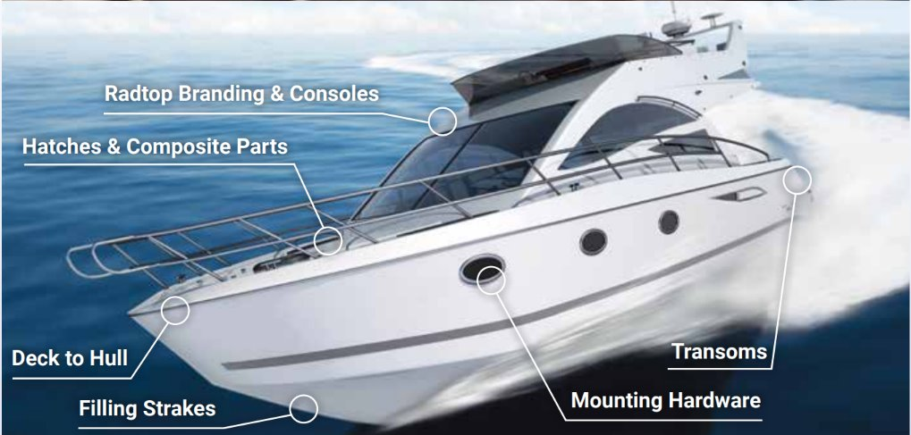
Marine Applications
Hull
Console assembly
Strakes
Mounting Hardware
Transome
Window frame
Flooring

Slide 10

Marine Application
Hull Manufacturing process:
Bonding the fibre-glass hull shell and the structural elements
Vertical sag resistance
Bead sizes up to 80mm
adhere to smooth, gel-coated and moist surfaces
  avoid/reduce preliminary abrasion of the composite
  Reduce dust in the factory
Impact and fatigue resistance
Quicker fixture time allows parts to be bonded and moved earlier
High bond strength even after extended exposure to marine envrmnt.

Slide 11
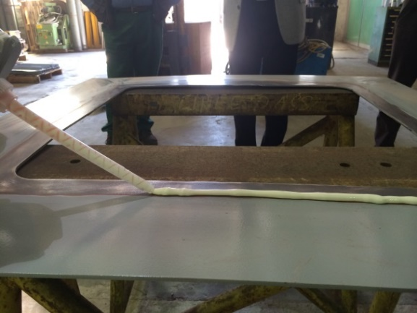
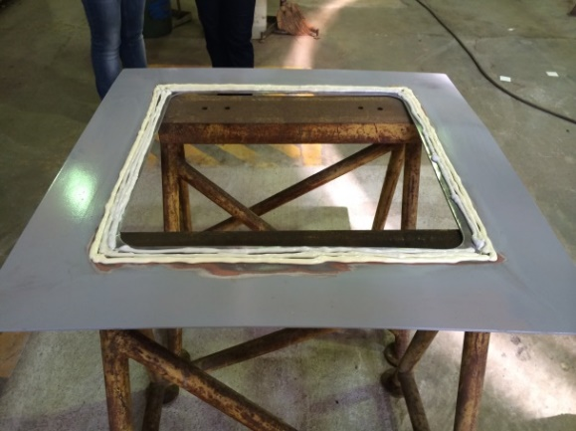
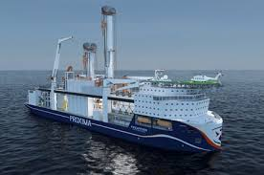
Marine Application
Marine Window Frame:
Bonding steel window frames for a marine industry application
Vertical sag resistance
Sealing surfaces against corrosives
Primerless adhesion to metal
Impact and fatigue resistance
Maintain strength even after exposure to marine environment.

Slide 12
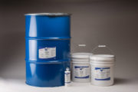
SG230HVA – Performance benefits
Excellent choice for bonding FRP composites with little to no surface prep
Unrivalled sag resistance
Outstanding fatigue and shock load resistance
Excellent environmental and chemical resistance
Bonds a broad range of substrates: PMMA, PVC, ABS, Thermosets (Vinyl ester, Polyester, Gelcoats, and Epoxies), primed metals
Large range of working times: 30, 40, 60, 80, 120

Slide 13
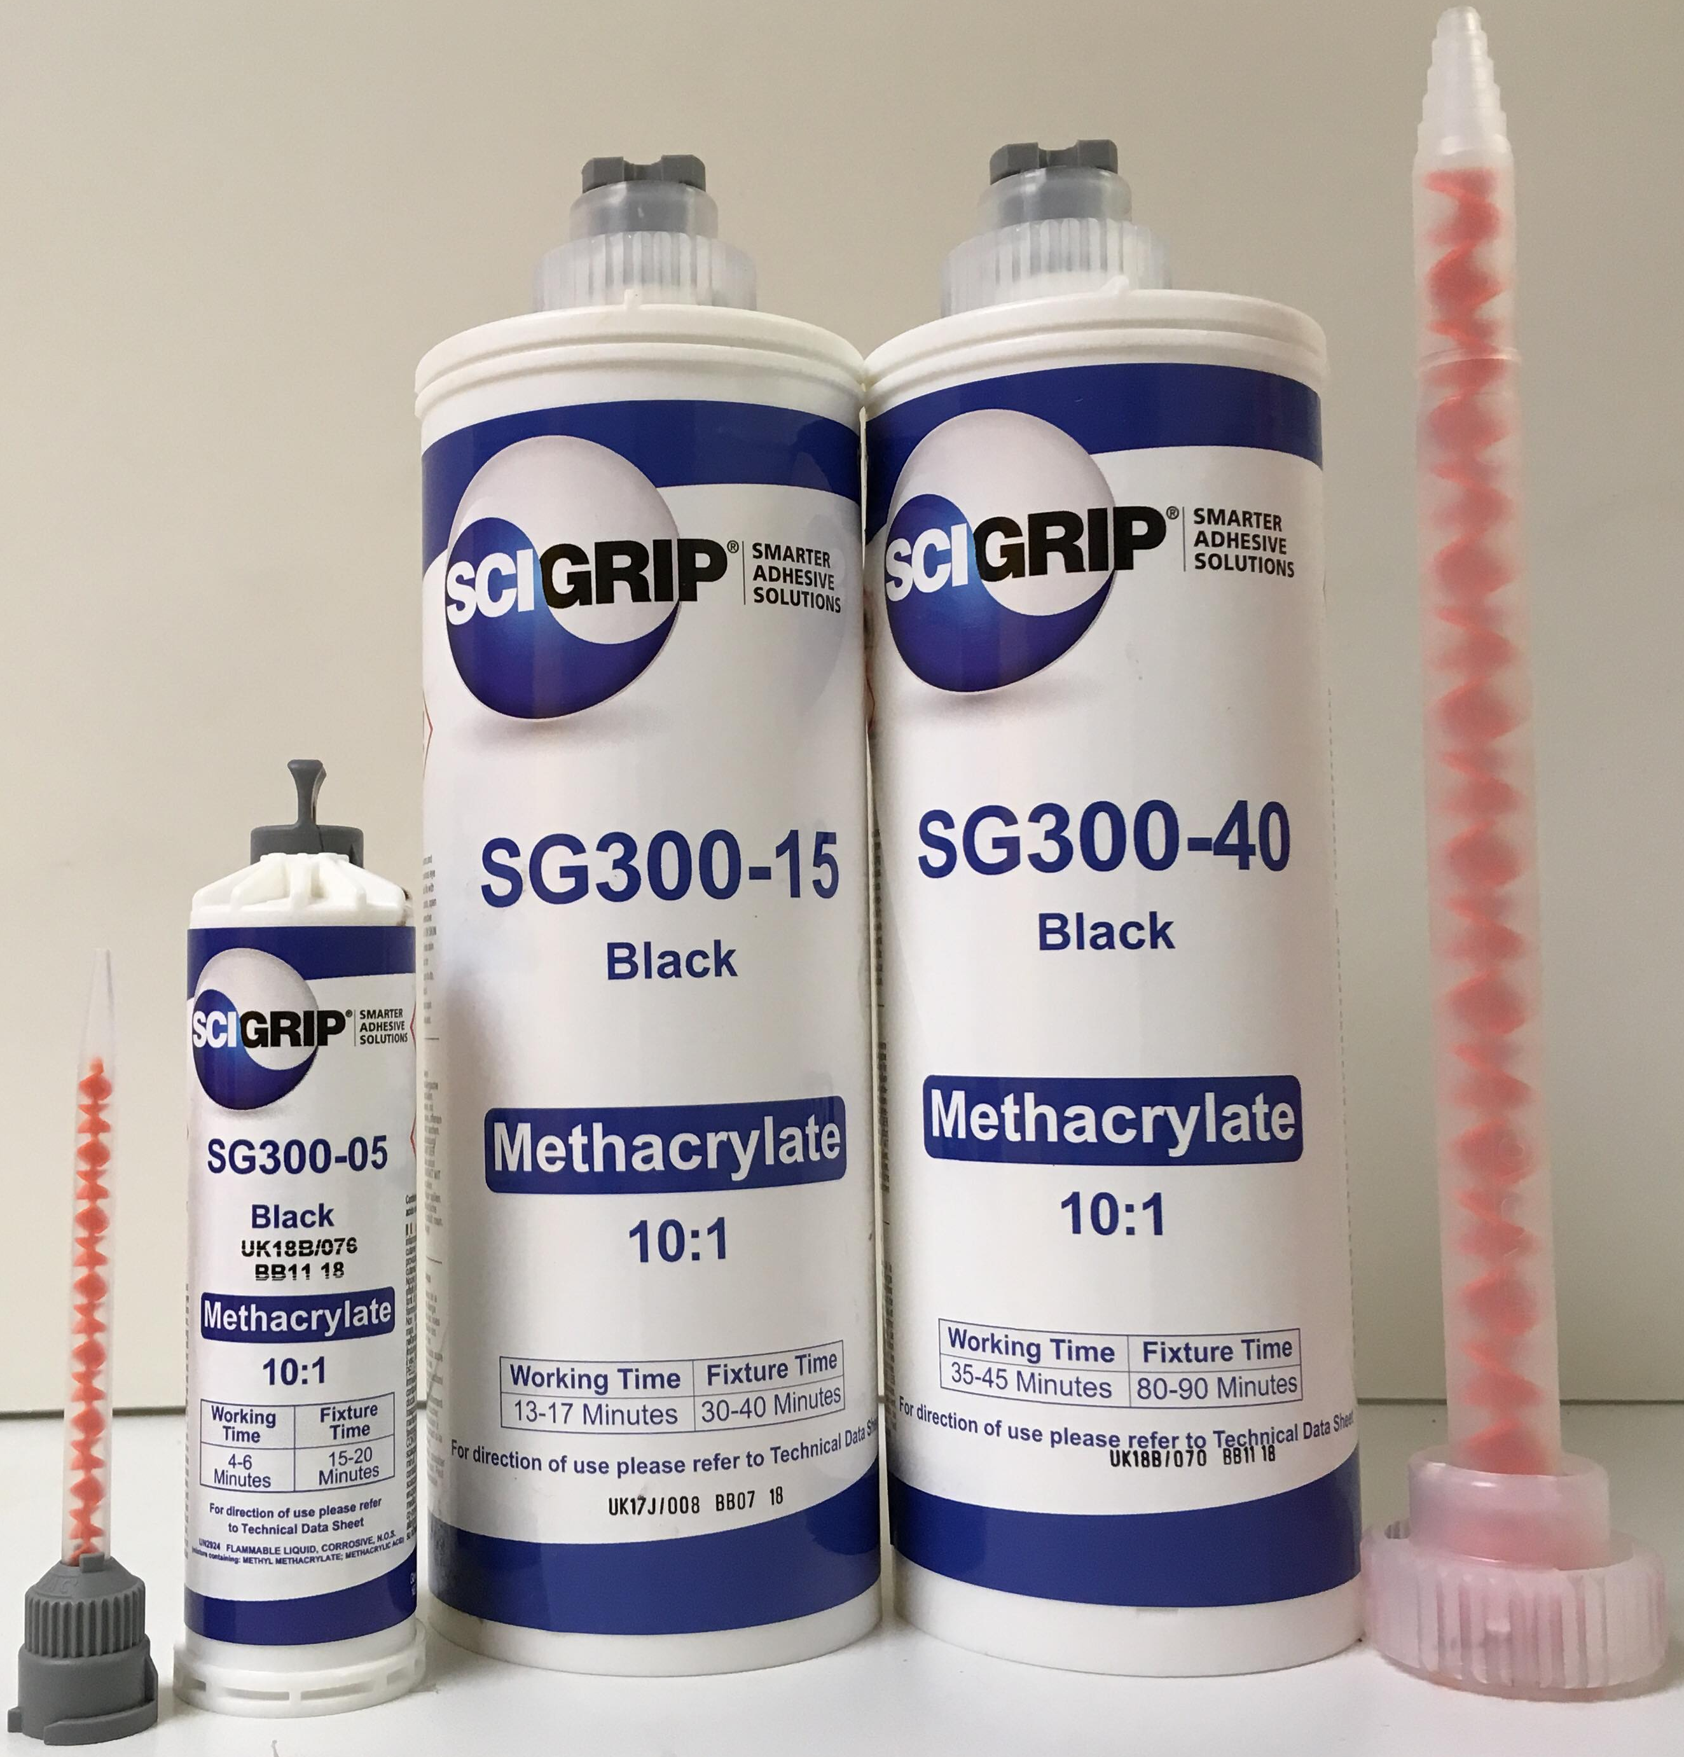
SG300 – Performance benefits
A variety of working times: 5, 15 & 40 minutes.
Used to bond metals, composites and plastics. Ideal for bonding dissimilar materials.
Primerless bonding to metals & requires minimal surface preparation.
Excellent fatigue, impact & environmental resistance properties including harsh environments.
Non-sag on non-level surfaces.
Reduced bond line read through and post finishing requirements.

Slide 14
Distributor Insight

Slide 15

Thank you for your attention

