Slide 1
Adhesive Applications: Mastering Part Joining
Taylor Santa – Technical Service Representative
June 3, 2025

Slide 2
About Taylor Santa
Taylor received her degree in Chemical Forensic Science at Western Carolina University and has worked in the methacrylate adhesive world for 8 years. In that time, she has worked in quality control, performance application testing, research and development, and finally technical service support.

Slide 3
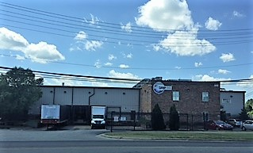
About IPS Adhesives
IPS Adhesives is a leading provider of adhesives, servicing the surfacing, structural, and assembly industries. With a combined 65 years of expertise and locations in both North America and Europe, its products are recognized by OEMs and fabricators globally for their premium quality, strength, and reliability.

Slide 4
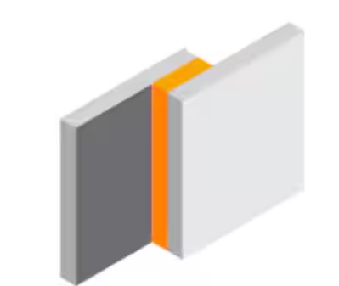
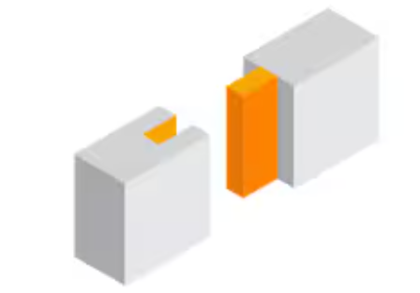
Types of Joints
Lap Shear
Most commonly seen
Butt
Tee
Tongue and Groove

Slide 5
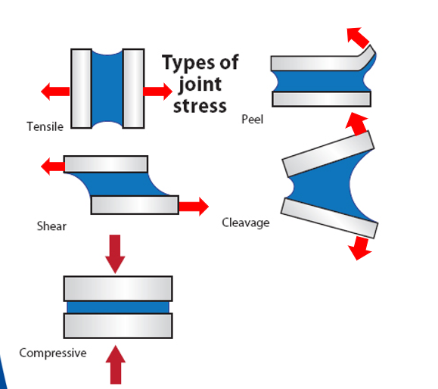
Types of Stress

Slide 6
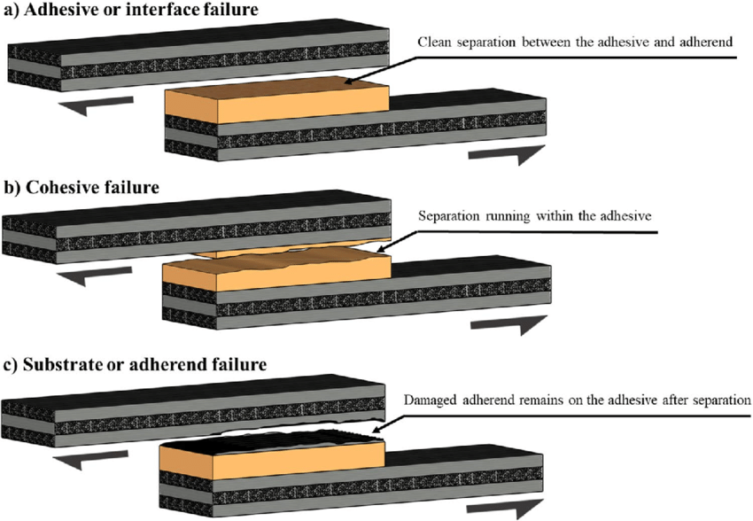
Failure Mode

Slide 7
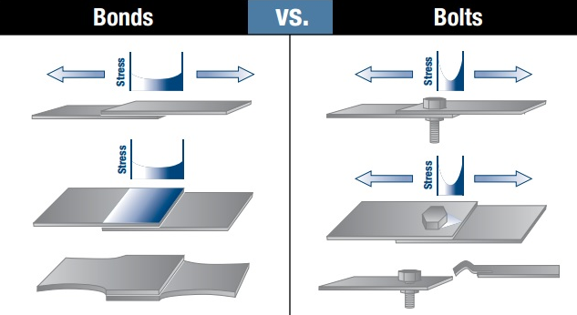
Challenges of Welding, Riveting, and Mechanical Fastening
Damaging substrates
Smaller spaces
Specialized personnel to weld
Not flexible or fatigue resistant
Heavy
Notes:
Talk about cost savings and less smell
Uniform distribution of stress over the bond area
The bonded joint remains flexible to allo wmovements and reduce noise
Eliminate damage to the structure
Good fatigue resistance
Sealing and bonding in one step
Bolts screws and rivets can become loose, fatigue and break

Slide 8
Adhesives in Part Joining
Benefits
Easy to use
Labor savings
Lightweight
Join Dissimilar Substrates
Quick set up, prep, and curing times
More aesthetically appealing
Minimal finishing work (no scrap, chips, uneven welds…)
Reduced risk of hand injuries
Limitations
Smell of MMAs
Can be messy
Need special dispensers
Notes:
Talk to all the limitations
-smell but use in well ventilated areas, not dangerous. Millions of people using

Slide 9
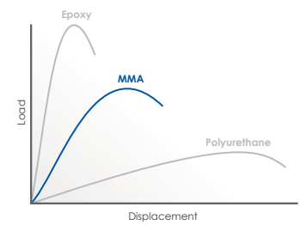
Types of Adhesive
 | Epoxy | MMA | PU (2K)
+ | Very high Strength (>30 MPa) Weathering resistance | Adhesion on Plastic, metal, and composite Min. surface prep. Easy to use Fast curing time Fatigue and impact resistant | Flexibility No odour Adhesion to plastic/wood Impact resistance
- | Surface Prep.required Can be brittle Longer curing time | Exothermic reaction (shrinkage) Odor | Low strength Surface prep. H&S (iso) Longer curing time
Notes:
Displacement=elongation(flexibitlity)
MMA is growing as part joining

Slide 10
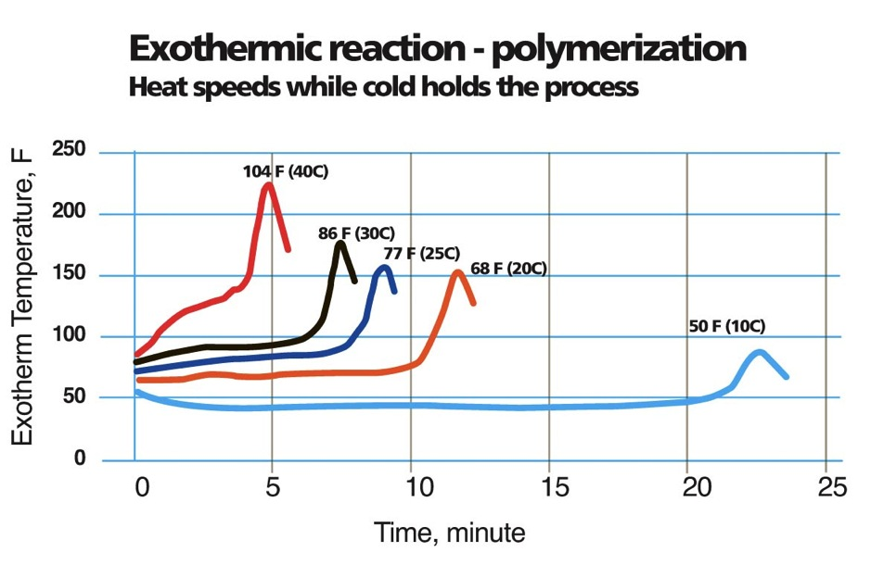
What Specifications Do You Have?
Time Restraints
Working time
Cure Time (mostly for subassemblies)
Application type
Bulk Machine
Cartridge
Strength and flexibility
Lap Shear
Elongation
Color
Sand and paint ability
Environmental Resistance
UV
Salt and Chemical Exposure
Service Temperatures
Curing speed and open time are influenced by Temperature !

Slide 11
How to Test Adhesives on YOUR Parts
Adhesive application:
Purging is an essential part of successful bonding
Apply enough material for a small amount of squeeze-out
Open time must be respected
Wait until the fixture time is reached to move the parts
Complete curing and full properties are achieved after few hours
Notes:
Collect parts to be tested
Ensure bonding area is clean, dry, and free of dust and oils
Prepare cartridge for use
Lay bead of adhesive in the bond area
Places pieces together
Apply pressure away from bond area
Place weights away from bond area

Slide 12
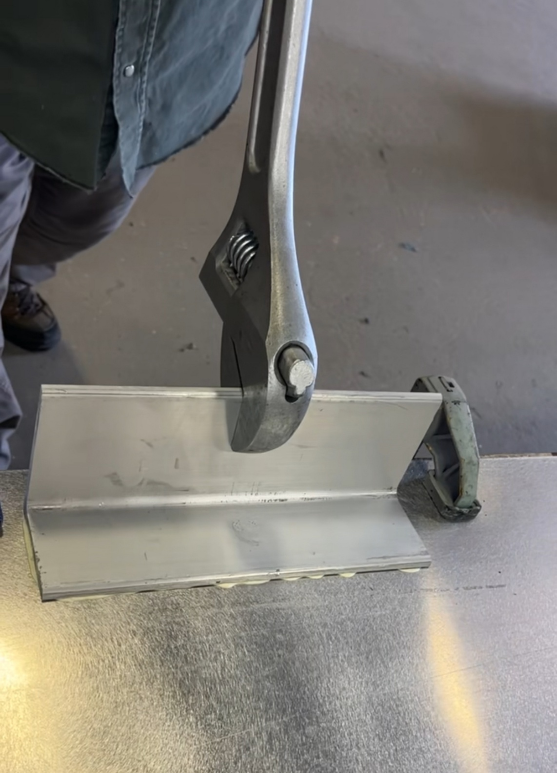
Testing Bonded Parts
Wait for adhesive is cured and fixture time has passed
Apply force in the same direction that the end use part will see
Identify failure mode
*If you would like to see numerical force data on your substrates, please reach out to our technical team. Scigrip Adhesives has a full applications lab and is more than happy to help get your parts tested.

Slide 13
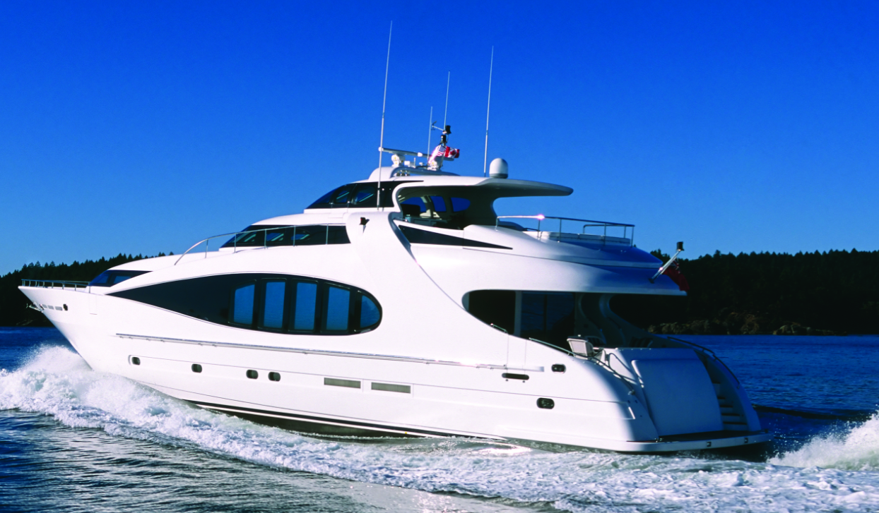
SCIGRIP® SG100 Series
High-Strength Adhesive with UV Resistance
Two component - 10:1 mix ratio methyl methacrylate adhesive
Bright White, UV resistant – Designed for Exterior Applications
Choice of 15 or 40 minute working times
No sagging, even when vertical
Excellent fatigue, impact and shock load resistance
Packaging Options
490 ml cartridges, 5 & 50-gallon bulk containers

Slide 14
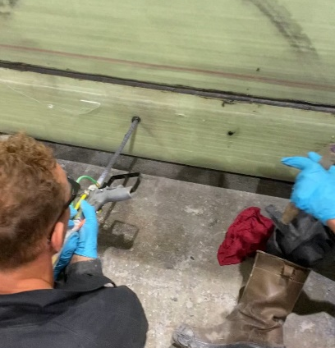
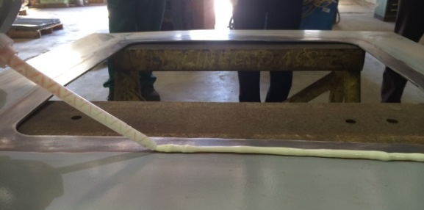
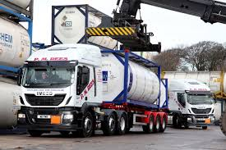
SCIGRIP® SG300 Series
Workhorse of Industrial Bonding - Primerless Metal Bonding for Manufacturing
Two component - 10:1 mix ratio methyl methacrylate adhesive
Multiple Working Times: 5, 15, 40
Two different colors – Black & Off-White
Cross-bonds a wide variety of substrates - Ideal for bonding dissimilar materials
Designed to meet specific requirements of the transportation industry, including reduced read through on show surfaces.
No sagging, even when vertical
Excellent fatigue, impact and shock load resistance
Packaging Options
50 & 490 ml cartridges, 5 & 50-gallon bulk containers

Slide 15
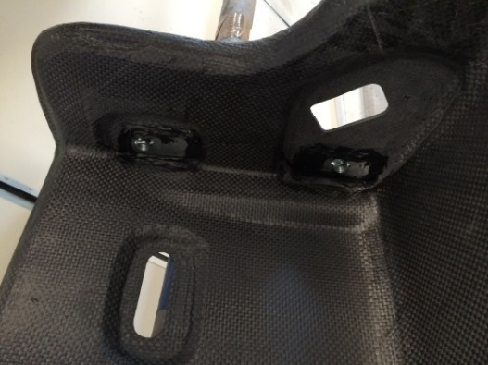
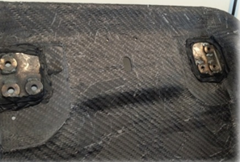
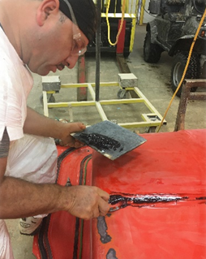
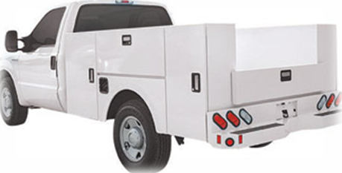
SCIGRIP® SG5000 Series
A Strong Metal Bonder That's Also Great at Repairing Fiberglass Molds
Two component, 1:1 ratio Methacrylate adhesive
6- & 13-minutes working times
Bond bonding metals, plastics and composites
Flowable viscosity, injectable
High tensile and shear strengths
Most metals, including steel and aluminum, can be bonded without surface pretreatment
Packaging Options
50 & 490 ml cartridges, 5-gal pails & 55-gal drums

Slide 16
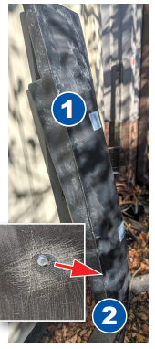
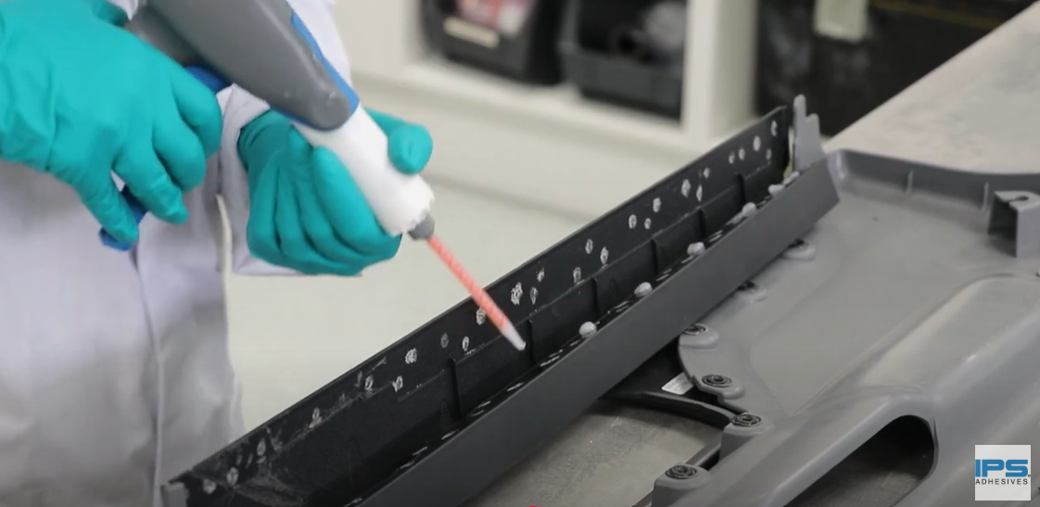
SCIGRIP® SG400LSE
High-Strength Adhesive Formulated to Bond LSE Substrates with No Surface Preparation Required
Two component - 10:1 mix ratio methyl methacrylate adhesive
Bond low surface energy plastics including polypropylene and polyethylene without surface treatment.
Simplifies processes and saves on labor costs by eliminating need for flaming, plasma treatment or other methods
Bonds dissimilar materials, including plastics, FRP, and metals
Excellent fatigue, impact and shock load resistance
Packaging Options
50 ml, 490 ml cartridges

Slide 17
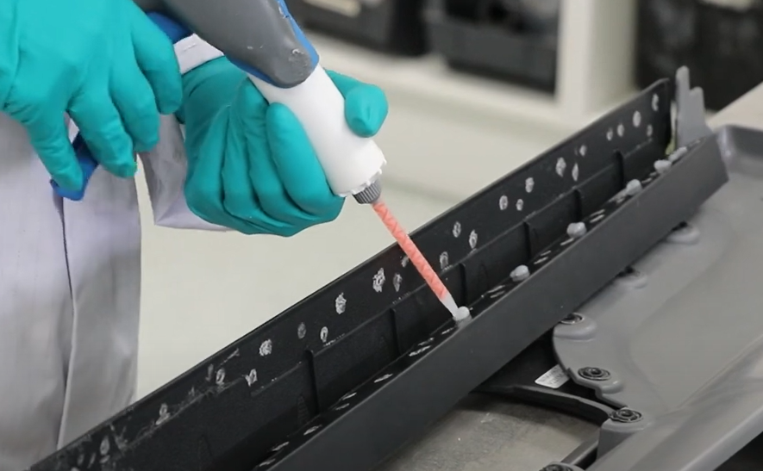
Summary
Welding and mechanical fastening has its challenges.
Heavy
Specialized personnel
Likelihood of loosening and breaking over time
Adhesives are an easy way to assemble large and small parts
Permanent bond
Lightweight
Easy to use
Notes:
MMA adhesives can help parting joining in all industries.

