Slide 1
Mastering Adhesive Specifications
Taylor Santa – Technical Service Representative
August 12, 2025

Slide 2

About Taylor Santa
Taylor received her degree in Chemical Forensic Science at Western Carolina University and has worked in the methacrylate adhesive world for 8 years. In that time, she has worked in quality control, performance application testing, research and development, and finally technical service support.

Slide 3
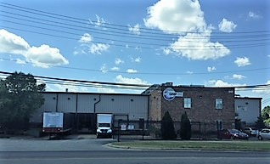
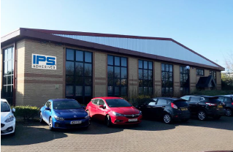
About IPS Adhesives
IPS Adhesives is a leading provider of adhesives, servicing the surfacing, structural, and assembly industries. With a combined 65 years of expertise and locations in both North America and Europe, its products are recognized by OEMs and fabricators globally for their premium quality, strength, and reliability.
Notes:
IPS Adhesive, a division of IPS Corp, is a manufatuer of Methyl Methacralte Adhesives, supplying several different markets such as homebuiling/remodeling with our seaming adhesives, the marine, transportation, rail, and others with our structural adhesives lines. The Scigrip brand has adhesive offerings that bond together metals, plastics, and composites, as well as cross bonding between all three. With 2 locations in Durham, NC and Newcastle, UK, both of which are 9001 ISO certified, we are able to provide adhesives across the globe in all types of markets

Slide 4
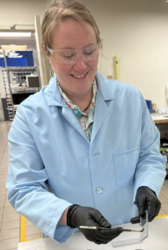




Safety When Handling Adhesives
MMA Adhesive Personal Protective Equipment (PPE)
  Safety Glasses
  Gloves
Environment
  Dispense adhesive in well ventilated area
  Do not dispense in small, tight areas
GHS02
Flammable
GHS03
Health Hazard
GHS04
Corrosive
GHS05
Serious Health Hazard
Notes:
Before we begin talking about different specifications you want to think about before choosing an adhesive, we want to briefly discuss the personal protective equipment and safety measures that must be taken when using any type of adhesive. All adhesives are chemicals and you should protect your eyes and skin from any potential contact with the material by wearing safety glasses and gloves. If contact is made with your skin, wash with soap and warm water. If contact with the eyes occurs, rinse thoroughly for 15 minutes and seek medical attention
With MMA adhesives, a bit of a chemical smell is to be expected, but is not dangerous. To lessen the smell, do not dispense adhesives in small, tight area like a very small closed room. Please dispense the adheisves in well ventilated areas.
Since these adhesives are all chemicals, there are a few hazards symbols associated with different adhesives. The four that you will see in some combination on our labels are these 4 you see here at the bottom; flammable, health hazard, corrosive, and serious health hazard. If you wear your ppe and dispense the material in a well ventilated area, away from open flames, you will be safe.

Slide 5
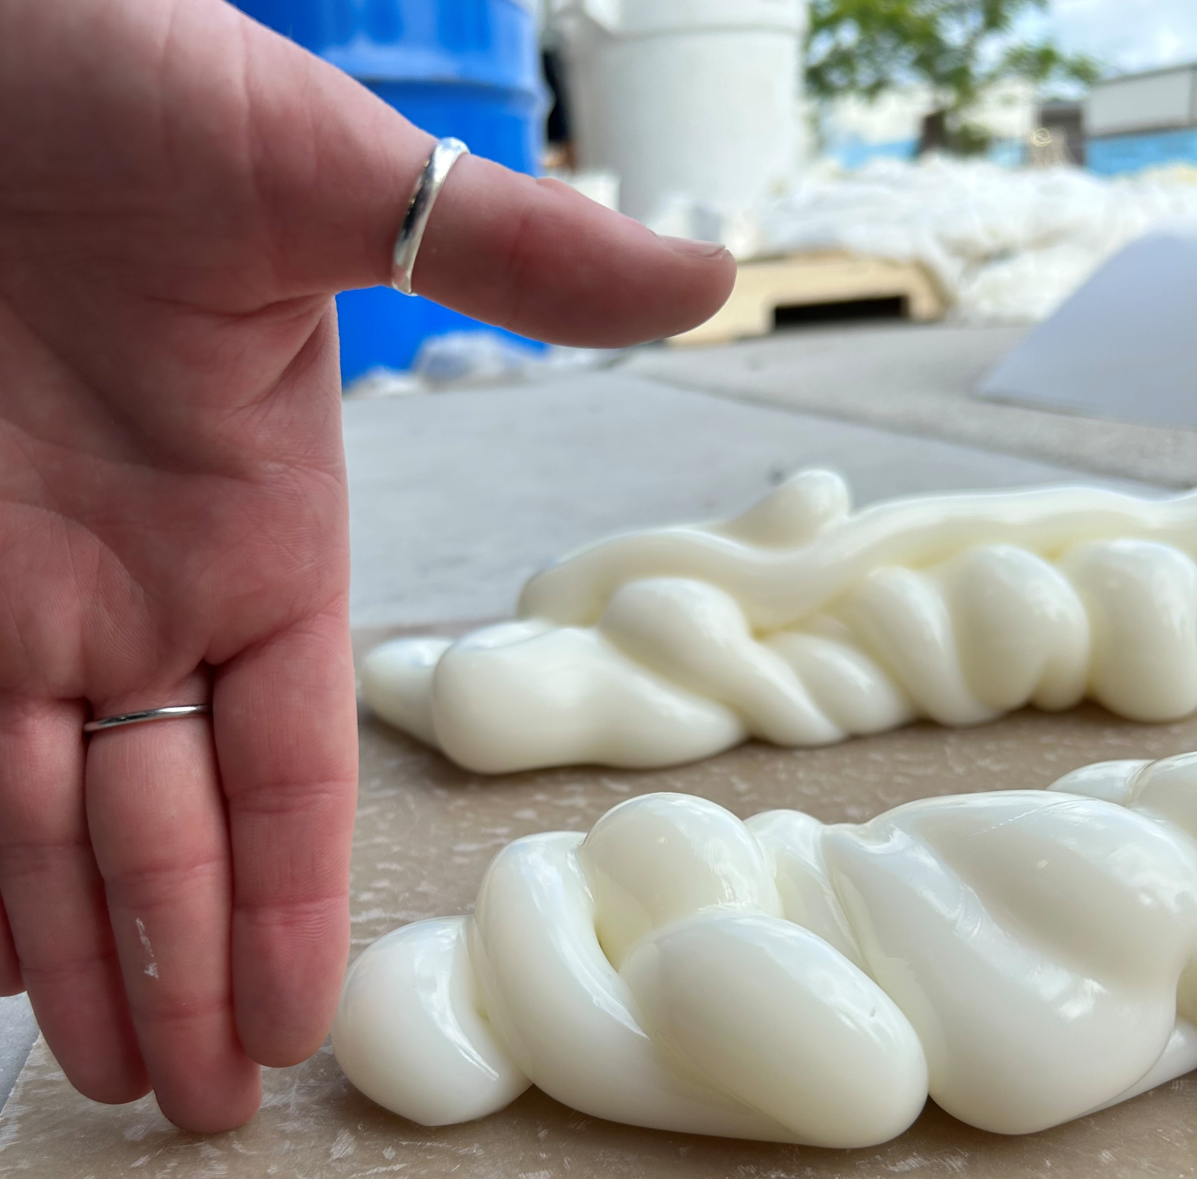
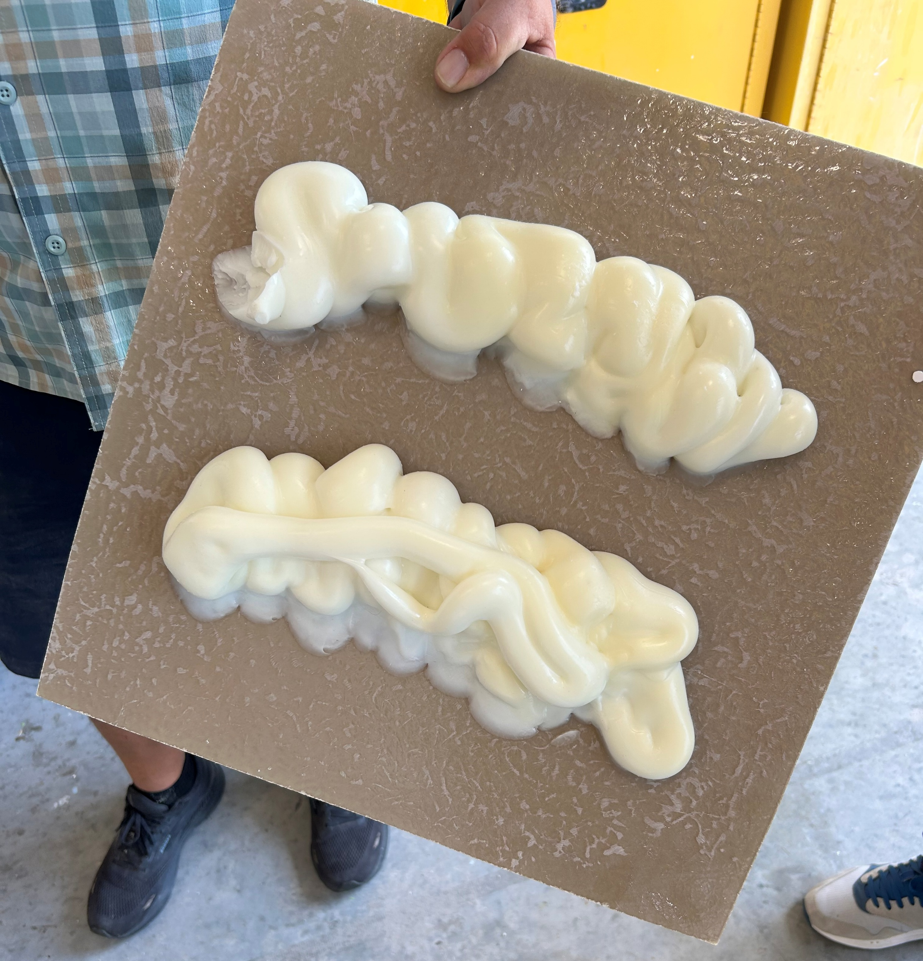
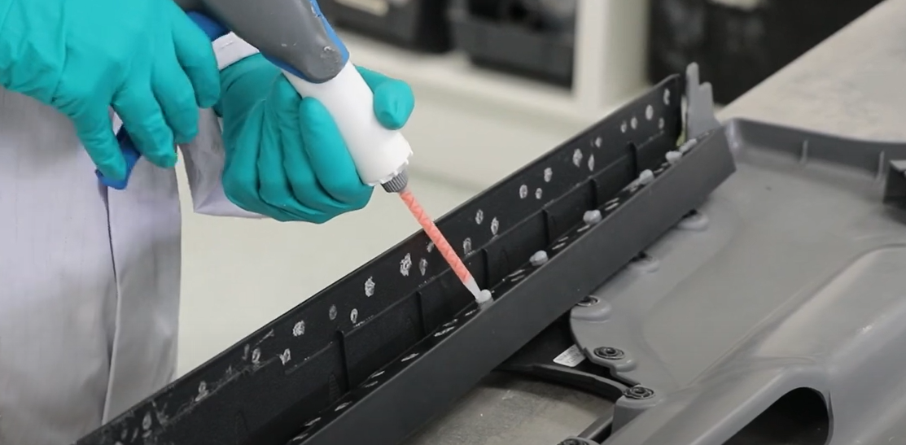
Pain Points in Part Joining
Long Processing Times
Difficult Process
Lightweighting
Joining dissimilar substrates
Labor Costs
High levels of rework and scrap
Final part looks
Notes:
There are many reasons manufactures will use methyl methacratlate adhesives in all different markets. Whether they are switching from welding, riveting and bolting, or from another type of adhesive, there are a few common pain points that is seen quite frequently.
Many users have seen very long processing times when using other types of adhesives. This not only slows down production, but also increases the amount of floor space needed to let the parts cure for 24 plus hours.
The process to get the parts together can also sometimes be difficult just purely based on the manner of part joining they are using. Riveting and bolting can be more difficult based on the areas needing bolting, or the amount prework needed before joining can even happen. With these rivetings and boltings, the parts will get fairly heavy as you add more and more fastening equipment to the part. With the need for lightweighting, not only are manufaturers looking to replace bolt and rivets, they are also looking to change the substrates. Many customers are moving from all metal pieces to metal and composite or solely composite. Cross bonding these metals and composites for lightweighting and sleek designed parts parts are the perfect place for adhesives to win.
With all of these pain points adhesives can help alleviate, how do you go about choosing an adhesive? What specifications do you need to consider before making a final decision.

Slide 6
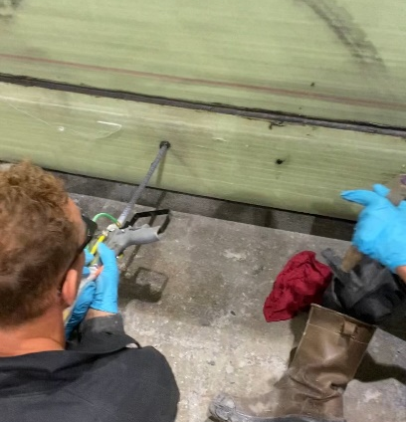
What Specifications Do You Have?
Time Restraints
  Working time
Application type
  Bulk Machine
  Cartridge
Strength and flexibility
Gap Size
Substrate Preparation
Color
Sand and paint ability
Environmental Resistance
  UV
  Salt and Chemical Exposure
  Service Temperatures
Notes:
Some common specifications you will need to understand and know about are time restraints, the type of application the customer wants to use, how much strength and flexibility the part will need to endure and the vibration amount the final part will see, the gap size needed to be filled, how much substrate preparation the customer is willing to do before bonding, the final color of the adhesive, any post cure work that needs to be performed such as sanding, painting, powdercoat, paint bake cycles. And what type of environment the final cured parts will be exposed to such a salt water environment, high UV exposure, any chemicals that the bond parts will be exposed to. In the next few slides, we will talk about some definitions in the adhesive specifications world and why these specifications matter to the end user.

Slide 7
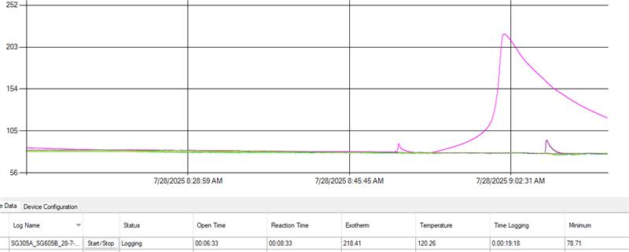
Application Specifications
Open Time/Working time/Gel time -> Amount of time the adhesive is still able to be worked with before it begins to cure
  Time to reach 105F for most products
Fixture time ->Time it takes for reaction to be finished
  Parts can be moved after this point
  Adhesive is at 70% strength
Notes:
The first few specifications we are going to talk about today are in relation to the time limits needed for working with adhesives.
The first thing to consider when choosing an adhesive is how much time does it take to get the adhesive laid, parts together, and clean up complete. This time has a few different names used throughout the adhesive world. Open time/working time, gel time, all meaning the same thing, is the amount of time the adhesive is still able to be worked with before curing begins. If a product has a 5 minute working time, the opereater will have 5 minutes to get the adhesive laid, parts in the correct spots and most of the clean up done before the material will start to harden and cure. For most of the Scigrip product line, we consider this point to be 105 degrees Fahrenheit. As you can see in the graph here at the bottom, the pink line, representing temperature over time, slowly increases until around 105degrees. At this point the temperature quickly raises. It is at this point where the temperature increases significantly, where the main part of the reaction is happening. The adhesive material is then becoming less workable and hardening.
After this 105 temperature is reached, we then have a certain amount of time before we reach the next point, fixture time. This fixture time is defined as the time it takes for the main exothermic reaction to be complete. In the graph, you can see where the temperature reaches its highest point, called the exotherm (we will talk about this more in the next slide). At this point, the parts are bonded together and can be moved. The adhesive, at the fixture time, will be around 70% strength. While it takes 24 hours for the adhesive to reach its full strength, the parts can be moved along the manufacturing process, eliminating the need for down time in the parts process.

Slide 8
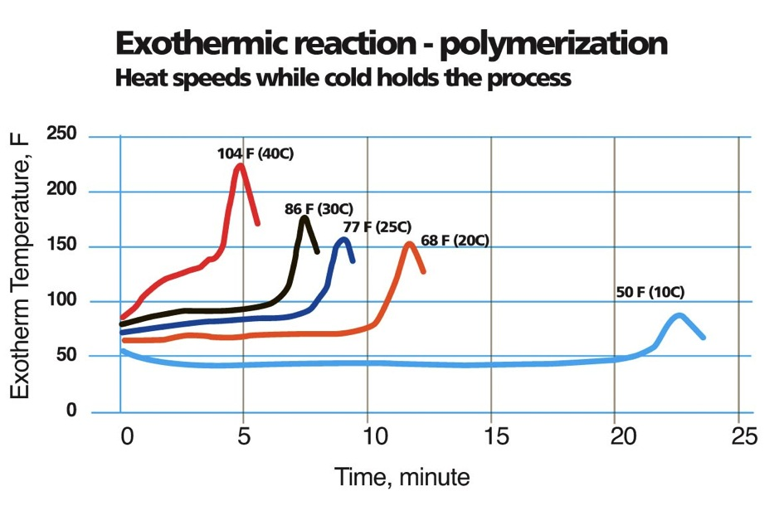
Application Specifications
Exotherm -> Peak heat that the reaction releases
Temperatures are very important for all aspects of adhesive use
  Storage Temperatures
  Application Temperatures
Curing speed and open time are influenced by Temperature !
Notes:
As we talked about in the last slide, exotherm is defined as the peak heat that the reaction releases. For must of the Scigrip product line, the exotherm does not reach over 270 degrees F if used in the correct gap or bead size. The temperature becomes very important when bonding together thin pieces of metal and composites or when you have a large mass of adhesive needed for gap filling. You need to consider the manufactures recommended gap or bead size when researching adhesive. Some adhesives are designed to have lower exotherms when in large mass. For example, the SG230HV Series from Scigrip was created to not boil when applied in large beads, up to 2 inches. If you need to fill a gap this size, and tried an adhesive not designed for gap fill, you will see boiling in the large mass of adhesive. This is because the temperatures in the large mass are much higher than seen when using a small mass. This boiling will cause weak points and failures in the bond line.
A lower exotherm also helps with bond line read through. When an adhesive has a higher temperature exotherm, and substrates are thin, you will see some warping of the substrates and will actually be able to see the adhesive line through the substrates. If this happens, the manufacturer will have more post finishing work, leading to longer manufacturing times.
External, or environmental temperatures are also important to think about. Environmental temperatures will have an effect on the working times and also the shelf life of the product. If adhesive cartridges or bulk material is left in very low temperatures for a long time, the activation chemical found in the activator side of the material will come out of solution. This can be seen as crystal in the product. Once this material gets out of solution, it will not go back in and the adhesive material will not cure properly, essentially ruining the material. On the other side, adhesives exposed to very high temperatures for an extended period of time will lessen the shelf life of the product. Some types of adhesives need to be in freezers or heat boxes for best results, but the Scigrip MMA adhesives just need to be store the between 55- 85F before use.
The last temperature consideration customers need to keep in mind while choosing an adhesive is the temperature of the environment while application is happening. Take Southern Florida in the summer. Temperatures can reach 95+. With this higher external temperature, MMA adhesives will react much faster. As you can see in this chart here, as the temperature rises, the reaction happens faster. The opposite happens in the colder temperatures. The reaction time will slow down as the temperature drops. Many MMA materials come in different working times in order to combat this. For example, boat builders in southern Florida will switch to the longer working time in the summer to get the same amount time as they have in the cooler winter months.

Slide 9
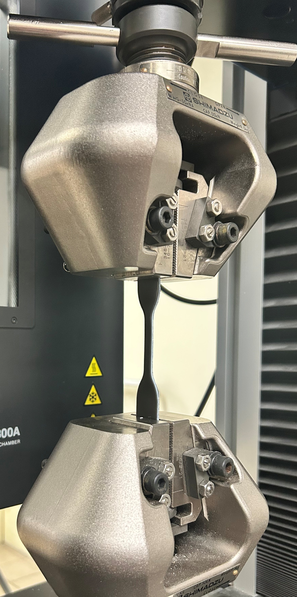
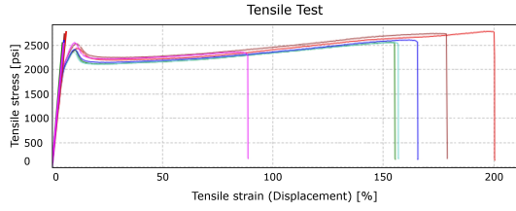
Application Specifications
Tensile Strength – Maximum amount of stretching or pulling force a material can handle before it breaks
Elongation/Tensile Strain – The amount of extension of an object under stress, usually expressed as a percentage of the original length
Notes:
There are a few different types of strength that most customers explore when switching from one adhesive to another or from mechanical fastening to adhesive bonding. Tensile strength is the maximum amount of stretching or pulling force a material can handle before it breaks. This strength is tested just the adhesive material itself using an ASTM method and pieces of cured adhesive called ‘dogbones’ You can see one of these pieces mid test in the top photo here. Tensile Strain, or elongation is often measured and reported at the same time as tensile strength. This elongation is the amount of extension of an object under stress, usually expressed as a percentage of the original length. This the graph here below, you can see the tensile strain or elongation is being seen as almost 100% of the original length at minimum and 200% of the original length at maximum. The elongation number helps show how well the matter can withstand vibrations in the parts. This product in the graph here will have excellent vibration resistance, while something that only has 10% elongation before breaking will not fair well under a high vibration environment.

Slide 10
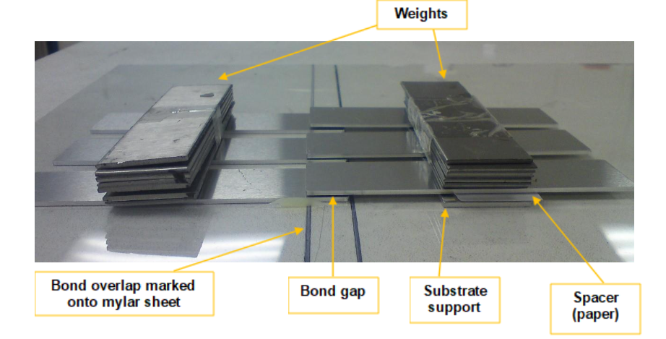
Application Specifications
Lap Shear Strength – Measure of adhesive’s ability to resist shear forces in a bonded assembly
Fatigue Strength – Maximum stress a material can withstand for a specified number of cycles without failing
Notes:
Another type of strength that will be looked at is lapshear strength. Before we can talk about this type of strength, we must first understand lap shear bonding. This is a configuration of bonding where parts are bonded in an overlap, like seen in the picture here. This configuration expects to see force applied by pulling each piece away from the other. The strength of the material seen here is called lapshear strength. Lap shear strength is a measure of how much shear force can be exerted on a lap joint before failure occurs. Lap shear strength is often tested during joining process qualification or material validation to avoid a future failure. Lap shear strength is measured in a unit force over an area., commonly measured in psi (pounds per square inch).
The last type of strength we will talk about today is fatigue strength. Fatigue strength is defined as the maximum stress a material can withstand for a specified number of cycles without failing. It is a critical mechanical property that quantifies a material's ability to endure cyclic or repeated loading without experiencing fatigue failure, basically vibration stress. This property is essential in engineering and material science, as it helps predict how materials will behave under repetitive stress conditions. Basically, what happens when we tests this property is we load samples bonded like seen in the picture here, into a testing unit. This unit then puts stress onto the sample then releases the stress, in a push pull type of movement. This happens at a very quick speed. A sample reaches a passing number when it has gone through this cycle of pull and release 1 million times without failures such as breaking. This is representative of parts lifetime of vibrations.

Slide 11
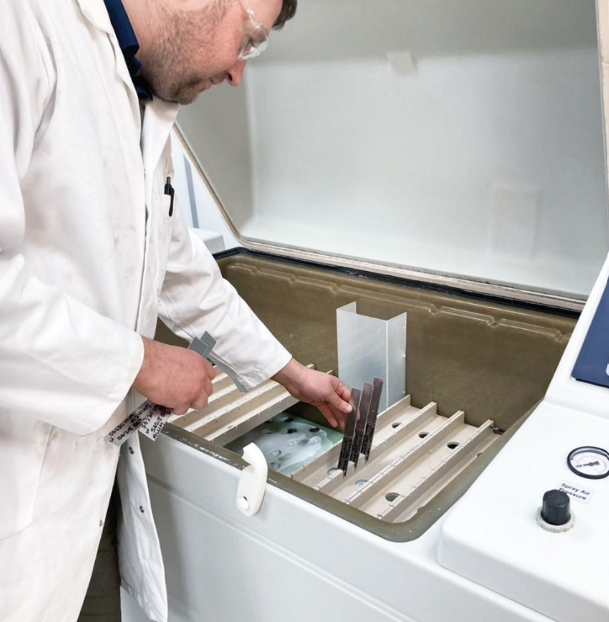
Application Specifications
Gap size
  Large bead
  Sag resistance
  Low exotherm
Environmental Concerns
  Final part temperature exposure
  Chemical exposure
  Salt exposure
  UV exposure
Notes:
The last few specifications we will talk about here today are gap size and environmental concerns.
There are a few aspects of MMAs that is needed to be kept in mind when choosing an adhesive for gap filling. First thing to keep in mind is that methyl methacrylate adhesives are two-part adhesives that cure using an exothermic reaction which we have talked about earlier. This means that heat is released during the curing process. This heat can be mitigated during the development of the adhesive. When choosing an adhesive for large gap filling applications, make sure to check the technical documents to ensure that the adhesive was designed for large bead and gap filling. The second thing to consider is that these gaps tend to see high rates of vibrations. Ensuring that you choose an adhesive that is vibration, or fatigue, resistant will ensure a stable and lasting bond throughout the lifetime of the product, like we discussed in the fatigue strength section. The last thing to keep in mind is the places these gaps are in the design of the final products. There tends to be a lot of gap filing needed on vertical surfaces. The gap filling adhesives, therefore, need to be able to hang on the vertical wall or surface in large beads without running down, or sagging, before the parts are together and the material is cured.
Finally, you need to know what types of conditions the final bonded parts are going to experience before choosing an adhesive. Many different MMA adhesives are designed to withstand certain environmental conditions. For example, the Scigrip SG800 series was designed to hold its strength when going through high heat processes such as powder coat cycles and paint post bake cycles. The SG100 series includes certain ingredients to ensure the bright white color doesn’t fade when exposed to UV over the lifetime of the parts, making it ideal for exposure exterior bonding of bright white gelcoat. The SG230 series is used all over in marine manufacturing, both fresh and salt water. This adhesive has been tested and will withstand a lifetime of salt water exposure.
Be sure to know what exposures your parts will have in order to get the best bond possible.

Slide 12
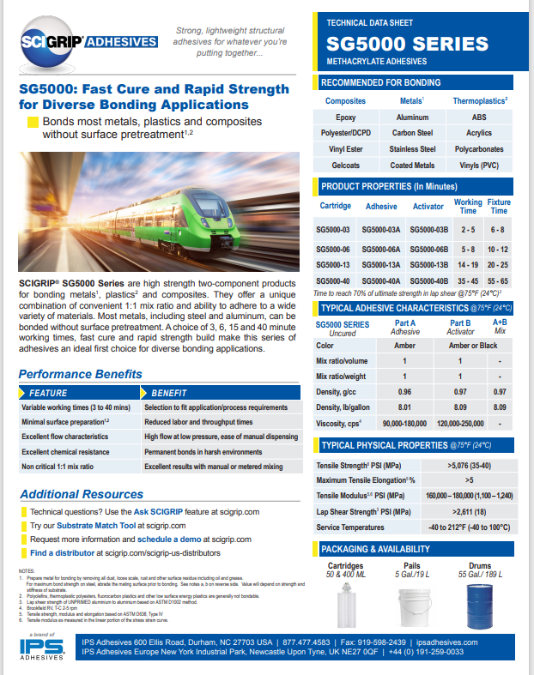
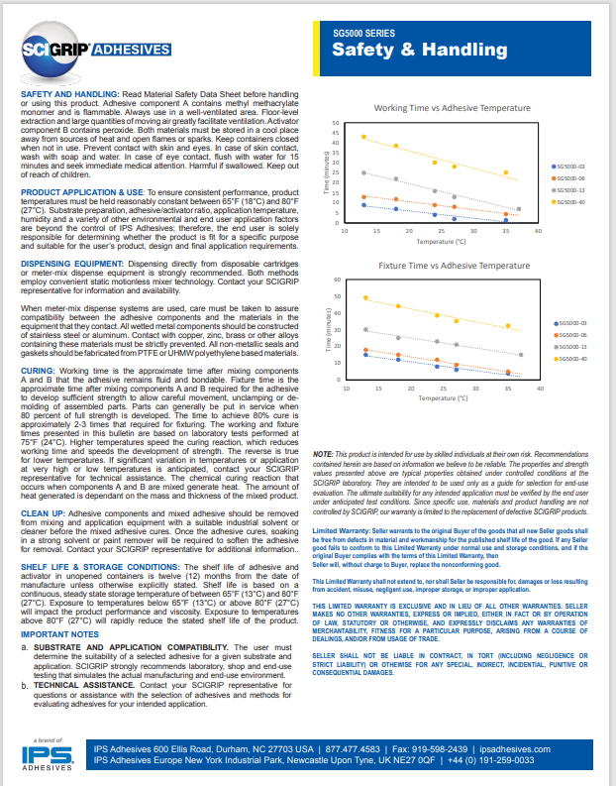
How to Read a Technical Data Sheet
Notes:
Now that we know about some common adhesive specifications, we should look at where exactly we can find all of this information. Almost everyone has seen a technical data sheet, or TDS before. These documents can be very helpful when trying to find some basic information about a product. Lets look at an example of an MMA adhesive TDS for the Scigrip Product series, SG5000. Scigrip configures their TDSs to have as much information as possible, but most people really only look at the first page. Both pages of this TDS have lots of great information that sometimes gets looked over. Let’s take a closer look on the types of information that can be found in this one document.

Slide 13
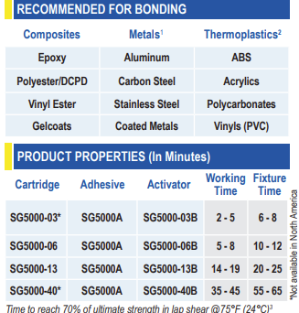
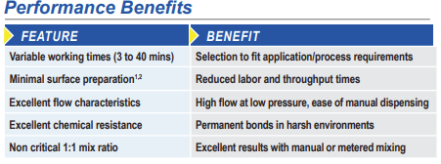

How to Read a Technical Data Sheet
Notes:
On the first page, we get a lot of information about the properties of the product. For example, here we can see a quick description of the features and benefits of this adhesive, from the variable working times to the type of preparation needed for the surface of the substrates. We then dive deeper into the types of substrates we recommend using this adhesive for with notes about how to prep certain substrates. After discussing substrates, we jump into the working and fixture times for the different adhesive and activator combinations. This section also informs customers about the names of cartridges as well as the adhesive/activator combinations, in case someone was looking to switch from cartridges to bulk or vice versa.

Slide 14
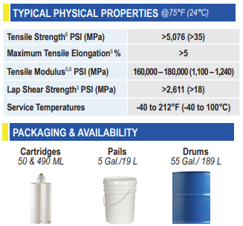
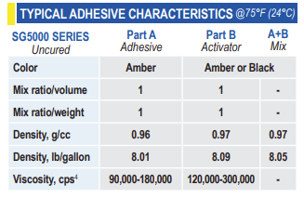
How to Read a Technical Data Sheet
Notes:
Continuing on the first page, we jump into more technical information, from mix ratios, density, and viscosity, to tensile strength, elongation, lapshear and service temperatures. These service temperatures related to the temperature range the cured adhesive will remain the same strength at. This product, for example, will not be a good choice for high temperature processes after curing. We can also see here the different size offerings for this product. This product comes in cartridges, size 50mL and 490mL as well as bulk offerings of 5 gallon pails and 55 gallon drums.

Slide 15
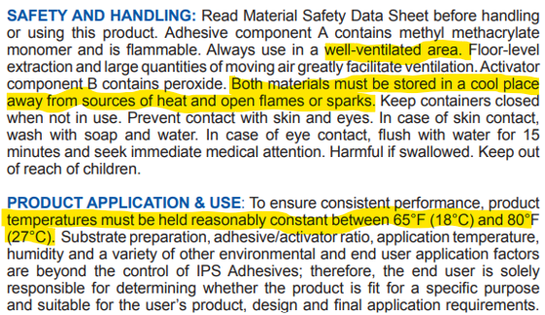
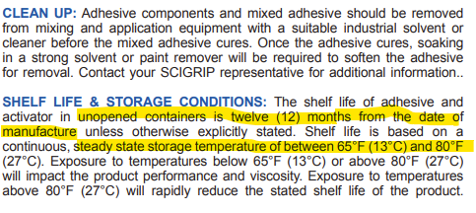
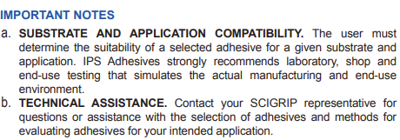
How to Read a Technical Data Sheet
Notes:
Most of the information on the first page is seen and recognized by everyone who reads these data sheets. The second page, on the other hand is where people skip over, but there is a ton of information that can be gathered from this second page. This page describes the types of safety procautions that need to be followed, such a using the material in a well-ventilated area. As well as how to store the materials when not in use. Here you can see it is stating that this material much be stored in a cool place away from sources of heat and open flames as well as holding the temperature consistent between 65F and 80F.
We also get information about shelf life, here the product has a shelf life of 12months from the date of manufacture if stored correctly in un opened containers.

Slide 16
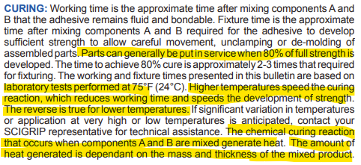
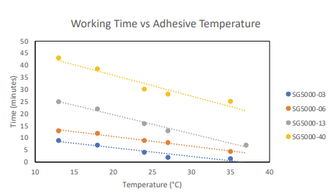
How to Read a Technical Data Sheet
Notes:
Some other data can be found on the second page as well. Descriptions and graphs of working times in relation to external temperatures are listed here. Using the graphs included, we can see that if the SG5000-06 material was being used at roughly 35C, we can expect a working time of 5 minutes and if the temperature was at roughly 13C we will have about 12.5-13 minutes to get the material laid down and the parts joined together.
Much of what we talked about today regarding adhesive specification considerations can be found on the Scigrip Adhesive technical data sheets for each product. If you do have any other questions that you can not find, always reach out to your technical service representative. They are more than willing to help you choose an adhesive that will work the best for your application.

Slide 17

Truck Application Call Out
Notes:
Finally, I just want to go through some application call outs for different industries and where we can see these specifications in real parts. First we will look at large truck applications. Here at the bottom we can see headlight surrounds. There is a good chance that this area will see higher than average temperatures. To ensure we do not lose any strength as the temperatures go up, using a high heat product, like SG800 series can help the longevity of the bond. Looking at the cabin and dashboard bonding, we tend to see materials used that are either hard to bond or low surface energy plastics. To bond these materials, we will need an adhesive designed for this difficult bonding, like SG400LSE

Slide 18
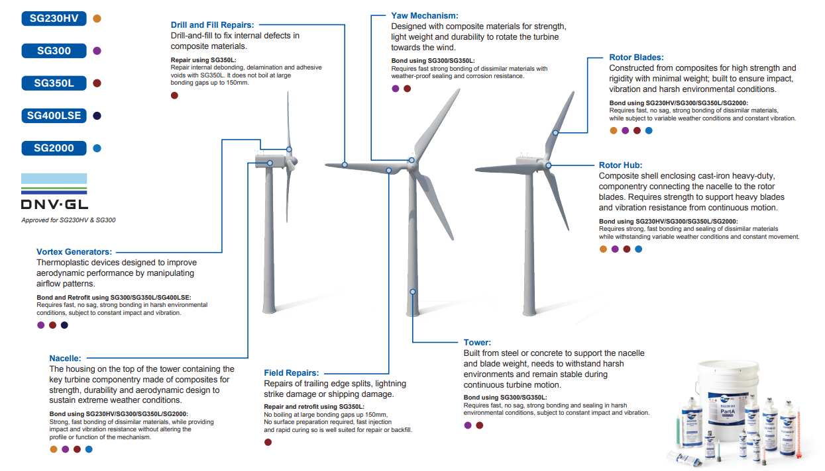
Wind Application Call Out
Notes:
Next we will look at some wind turbine bonding. Again starting at the bottom with field repairs. These repair adhesives are often needed to fill large gaps in the substrates after damage from lightening strikes or shipping damage. Using a product like SG350L can ensure there is no boiling at gaps up to 6 inches and a quick working and fixture time to repair these blades quickly.
Bonding around the roto hubs requires and adhesive that can bond both composites and cast iron. These parts also see a ton of vibration, requiring an adhesive with high fatigue or vibration resistance.

Slide 19
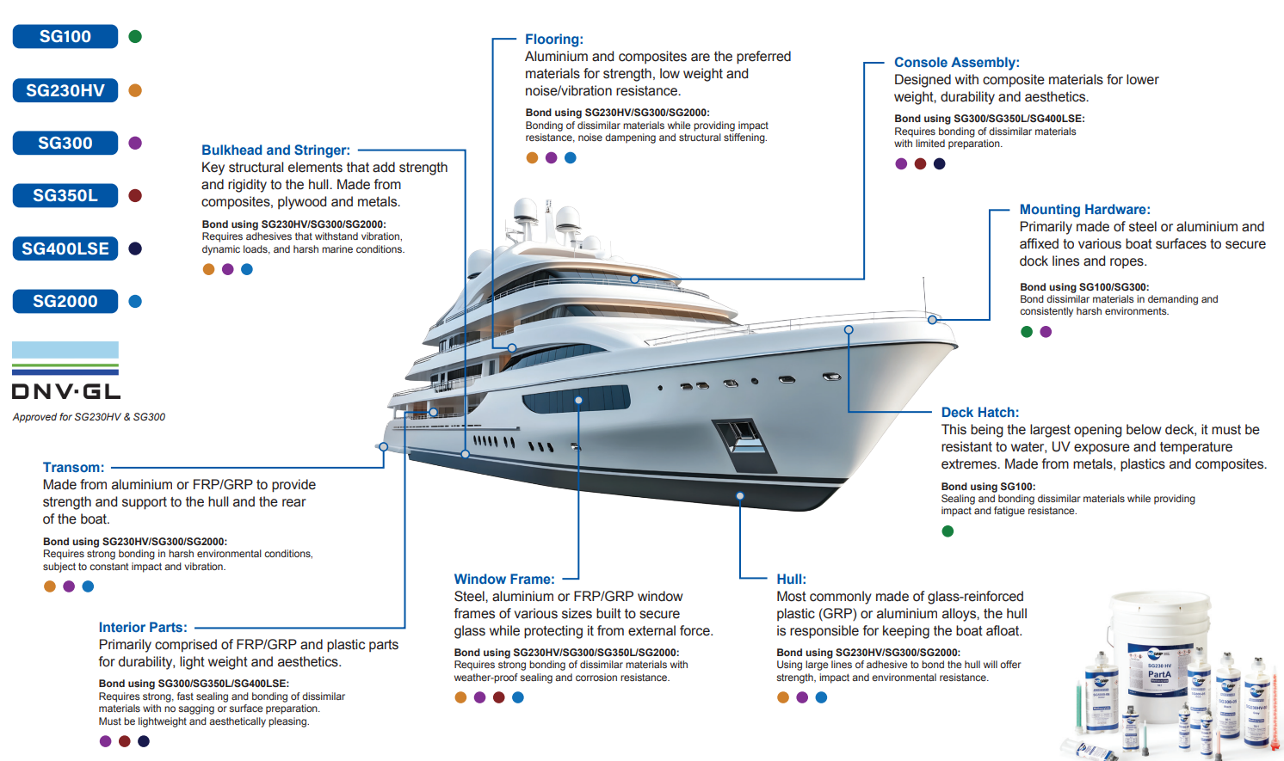
Marine Application Call Out
Notes:
Finally, we will look at some marine applications. When mounting hardware to the deck of the boat, there is a good chance that the adhesive will be exposed to UV rays. UV will yellow certain adhesives so selecting the proper adhesive will include looking into UV resistance as well as bright white colorant to match the gel coat white color found in most deck manufacturing.
When looking at bonding deck hatches, there is a very high likelihood that this bond will get sprayed with salt water throughout the lifetime of the part. Being able to withstand this spay is very important to the longevity of the bond.
The last part we will look at today is bonding stringers to hull and hulls to decks. The parts of the boat take that the most beating. There is a lot of vibrations that go through these parts so high fatigue results and vibration resistant characteristics are key. The parts of the boats are often where a majority of the large gaps are found. Having an adhesive that can withstand high vibrations and can fill large gaps without boiling is crucial. Adhesives like SG230HV and SG2000 are designed for this application.
I did not go over every type of bonding in these callouts but if you want to take a closer look at any of the application call outs, you can find these callouts and more on our website, scigripadhesives.com

Slide 20


