Slide 1

Manufacturing with MMA: Proven Applications
Mélissa Thorelle & Andy Pace
Webinar 09 September 2025

Slide 2
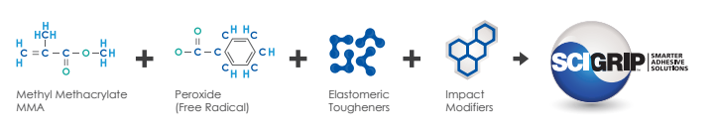
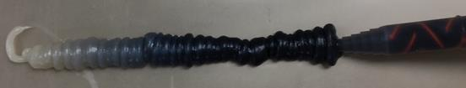
Introduction to MMA Adhesives
What is an adhesive ?
SUBSTRATE
Adhesion to the substrate
“An adhesive is a non-metallic substance which is able to join two substrates together via bonding to the surface (adhesion) and via its internal strength (cohesion)” DIN EN 923
ADHESIVE
Cohesion within the adhesive
MMA Adhesives
SUBSTRATE
Two-parts acrylic adhesives that consist of :
Adhesive Resin composed of methacrylate monomers, amines + rubbers and toughening agents
Peroxide-based Activator

Slide 3
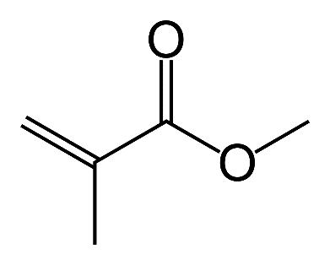
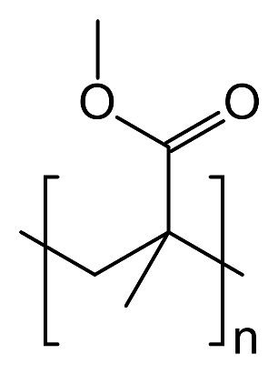
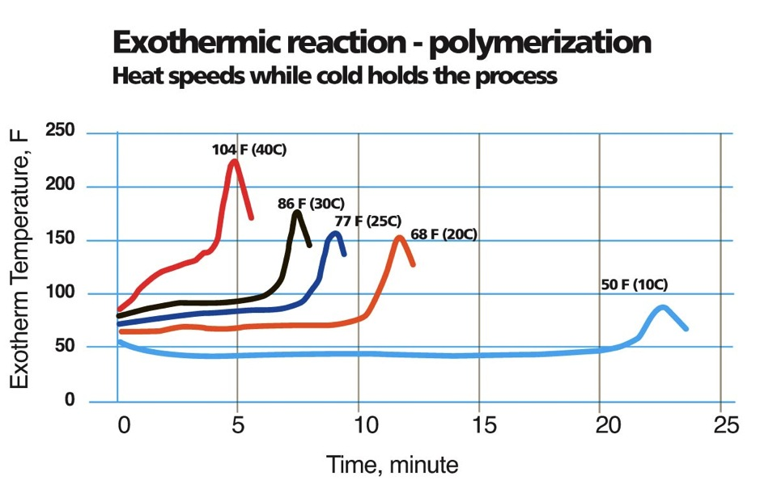
Introduction to MMA Adhesives
Polymerization Reaction
Methyl Methacrylate (MMA) adhesives cure through an exothermic polymerization reaction. This reaction involves monomers chemically bonding to form strong polymer chains, generating heat in the process.
Key Characteristics
✔️ Mix Ratios: Commonly available in 1:1 and 10:1
✔️ Fast Handling Strength: Achieved within minutes
✔️ High Bond Strength: Lap shear strength >20 MPa
✔️ Excellent Gap Filling: Up to 150 mm
✔️ Wide Service Temperature: Approx. -50°C to +100°C

Slide 4

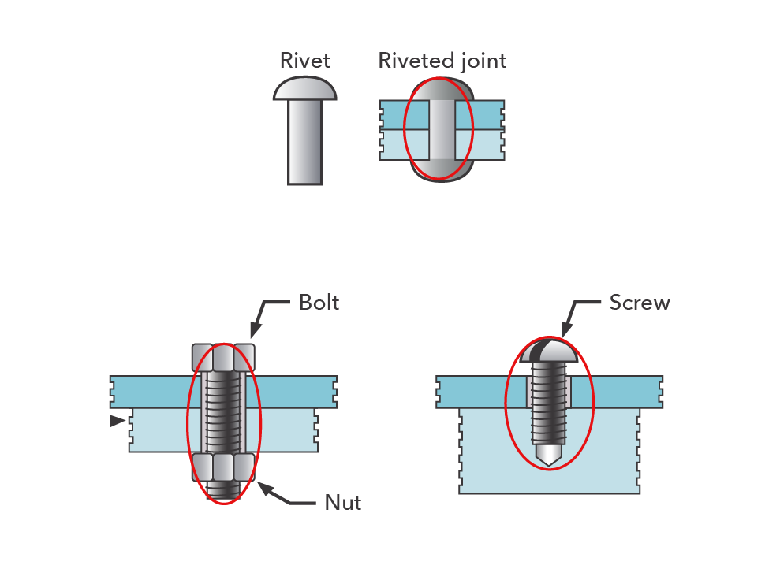
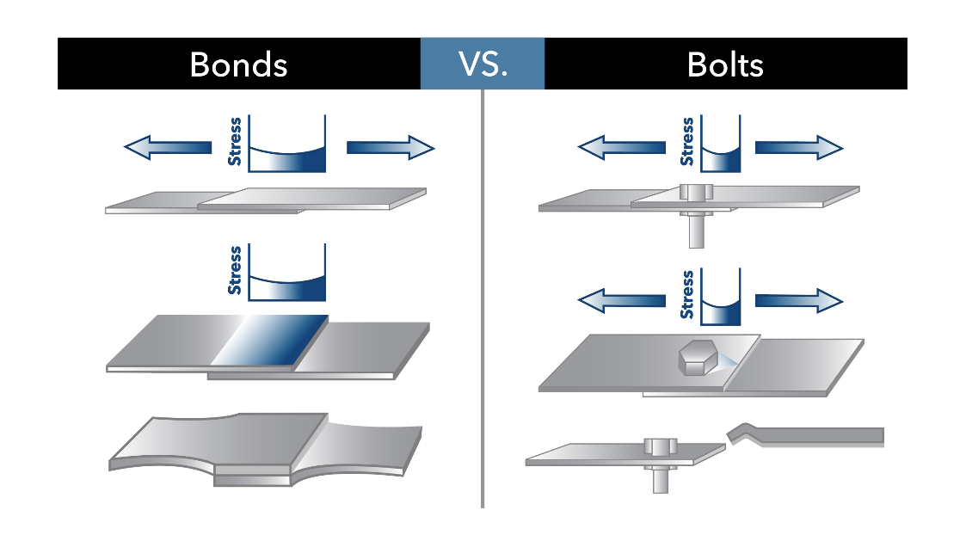
Advantages of MMA vs Rivets/Bolts
Uniform distribution of stress over the bond area
Eliminate damage to the structure
The bonded joint remains flexible to allow movements and reduce noise
Good fatigue resistance
Sealing and bonding in one step
Bolts, screws and rivets can become loose, fatigue and break.
Adhesive bonding is the only joining technique that allows certain lightweight designs

Slide 5
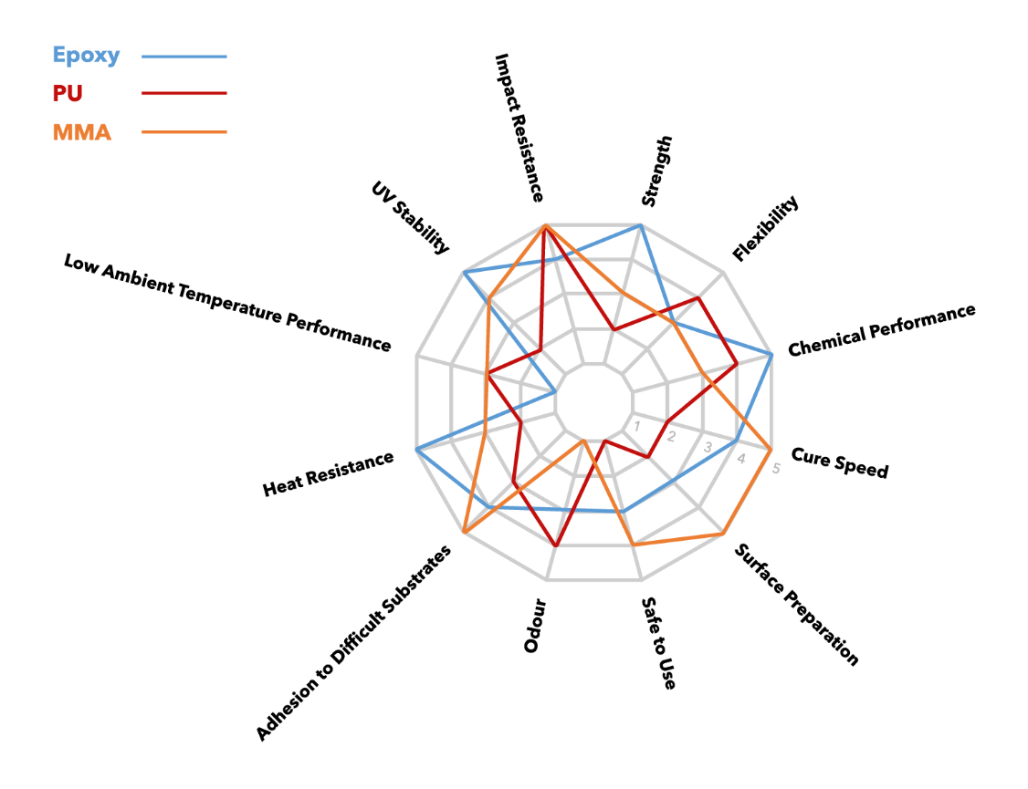
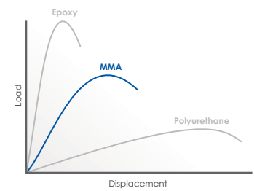
Structural adhesives: Epoxy VS 2K MMA VS 2K PU

Slide 6
Structural adhesives: Epoxy VS 2K MMA VS 2K PU
Property | Epoxy | 2K MMA | 2K Polyurethane
✅ Advantages | • Very high strength (>30 MPa) • Excellent chemical & temperature resistance • Superior weathering resistance | • Strong adhesion to plastics, metals, and composites • Minimal surface preparation needed • Easy application • Fast curing time • Good fatigue & impact resistance | • High flexibility • No odor • Good adhesion to plastics and wood • Strong impact resistance
⚠️ Limitations | • Requires thorough surface preparation • Can be brittle • Longer curing time + post curing | • Exothermic reaction (can cause shrinkage) • Strong odor • Lower chemical & temperature resistance compared to epoxy | • Lower mechanical strength• Requires surface preparation• Health & safety concerns (isocyanates)• Longer curing time• Lower chemical & temperature resistance compared to epoxy

Slide 7






Benefits of MMA Adhesives
Minimal surface preparation
Only cleaning on most substrates to enhance productivity
Room Temperature curing
No heating or post cure required
Variable cure time and fast strength build up
From few minutes to hours
Bonding dissimilar materials
High elongation suitable for diff. expansion coefficient
Variable Rheology
High for large structure to lower for small gaps
High peel and Impact Resistance
Reduce product failure
better performance for applications with mixed-mode stresses

Slide 8

“Next-Generation” of Acrylate Adhesive
Low Odor Formulation and Non-Flammable Classification
Improved formulation for enhanced workplace safety and productivity.
Nylon and LSE bonding
No flame or plasma pre-treatment
Reduce costs and production time
Galvanized Steel Bonding
No primer required
Resistance to E-coat and Paint Bake Cycle
bonding parts won’t shift/separate during bake

Slide 9

MARKET SECTORS
Maritime
Transportation (BTR)
Building & Construction
Automotive
Agricultural Vehicles
Wind Energy
Aquaculture
Sub-sea
Sign & Display
Infrastructure

Slide 10
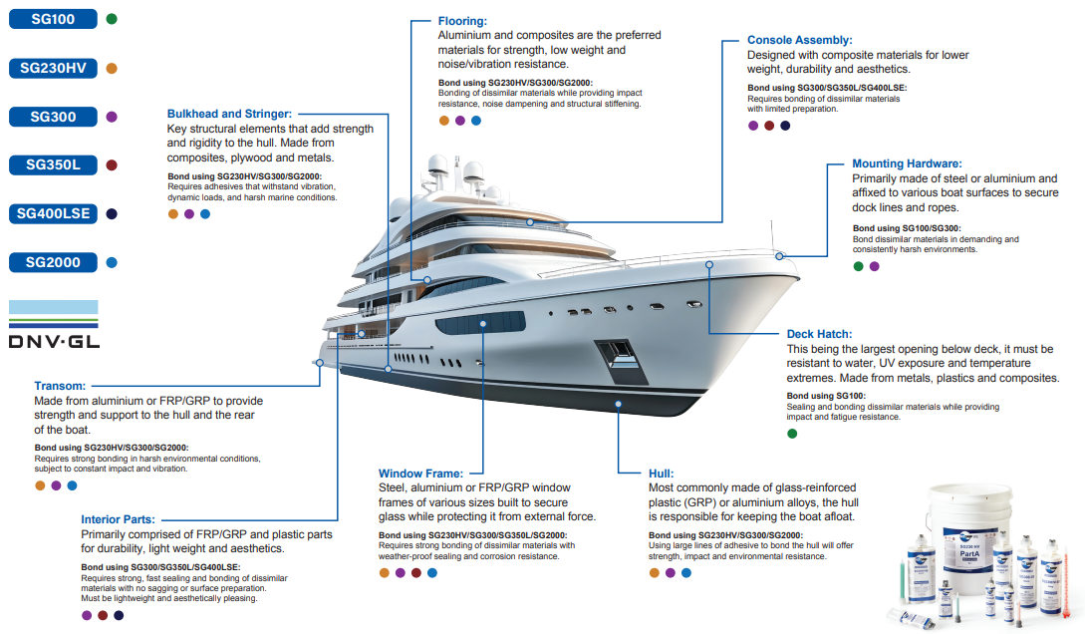
Marine Applications

Slide 11

Marine Application
Hull Manufacturing process:
Bonding the fibre-glass hull shell and the structural elements
Vertical sag resistance
Bead sizes up to 80mm
adhere to smooth, gel-coated and moist surfaces
  avoid/reduce preliminary abrasion of the composite
  Reduce dust in the factory
Impact and fatigue resistance
Quicker fixture time allows parts to be bonded and moved earlier
High bond strength even after extended exposure to marine envrmnt.

Slide 12
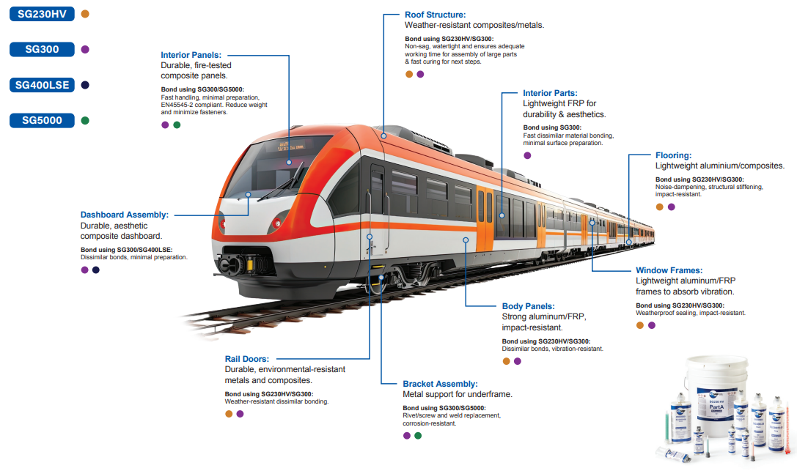
Train Applications

Slide 13
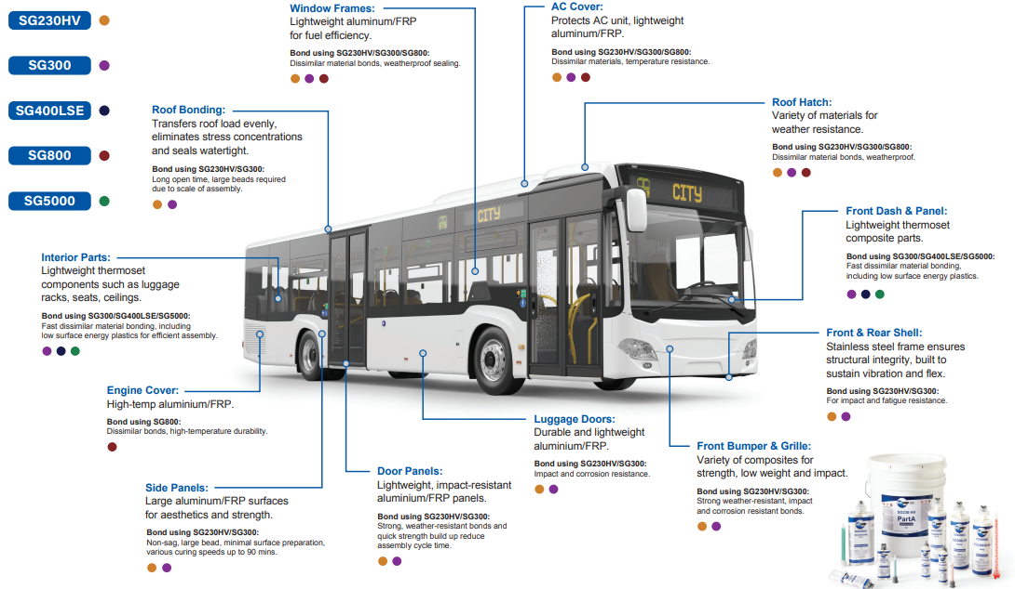
Bus Applications

Slide 14
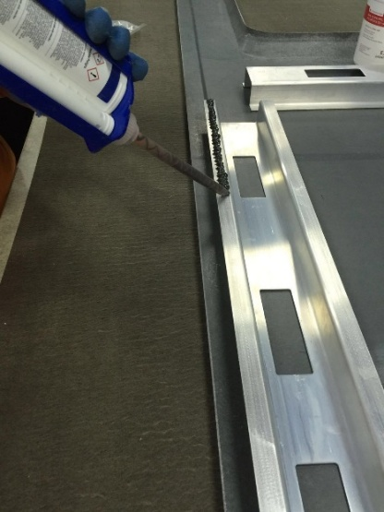
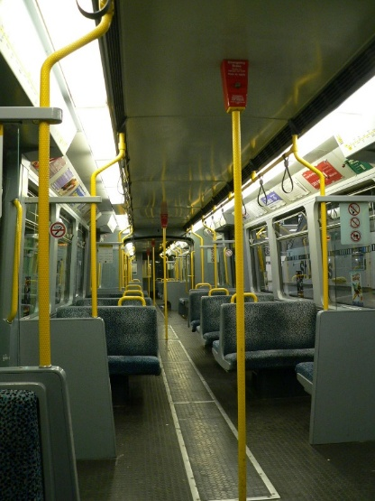
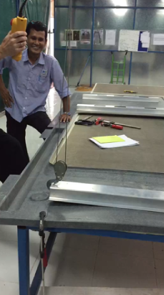
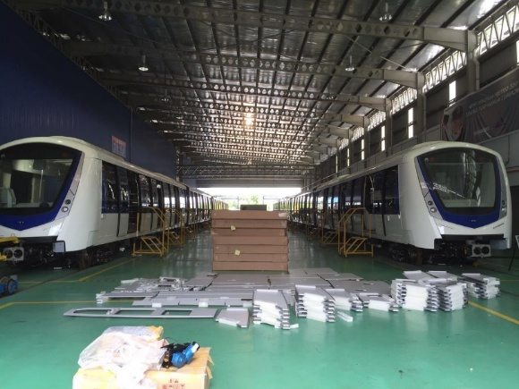
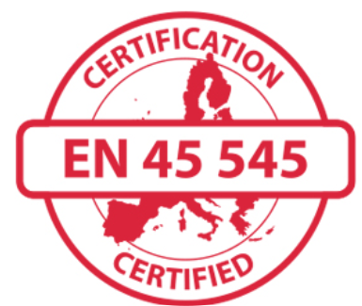
Bus/Tram/Rail
Bonding fixtures in public and private transportation:
Vertical sag resistance
Minimal surface preparation
Bonding dissimilar substrates
Impact and fatigue resistance
Fast curing time
EN45545-2

Slide 15
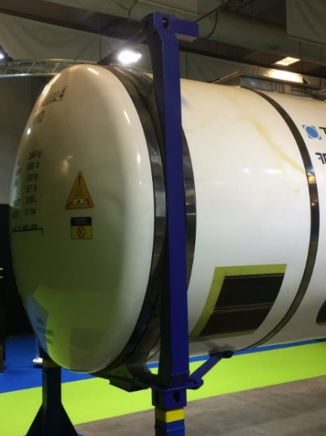
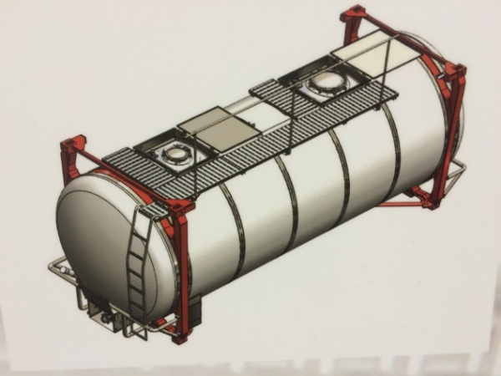
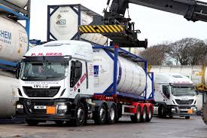
Composite Applications
Tankwell carrier:
Bonding metal reinforcement parts to GRP tank
Minimal surface preparation
Bonding dissimilar substrates
Impact load absorption
Reduced throughput times

Slide 16
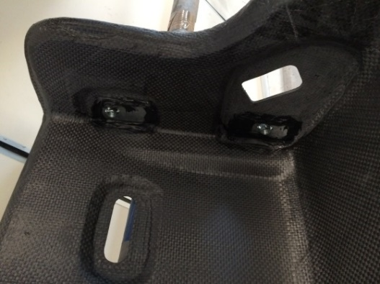
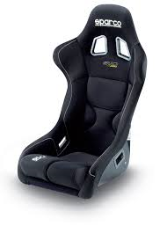
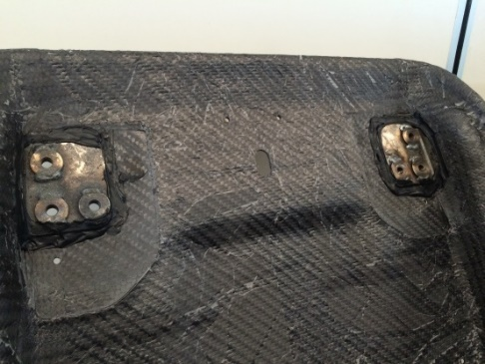
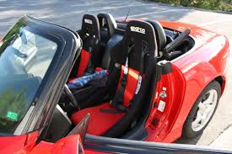
Composite Applications
Bonding metal brackets to CFRP motorsports seat
Excellent adhesion to CFRP
Minimal surface preparation
Bonding dissimilar substrates
Manual application and easy flow
Fast curing time

Slide 17
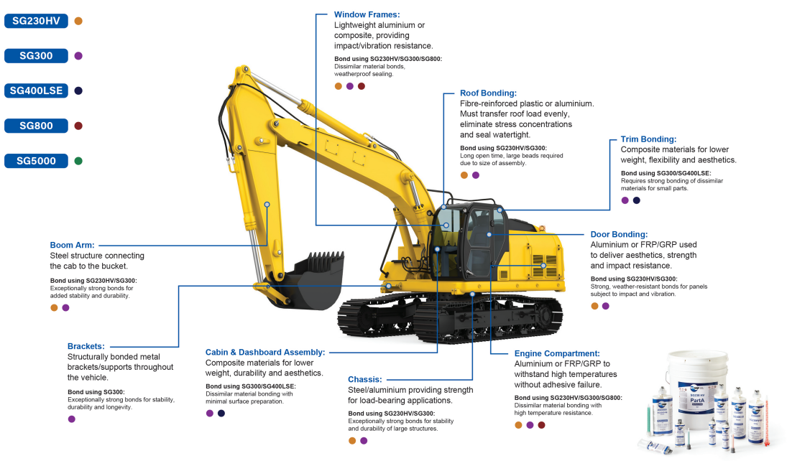
Construction Vehicle Applications

Slide 18
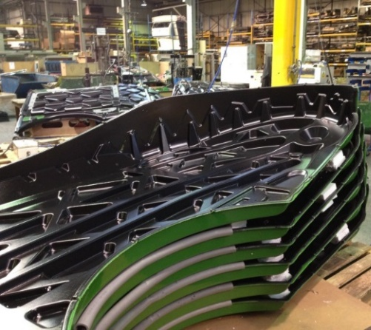
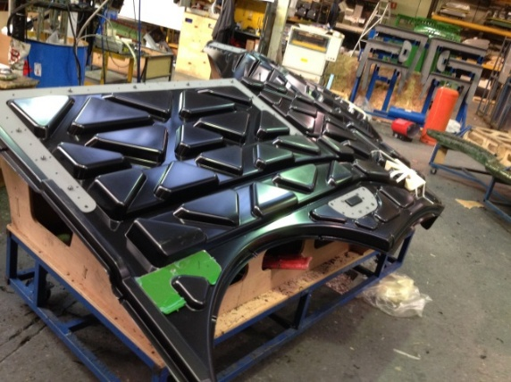
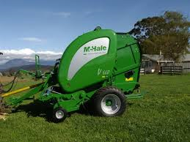
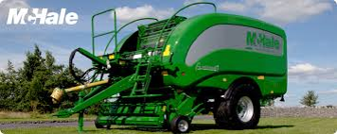
Plastic Applications
Agricultural parts:
Bonding plastic parts for agricultural applications
Ease of application
Minimal surface preparation
Limited shrinkage
Fast curing time

Slide 19

Thank you for your attention

