Slide 1
Strong Plastic Bonds
Made Easy!
Jim Duff
December 11, 2024

Slide 2

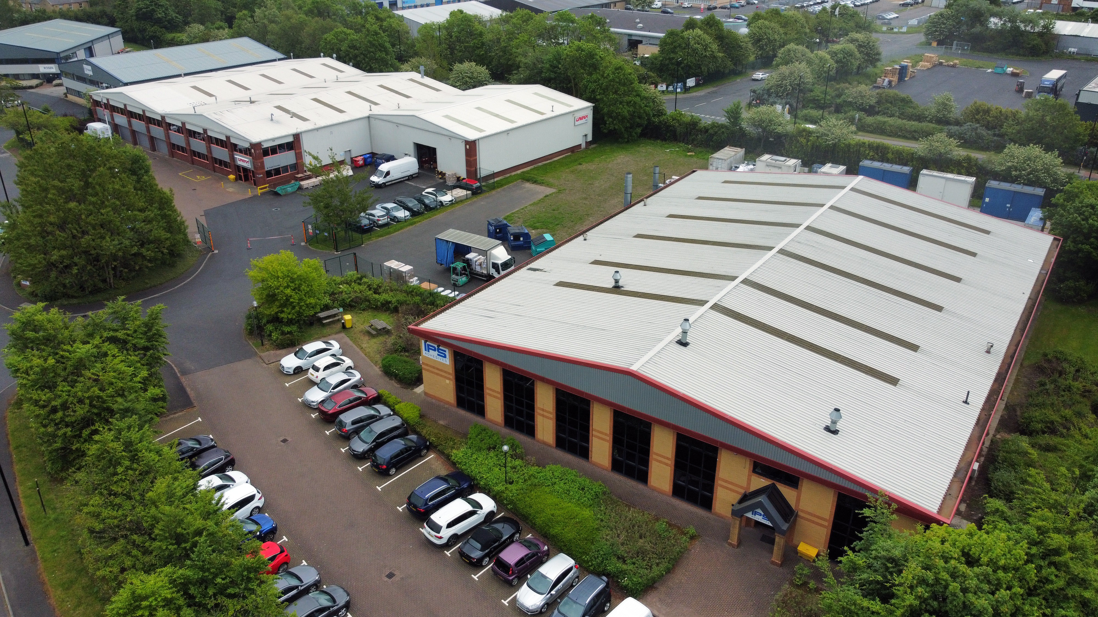
Introductions
About Jim Duff
Jim is a chemist with 24 years experience working with methacrylates in both UV and peroxide curing technologies. He’s spent the past 8 years focusing on 2k methacrylate adhesives.
About IPS Adhesives
IPS Adhesives is a leading provider of adhesives serving the surfacing, structural, and assembly industries. With a combined 65 years of expertise, its products are recognized by OEMs and fabricators globally for their premium quality, strength, and reliability.

Slide 3
Agenda
At the end of our presenation you will be able to ….
Plastics Overview
Common plastic bonding applications
Plastic design and manufacturing trends
Joining method comparison
Plastic substrates: surface energy considerations
Bonding Low Surface Energy plastics
Challenges bonding Low Surface Energy plastics
Example: Low Surface Energy bonding in action
Finding the Right Adhesive
How adhesive bonds are tested
“Virtual lab tour”
Performance specifications to look for
Selecting an adhesive
Summary

Slide 4
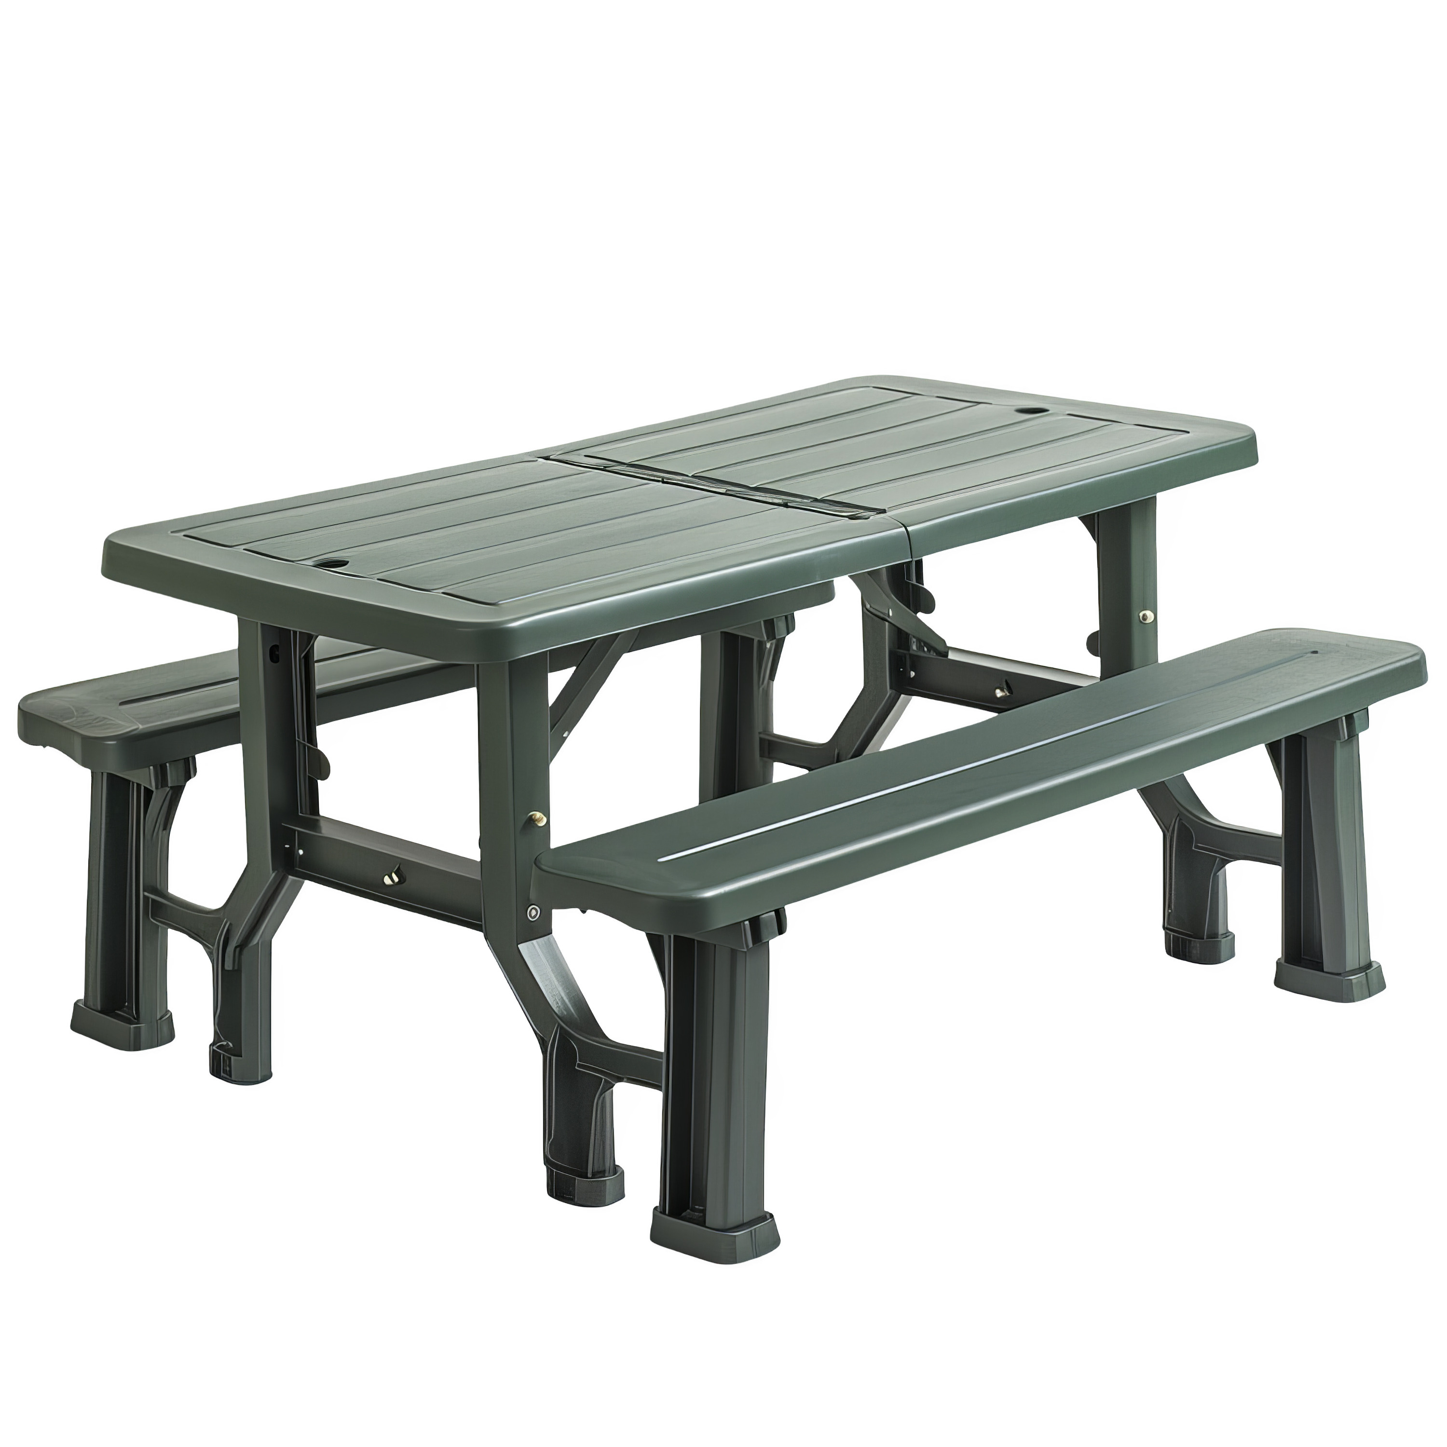
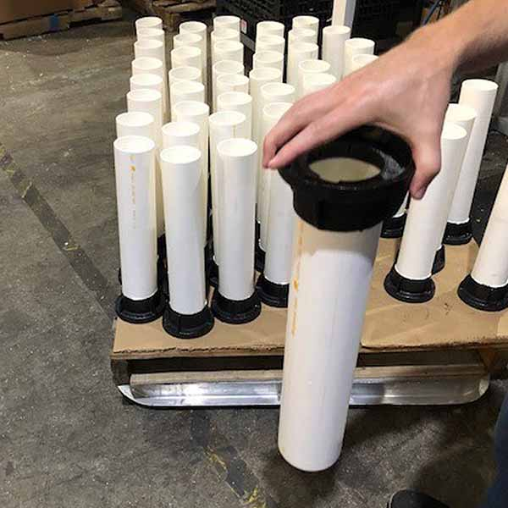
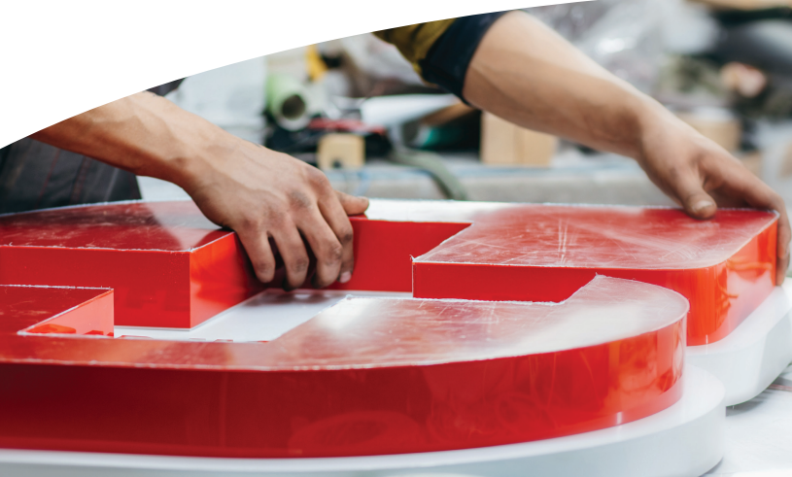
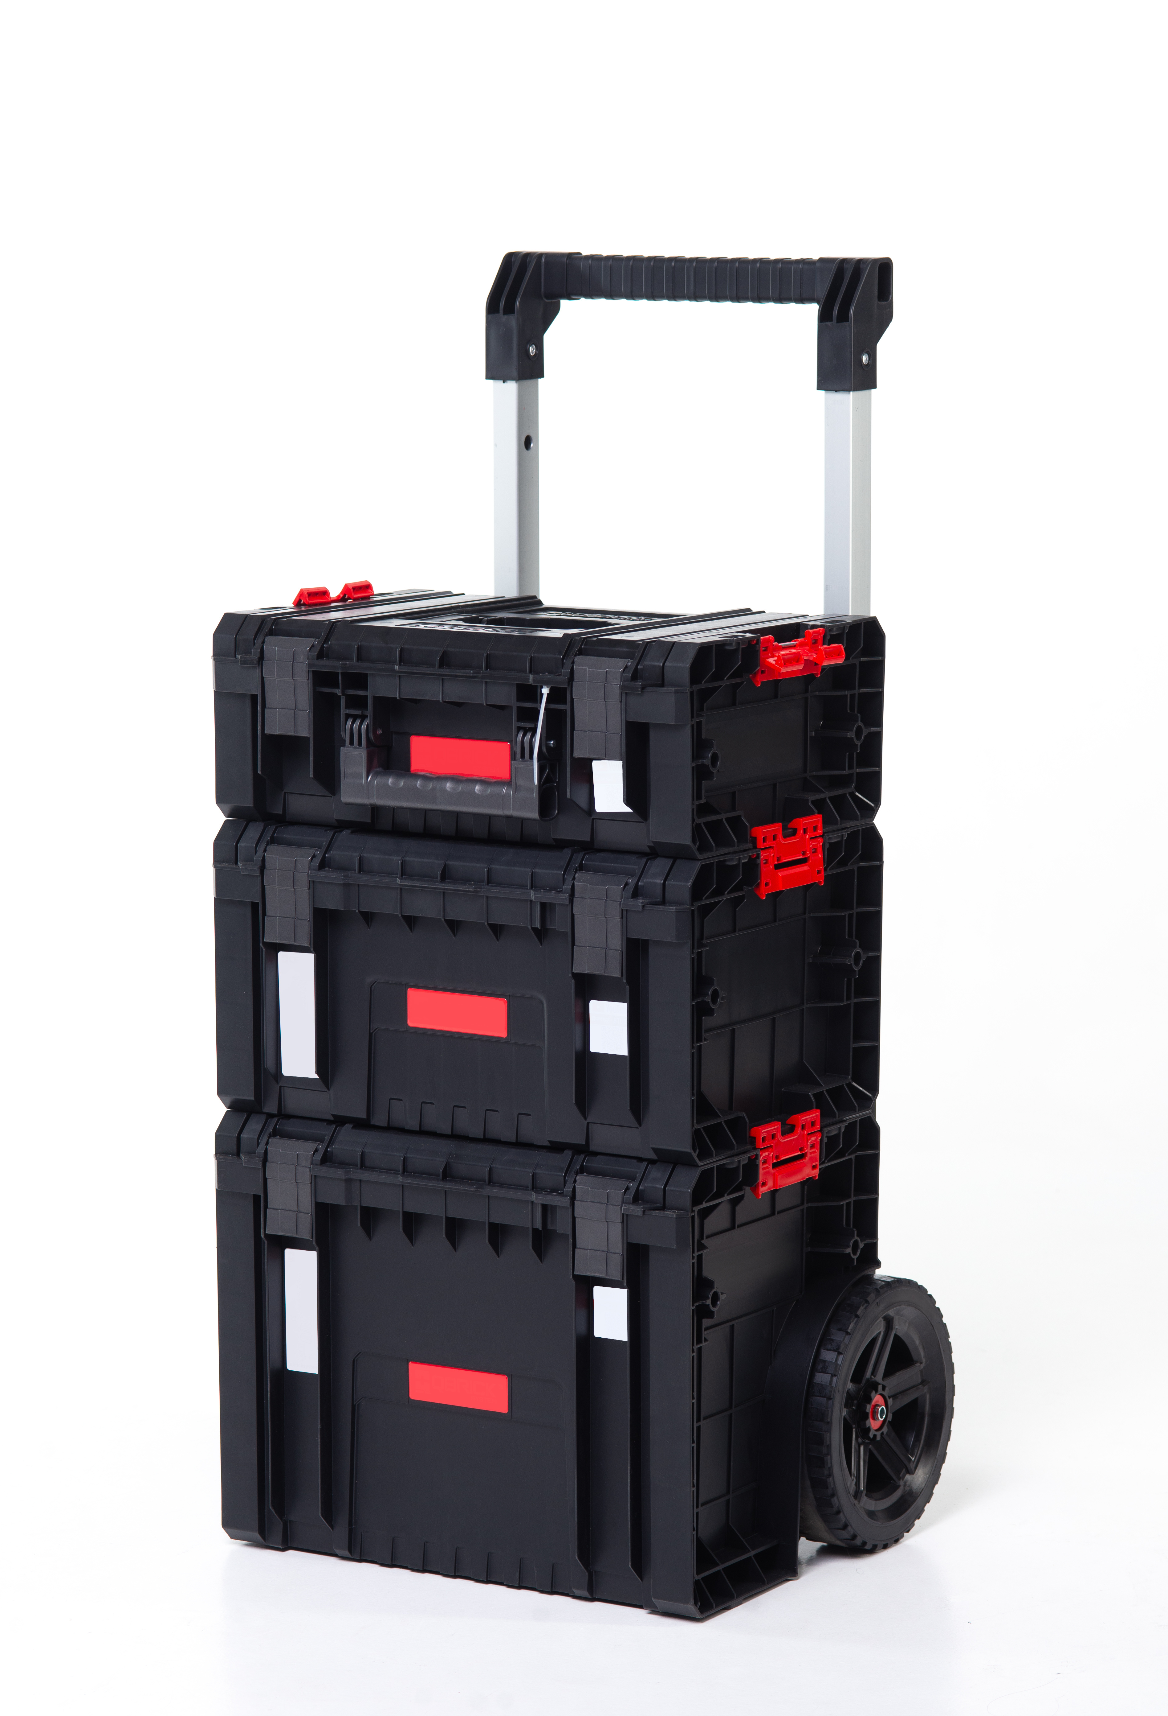
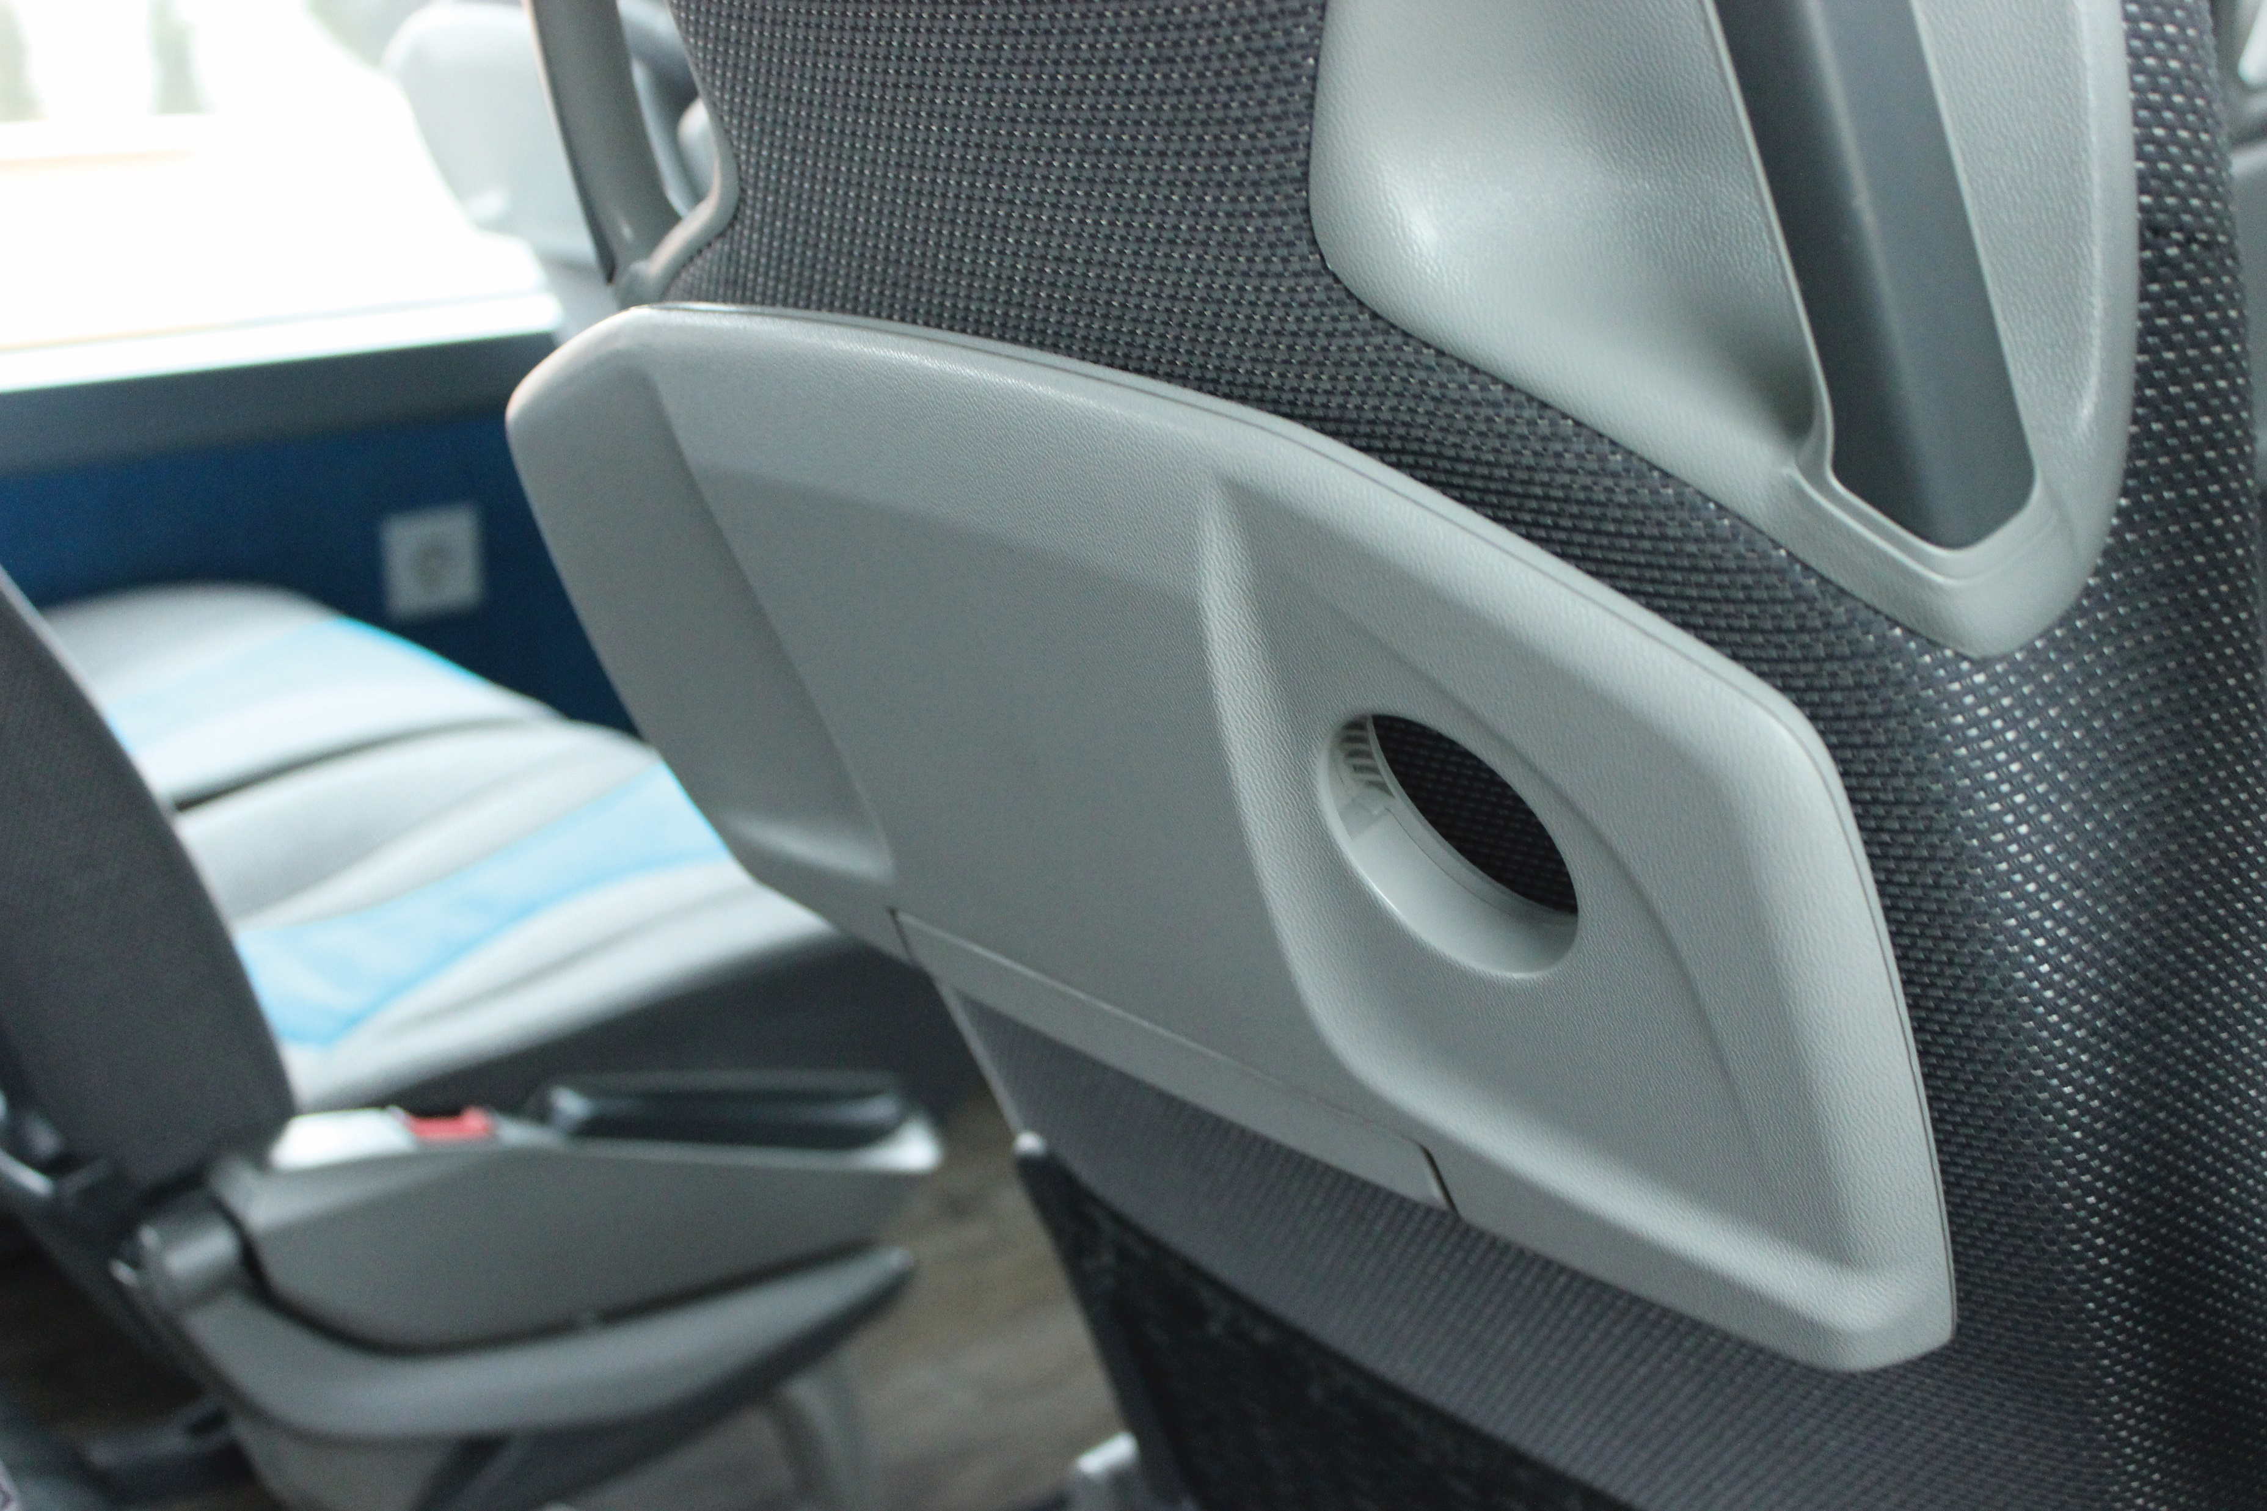

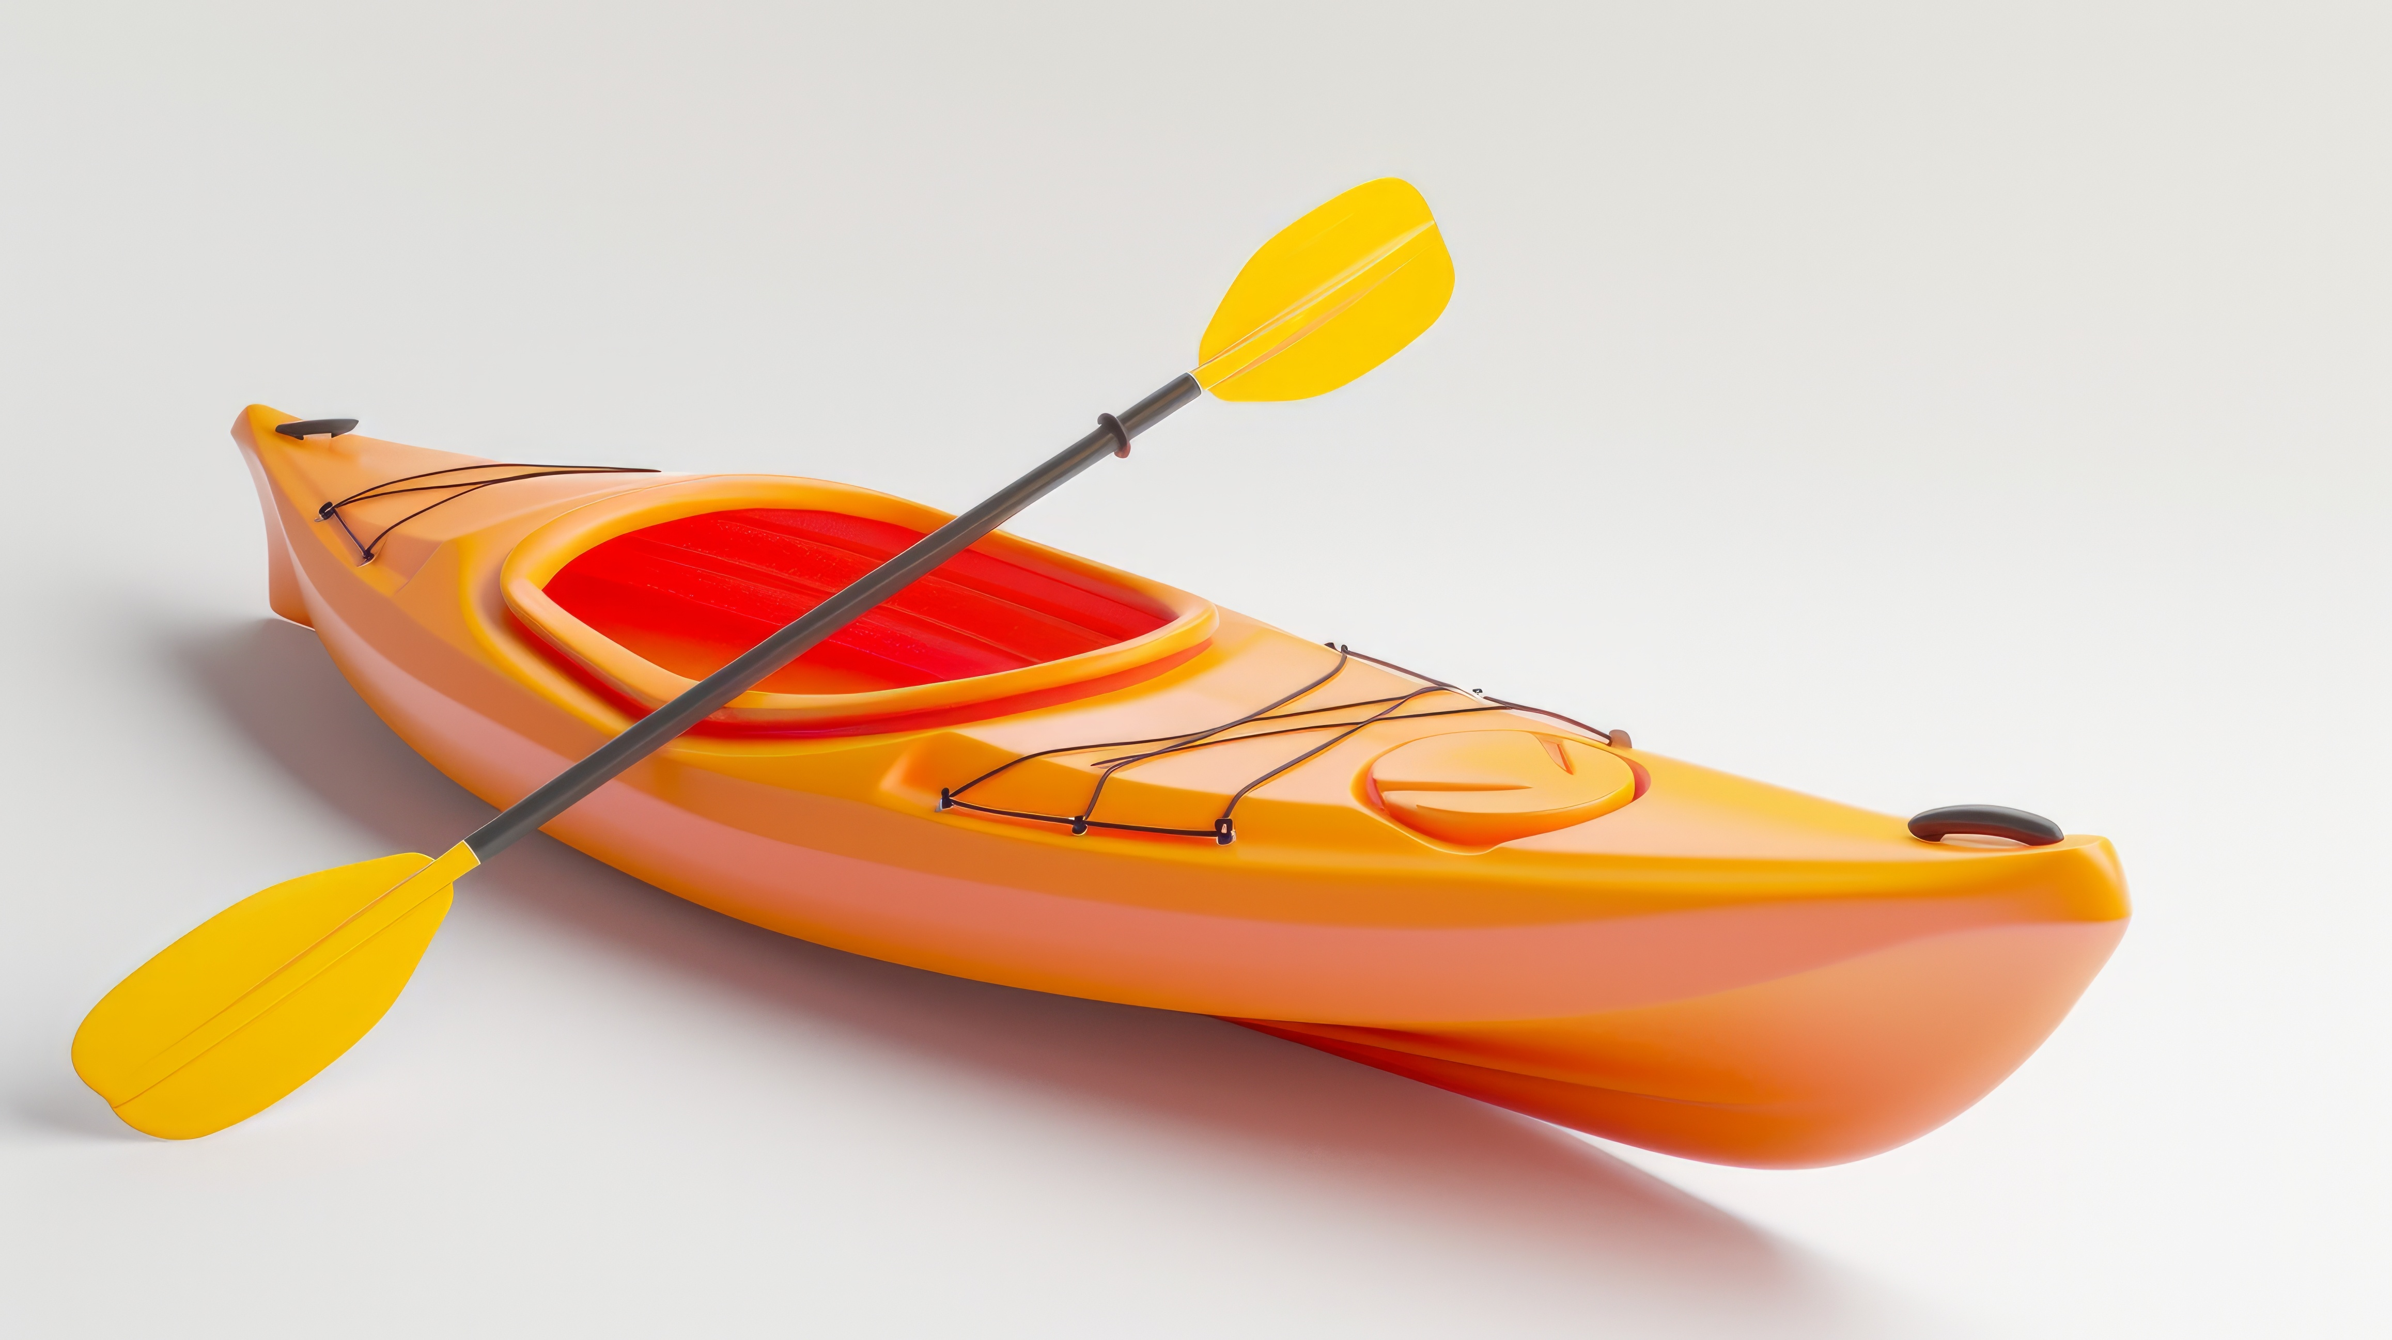
Common Plastic Bonding Applications
Sign and display
Outdoor cabinetry and furniture
Injection and blow-molded assemblies
Transportation
Building components
Consumer goods (appliances, sporting goods)
Packaging, storage and containment
Notes:
Most common plastics:
Acrylic (pMMA)
ABS
PE
PP
PVC
PC

Slide 5
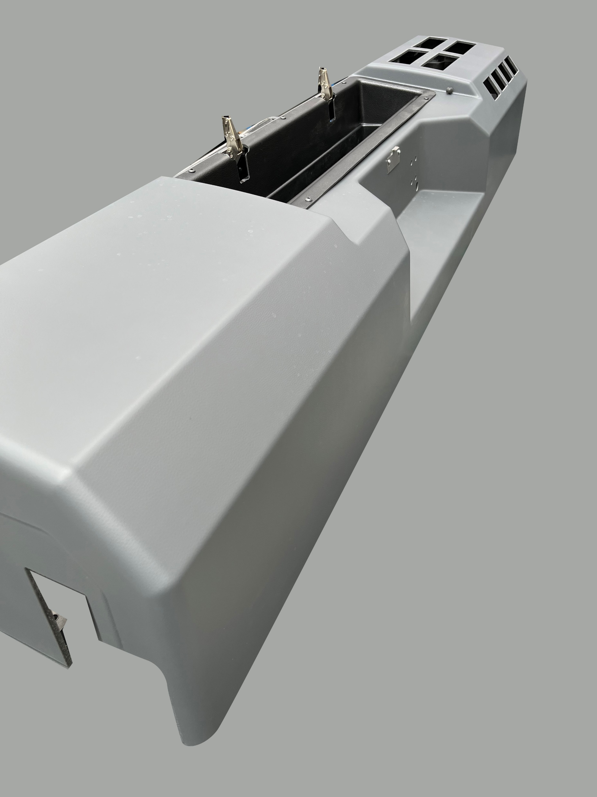
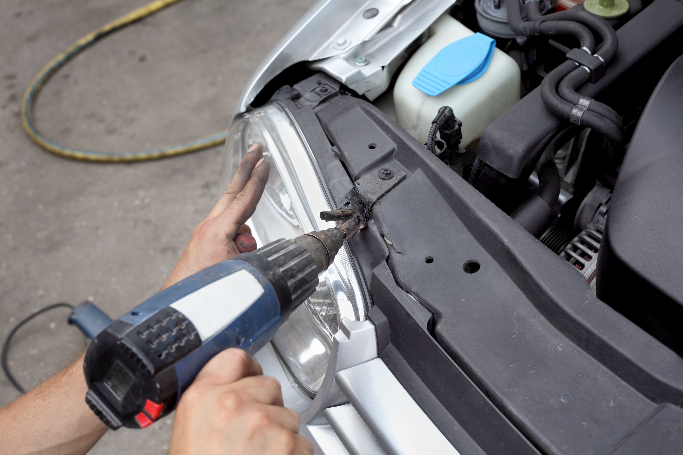
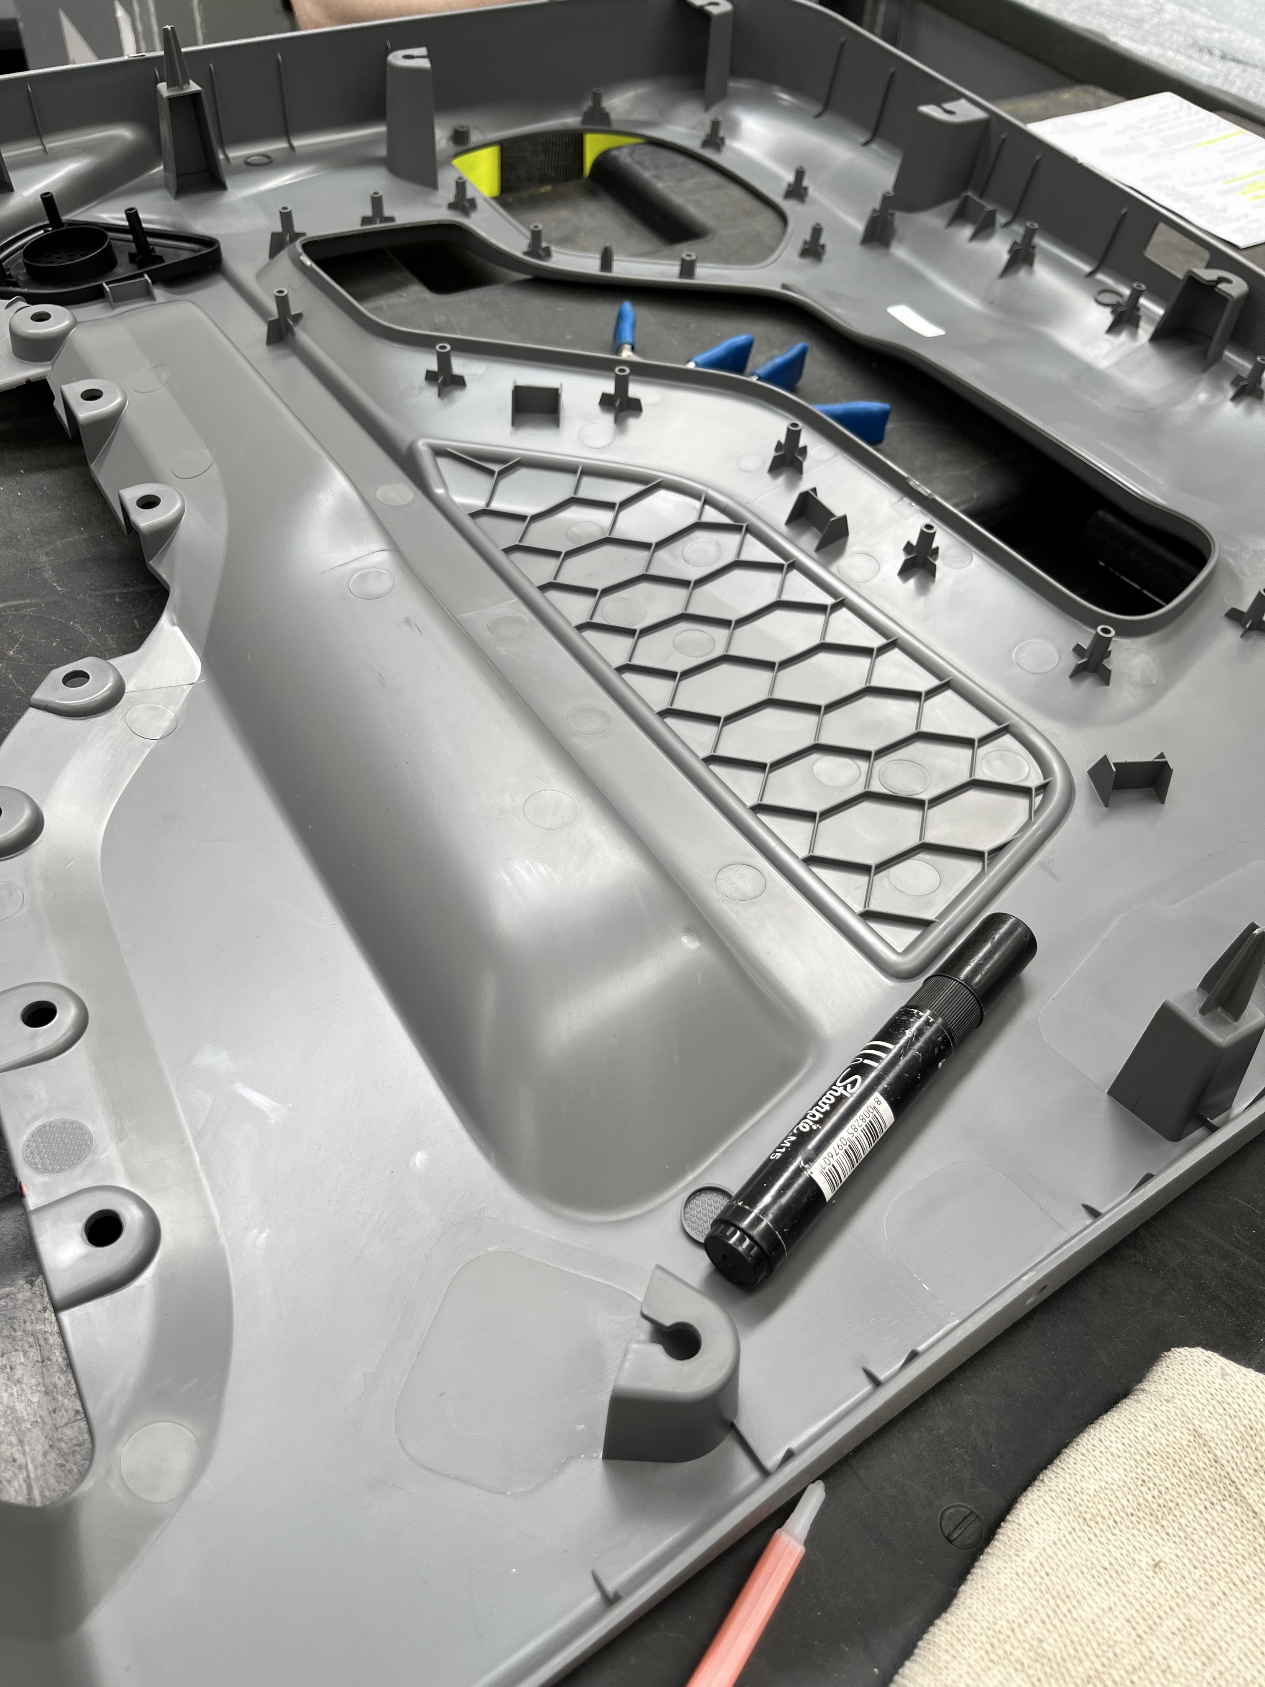
Plastic Design and Manufacturing Trends
Complex Shapes
With continuing advances in modeling software and AI-generated designs as well as lightweighting for sustainability, interior profiles are increasing in variety and complexity.
Aesthetics
As industrial design and modern preferences influence an ever-greater volume of designs, smoother materials and clean visual lines continue to be in high demand.
Skilled Labor Shortages
Availability of skilled human welders continues to decline as generations change. While robotic welding is making inroads, high mix manufacturing operations requiring flexibility struggle to staff production.
Notes:
Plastics are more important than ever. Their weight advantage over metals, their ability to be formed into complex shapes and geometries, and their aesthetic properties make them well suited for commercial markets.

Slide 6
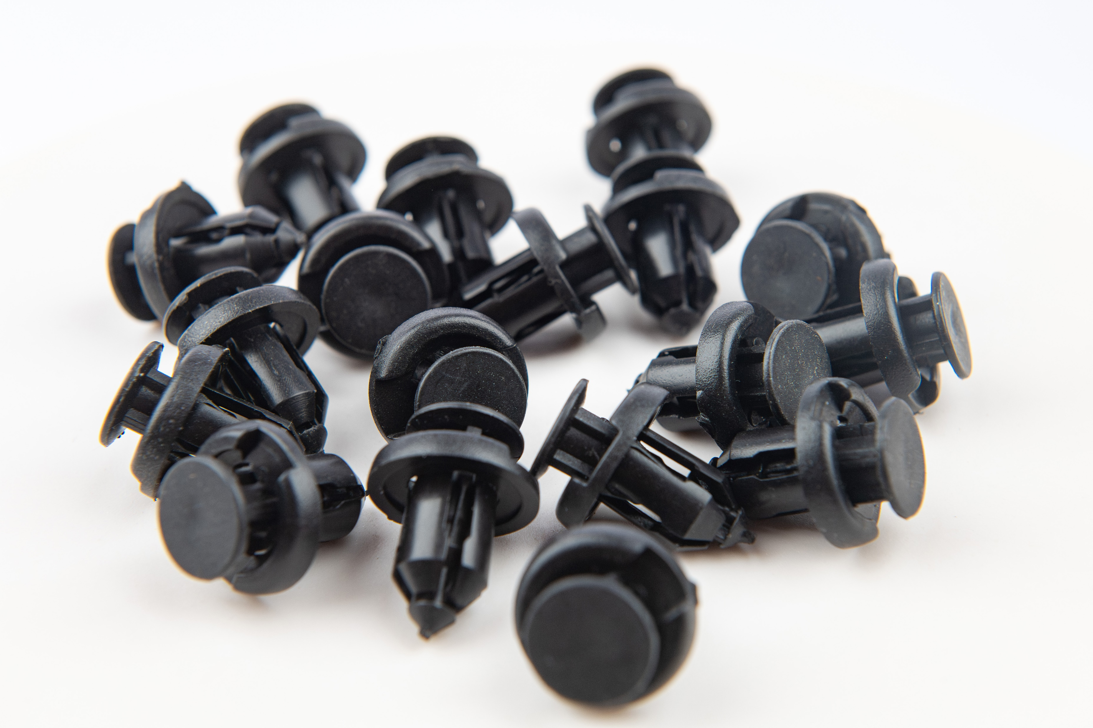
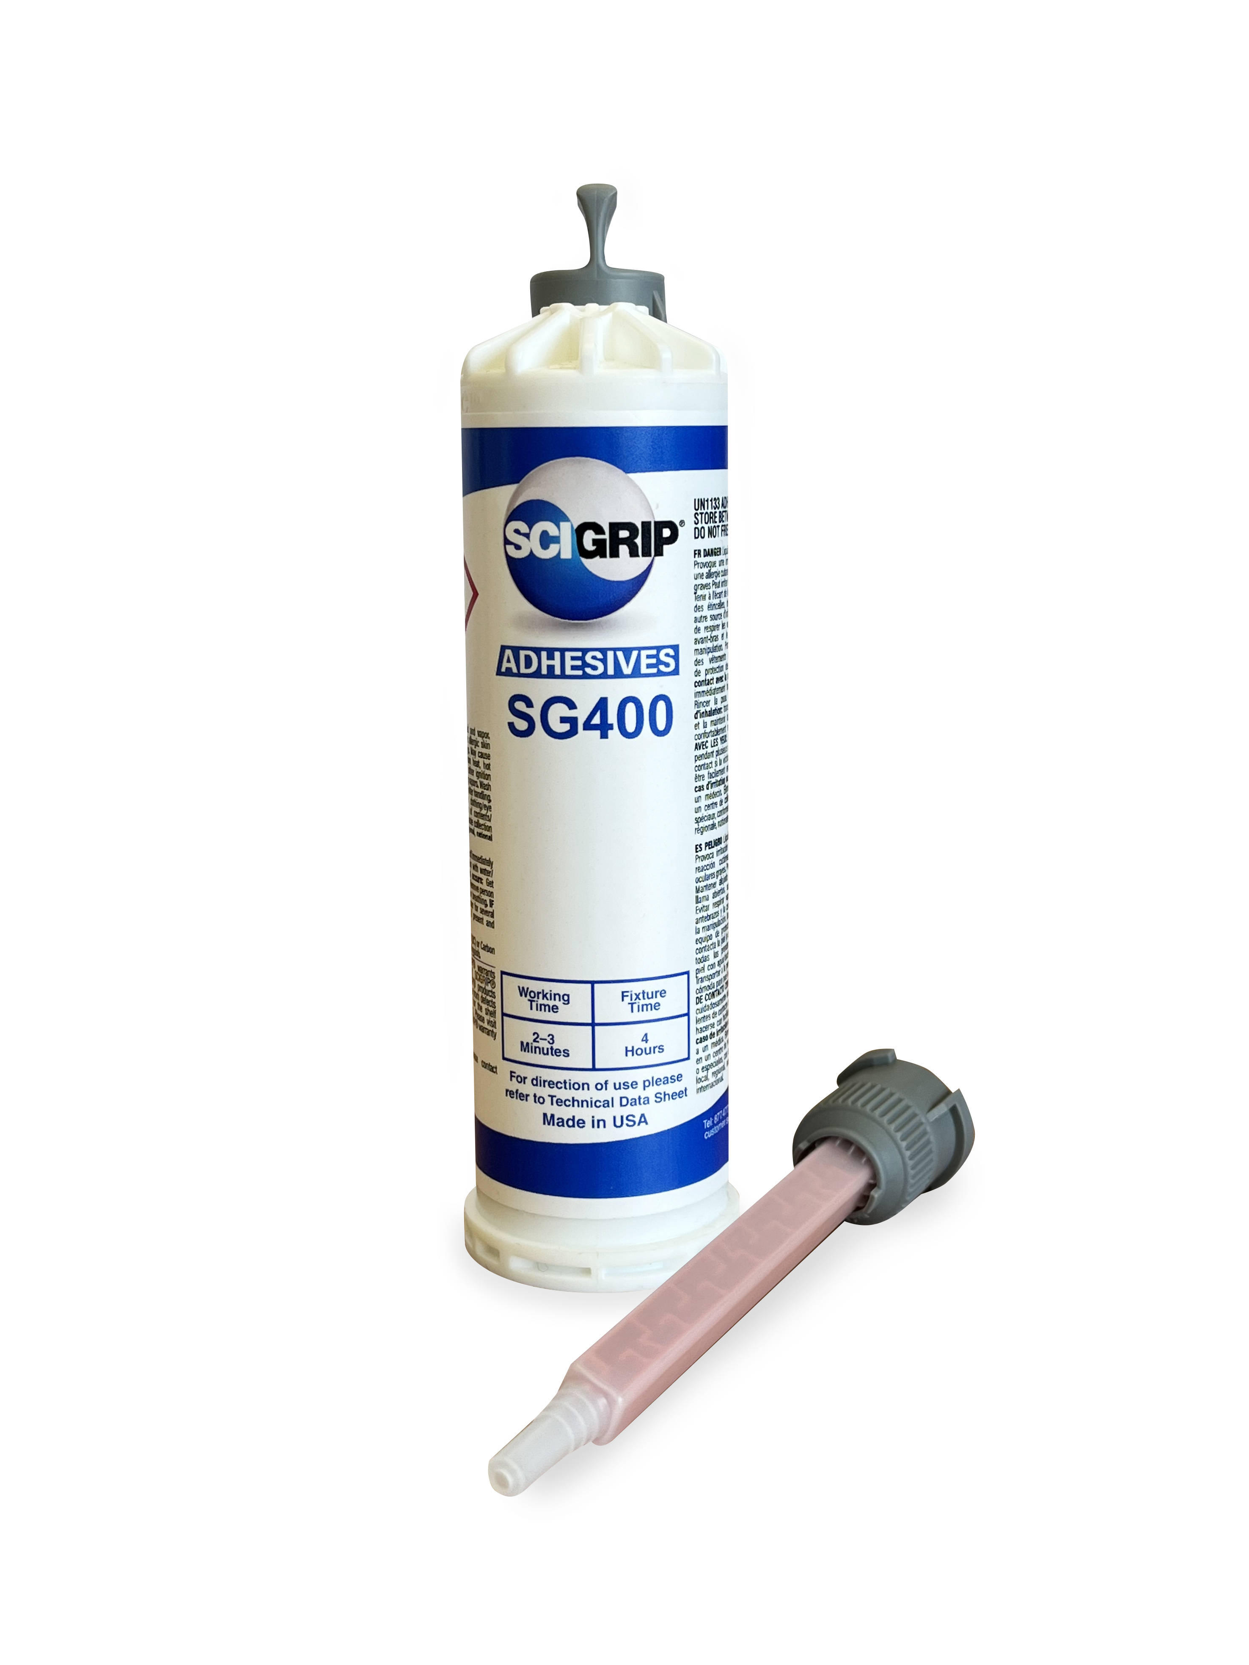

Joining Method Comparison
 | Fasteners | Welding | Adhesives
PROS | No cure time No odor Low skill labor Fast for small bond areas Instant strength | Strong “Same material” appearance Can be watertight | Consistent stress distribution Sleek aesthetics Low-medium labor skill to apply Increased Bond strength area Dissimilar substrate bonding capability Reduced surface marks and read through
CONS | Holes, hole accuracy Uneven stress distribution Many not suited for harsh environments Heavy in high volumes Difficult to rework errors | Difficulty joining thick substrates Difficulty joining dissimilar substrates Highly skilled labor or capital investments required Often inconsistent in strength Joint surface distortion Limited use outside of metals | Some odor Cure time requirement

Slide 7
Plastic Surfaces: Surface Energy Considerations
Lower Surface Energy
Teflon (PTFE)
Polyethylene (both LDPE and HDPE)
Polypropylene (PP)
Polystyrene (PS)
Acrylic (PMMA)
Polyvinyl Chloride (PVC)
ABS
Polyethylene Terephthalate (PET)
Polycarbonate (PC)
Treated HDPE, PP, and LDPE
Liquids, adhesives, gels, and coatings BEAD UP on LOW SURFACE ENERGY surfaces.
Liquids, adhesives, gels, and coatings SPREAD OUT on HIGH SURFACE ENERGY surfaces.
Higher Surface Energy

Slide 8
Agenda
Plastics Overview
Common plastic bonding applications
Plastic design and manufacturing trends
Joining method comparison
Plastic substrates: surface energy considerations
Bonding Low Surface Energy plastics
Challenges bonding Low Surface Energy plastics
Example: Low Surface Energy bonding in action
Finding the Right Adhesive
How adhesive bonds are tested
“Virtual lab tour”
Performance specifications to look for
Selecting an adhesive
Summary

Slide 9
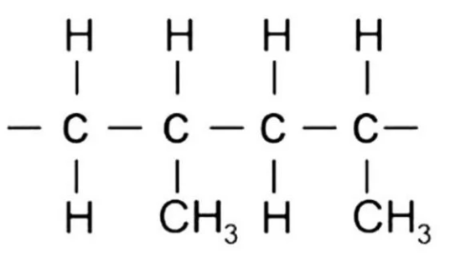
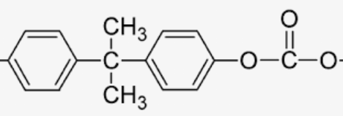
Challenges in Bonding Low Surface Energy plastics
Why are low surface energy substrates so difficult to bond to?
VS
Polypropylene Polycarbonate
Surface treatment?
Pros: Very good at increasing the surface energy
Cons: Expensive
Temporary
Sensitive to environment
Notes:
Imagine spreading peanut butter on a glass pane and a shag carpet. It’s easy to wipe off the glass because there’s nothing for the PB to stick to.
CC bonds are very difficult to break, this is one of the things that makes plastics strong. Having oxygen or other hetero atoms to bond is what allows us to bond most plastics fairly easily.

Slide 10
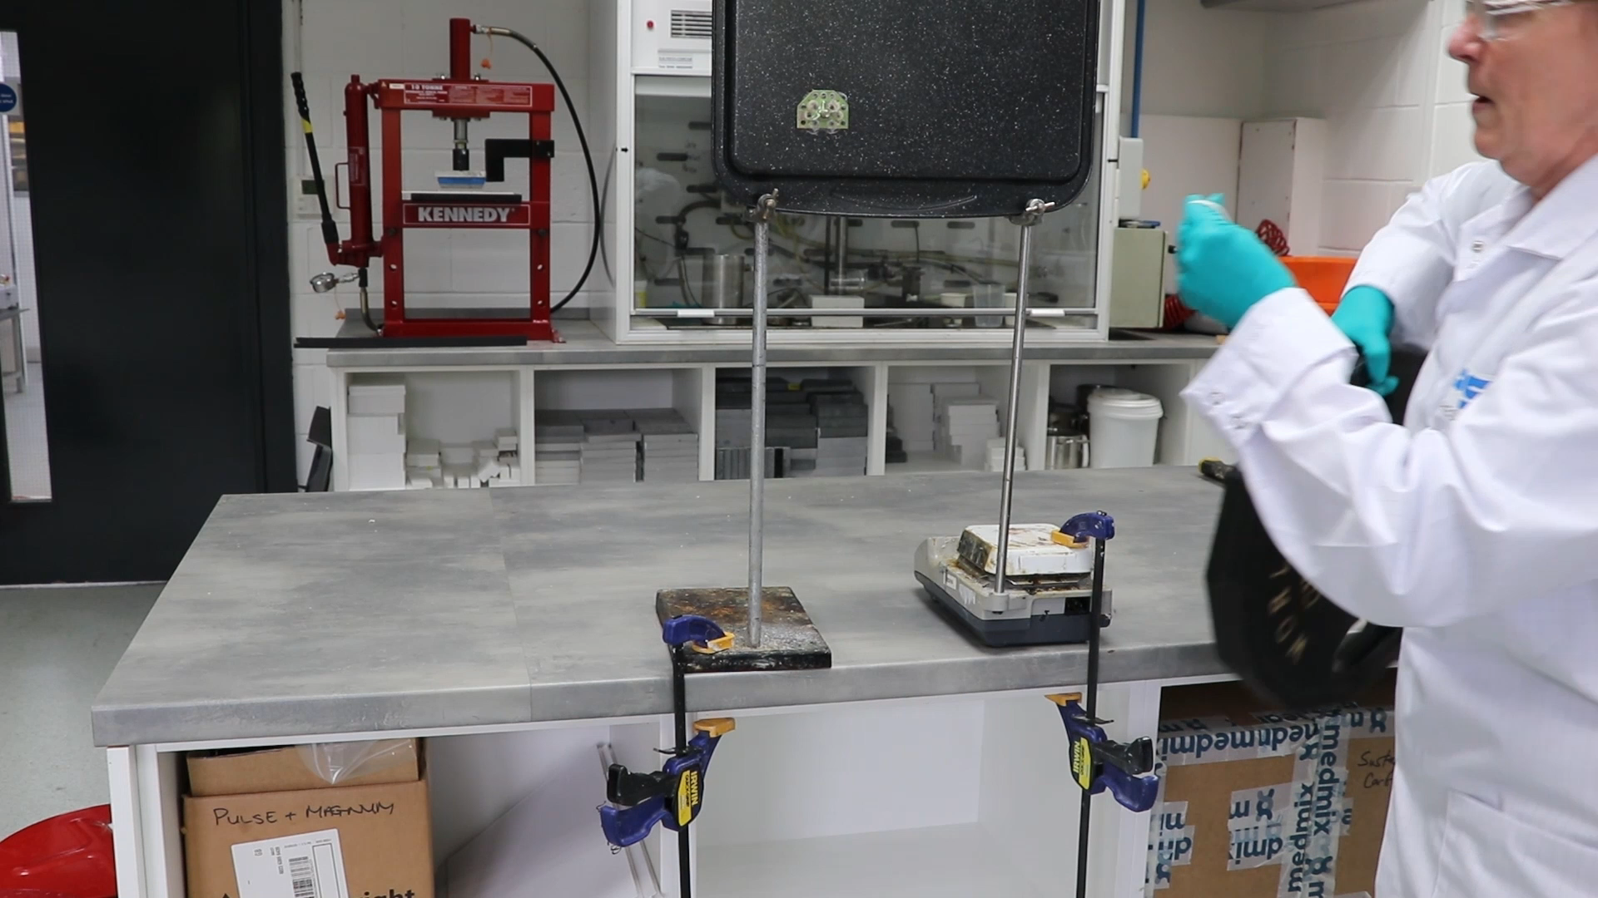
Example: Low Surface Energy bonding in action
Composite and thermoplastic components for vehicle manufacturing
Supplier collaboration:
  Efficient prototype reviews, jointly onsite
  Bonding of dissimilar substrates (including LSE plastic)
  Use of fewer types of adhesive on the production
Benefits achieved:
  Reduced complexity
  Improved productivity
  Risk reduction
Notes:
I’m not sure what we want on this page. Should we show samples being tested?

Slide 11
Agenda
Plastics Overview
Common plastic bonding applications
Plastic design and manufacturing trends
Joining method comparison
Plastic substrates: surface energy considerations
Bonding Low Surface Energy plastics
Challenges bonding Low Surface Energy plastics
Example: Low Surface Energy bonding in action
Finding the Right Adhesive
How adhesive bonds are tested
“Virtual lab tour”
Performance specifications to look for
Selecting an adhesive
Summary

Slide 12
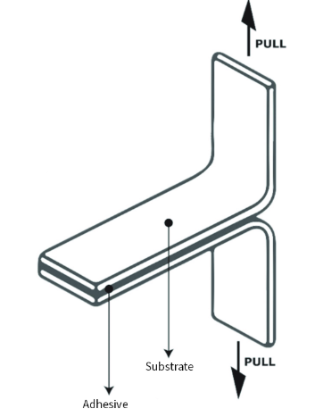
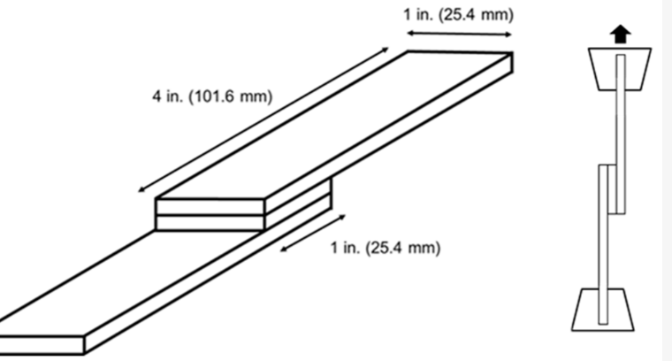

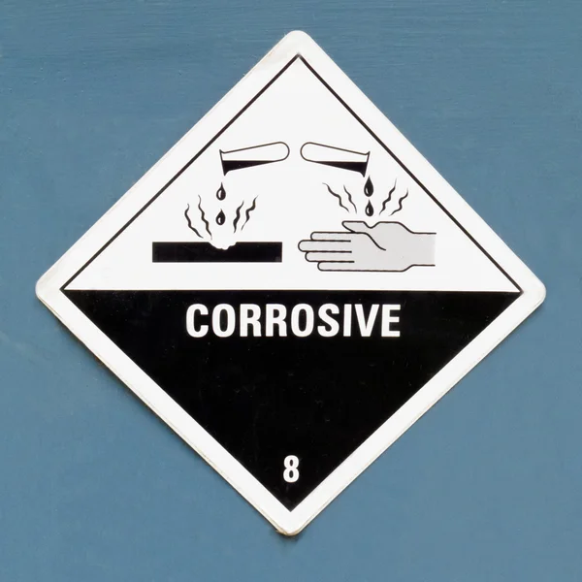
How adhesive bonds are tested
Lap Shear
Peel
Test
UV/Environmental Exposure
Chemical Resistance
Notes:
Lap shear testing is the primary test for the strength of the bond. This usually represents how bonded pieces will be used.
Peel testing is less common but can still be important depending on the application.
UV/environmental testing is important for anything that’s going to be outside or exposed to big variations in temperature. UV is mor important when crossbonding to clear substrates.
Chemical Resistance testing is also application dependent but is often found in automotive applications where a bond may be exposed to things like sulfuric acid, oil, gasoline/diesel, and hydraulic fluids.

Slide 13
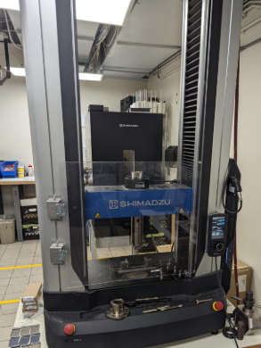
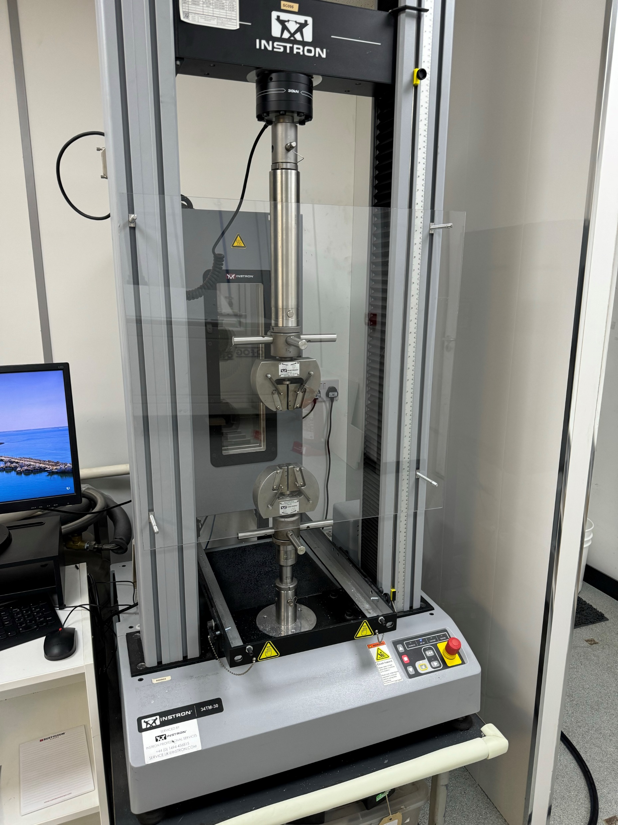
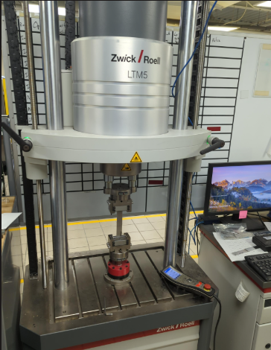
“Virtual lab tour”
Shimadzu and Instron Universal Testers
Zwick Fatigue Tester
Notes:
Instron is our “work horse”. Mostly used for lap shear and tensile testing.
Shimadzu has multiple fixtures that allow for testing unique geometries.
Zwick tests a fraction of the max strength multiple times a second. Similar to riding on a bumpy road.

Slide 14
Performance specifications to look for
Design Considerations
Substrate suitability
Flexibility / elongation
Adhesive Application Considerations
Open time
Odor
End Use Considerations
Temperature
Chemical resistance
Initial bond strength
Strength over time
Application method/ equipment requirements
Surface preparation
Gap filling ability
Exotherm
Working time
Cure time
Application environment
Storage requirements, shelf life
UV/environmental resistance
Odor

Slide 15
Selecting an adhesive
How Adhesive Suppliers can Help
Feasibility conversations
Bond modeling tools
Tradeoff considerations
Application experience
Narrowing options
Consulting on test plans
Conducting testing
Know Your Application
Obtain and review product design specifications
Understand minimum and desired application and end use specifications
Define Critical Specifications
Determine the most critical design, application, and end use requirements
Identify Possible Solutions
Review Technical Data sheets for suitability
Test, Iterate, Validate
Customization may be an option
Complete test plan
Develop a test plan, for samples and application testing
Translate those requirements into adhesive specifications
Ask the experts

Slide 16
Agenda
Plastics Overview
Common plastic bonding applications
Plastic design and manufacturing trends
Joining method comparison
Plastic substrates: surface energy considerations
Bonding Low Surface Energy plastics
Challenges bonding Low Surface Energy plastics
Example: Low Surface Energy bonding in action
Finding the Right Adhesive
How adhesive bonds are tested
“Virtual lab tour”
Performance specifications to look for
Selecting an adhesive
Summary

Slide 17
Summary
Adhesives outperform welding and fasteners in many applications for bond continuity, ease of application, aesthetics, and more!
Understanding the surface energy of your plastic substrate will help you find the right adhesive.
Plastics like LDPE, HDPE, and PP, with surface energies <30 dynes/cm are generally considered “Low Surface Energy” and only certain adhesives will work well.
In-house tests at suppliers can be combined with application-based testing to help ensure a good match of adhesive and substrate.

Slide 18
Questions?

