Slide 1
Solving Plastic Bonding Challenges with MMAs
Taylor Santa – Technical Service Representative
Shaun Kennedy – Business Development Manager
April 28th, 2026

Slide 2
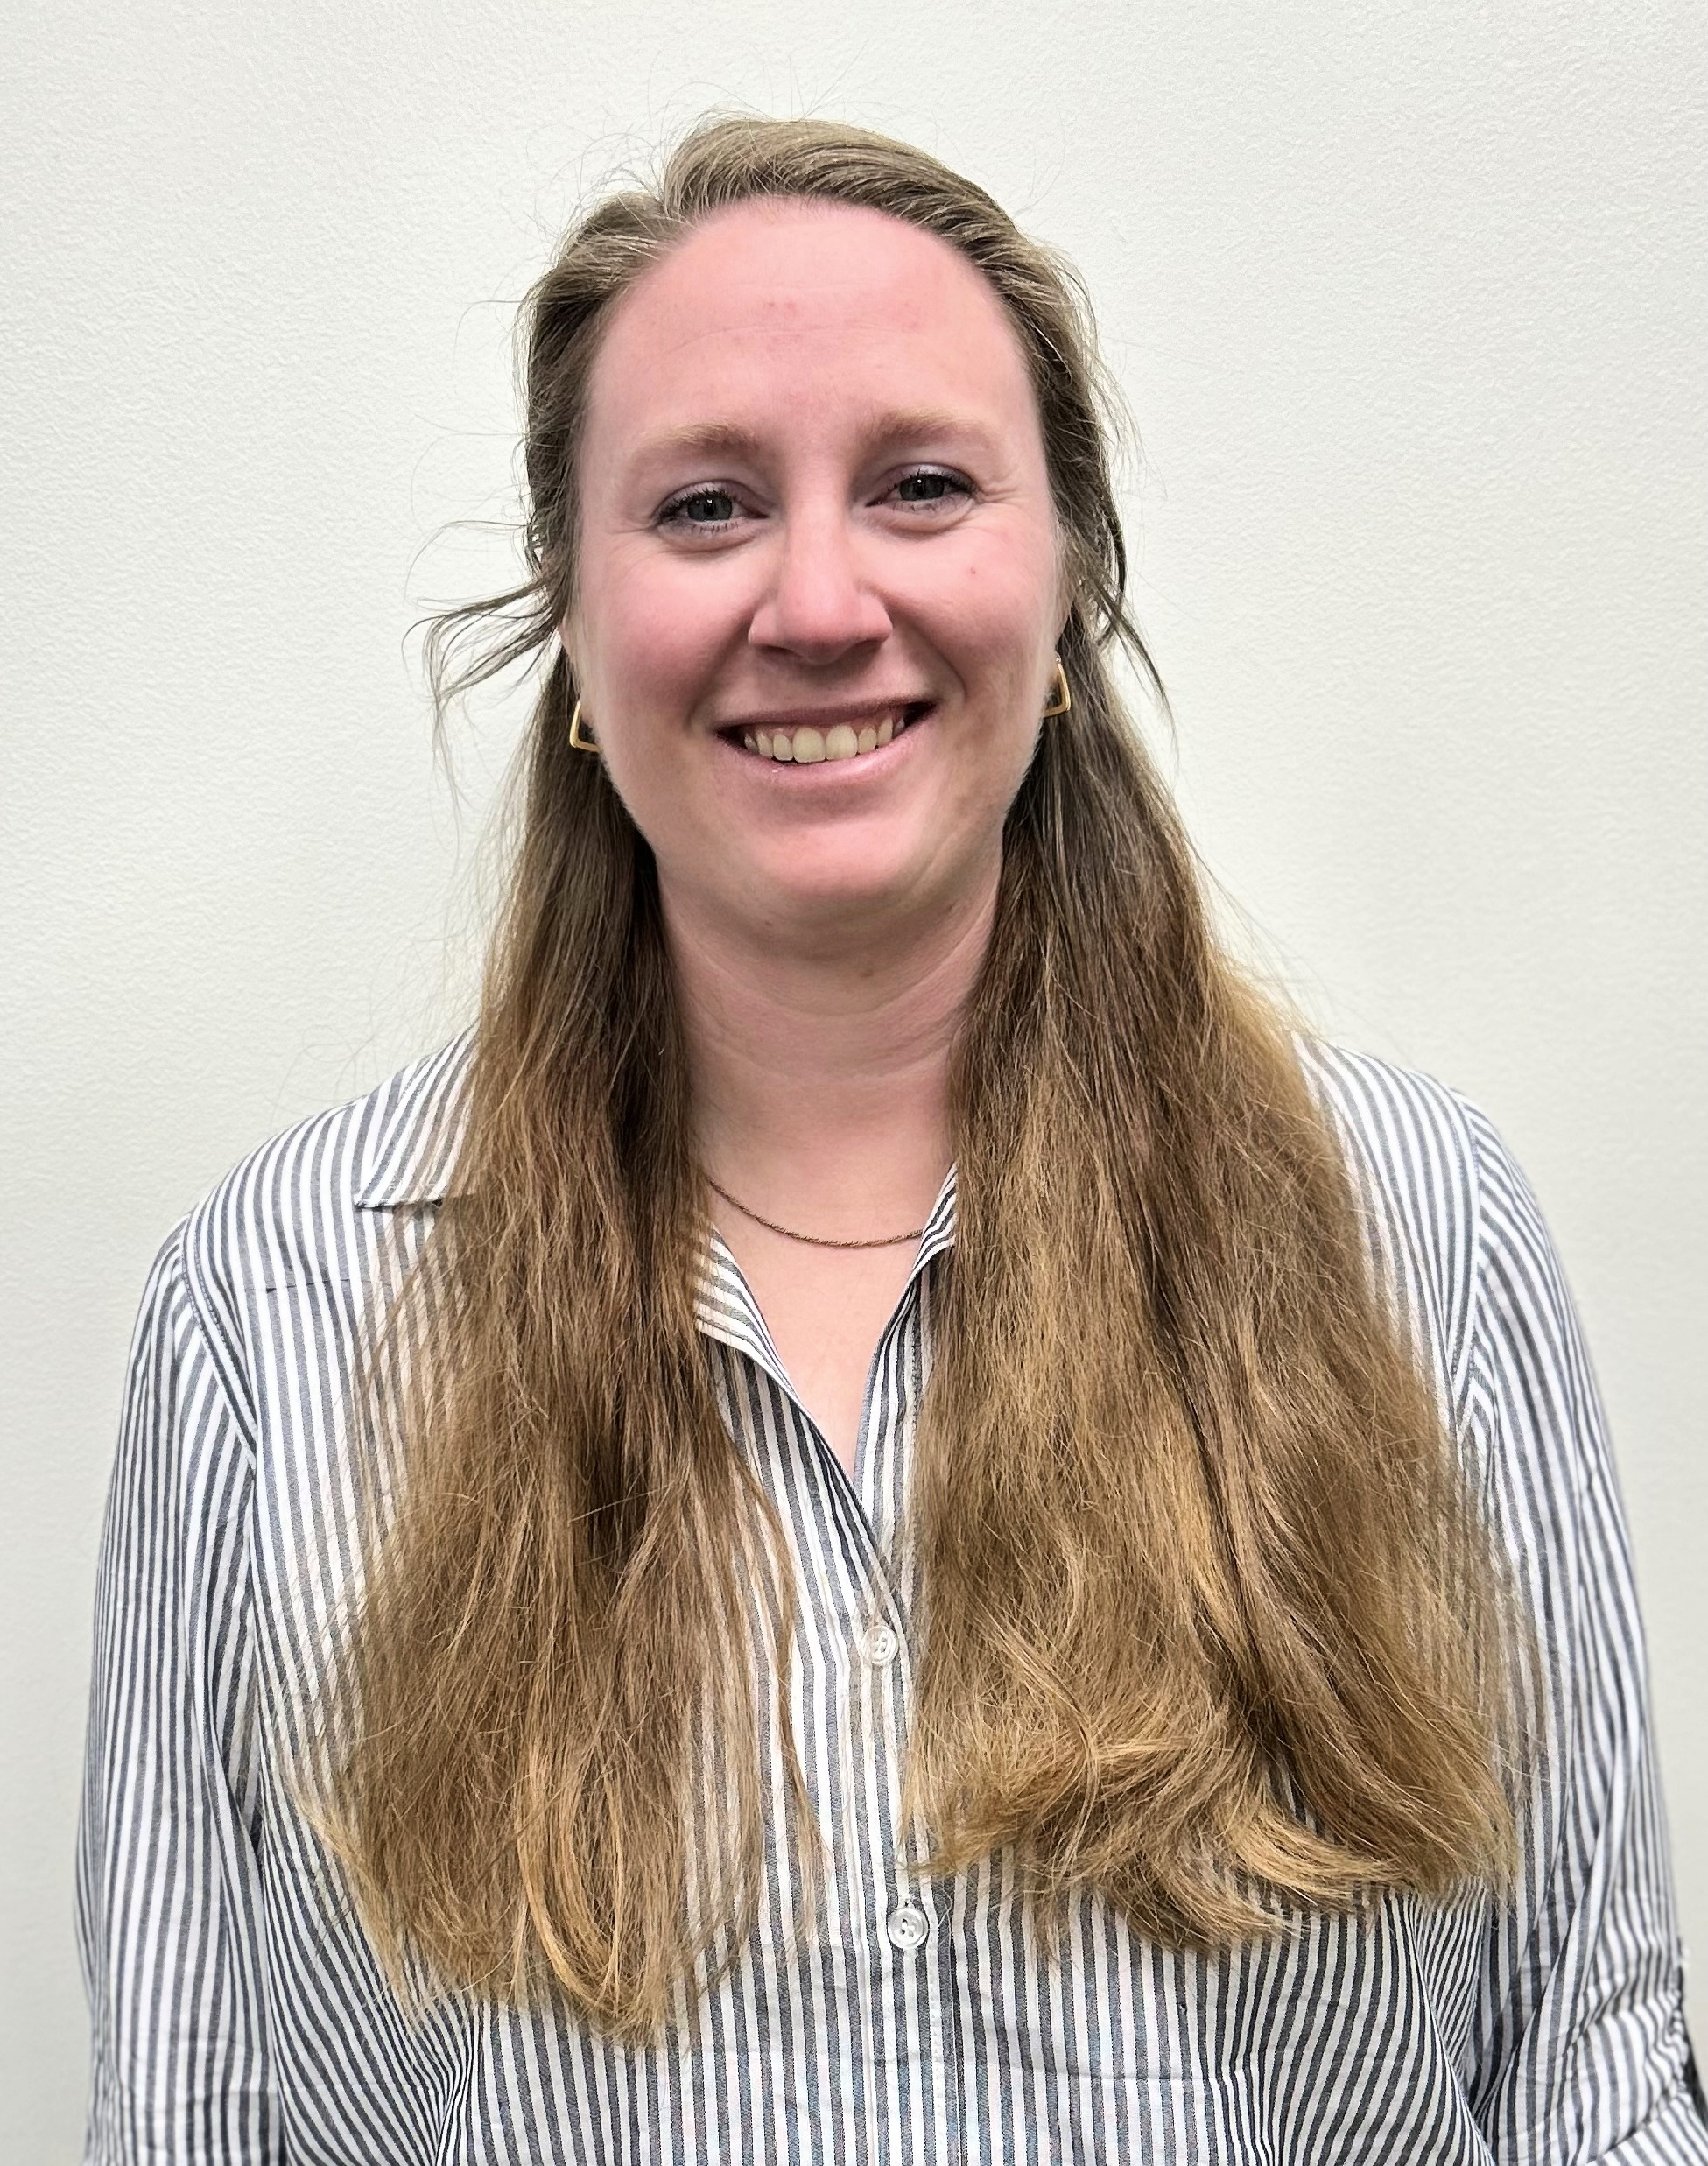

About Taylor Santa
About Shaun Kennedy
Taylor graduated from Western Carolina University with a degree in Chemical Forensic Science and has spent the past 8 years building expertise in the methacrylate adhesive industry. Having worked across quality control, application testing, and R&D, she brings a breadth of hands-on knowledge to her role in technical service support.
Shaun brings over 25 years of expertise across both pressure sensitive and structural adhesive markets. Having progressed from sales and product management into technical roles, his blend of commercial acumen and hands-on knowledge makes him a trusted advisor to businesses looking to improve performance through smarter adhesive choices.

Slide 3
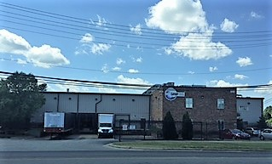
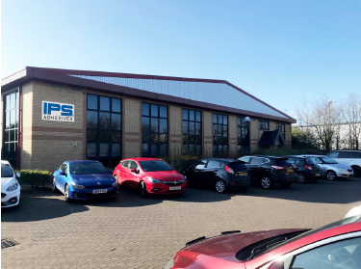
About IPS Adhesives
IPS Adhesives is a leading provider of adhesives, servicing the surfacing, structural, and assembly industries. With a combined 65 years of expertise and locations in both North America and Europe, its products are recognized by OEMs and fabricators globally for their premium quality, strength, and reliability.
Notes:
IPS Adhesive, a division of IPS Corp, is a manufatuer of Methyl Methacralte Adhesives, supplying several different markets such as homebuiling/remodeling with our seaming adhesives, the marine, transportation, rail, and others. The Scigrip brand has adhesive offerings that bond together metals, plastics, and composites, as well as cross bonding between all three. With 2 locations in Durham, NC and Newcastle, UK, both of which are 9001 ISO certified, we are able to provide adhesives across the globe in all types of markets

Slide 4
Today’s Discussion
Overview of Plastic Bonding
Key Challenges
Adhesive Solutions (MMA focus)
Product Highlights
Q&A
Notes:
Here’s a quick look at what we’ll cover. We’ll start with the basics of structural plastic bonding, then move into common materials and challenges. From there, we’ll compare joining methods, talk about surface energy—which is a key concept—and then spend time on adhesive solutions and specific products. We’ll wrap up with how we can support you and open it up for questions.

Slide 5
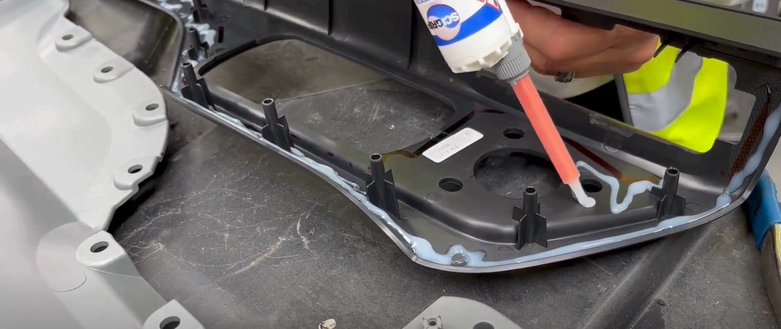
What is Structural Plastic Bonding?
Bond strength exceeds substrate strength
Designed for harsh environments
Enables both bonding + sealing
*In many cases, the adhesives is stronger than the plastics itself

Slide 6
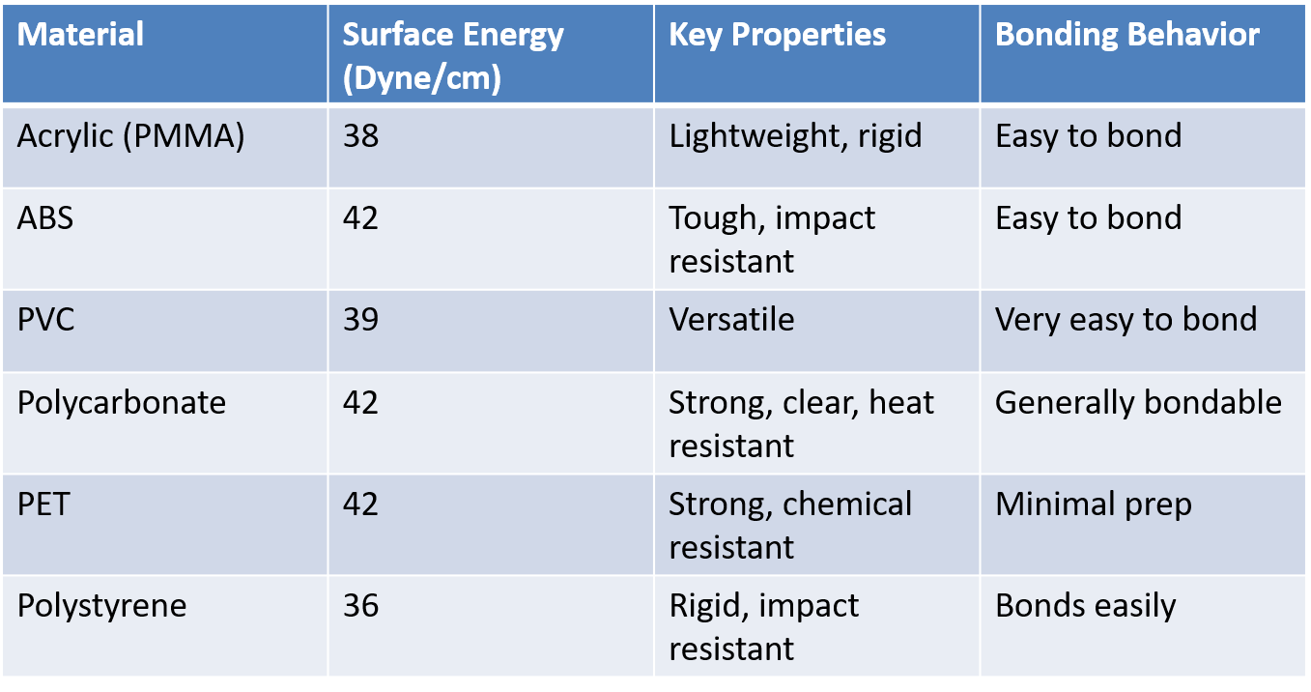
Easy to Bond Plastics
Higher surface energy = better adhesive wet-out = easier bonding
Notes:
“On this first slide, we’re looking at plastics that are generally easier to bond.
The key factor driving this is surface energy, which you can see ranges from about 36 to 42 dynes per centimeter.
Materials like ABS, polycarbonate, and PET sit on the higher end of that range, which means adhesives can spread and wet out effectively on the surface.
From a practical standpoint, that translates to:
Less surface preparation
More consistent adhesion
Broader adhesive compatibility
So for these materials, bonding is typically straightforward and reliable in most applications.”

Slide 7
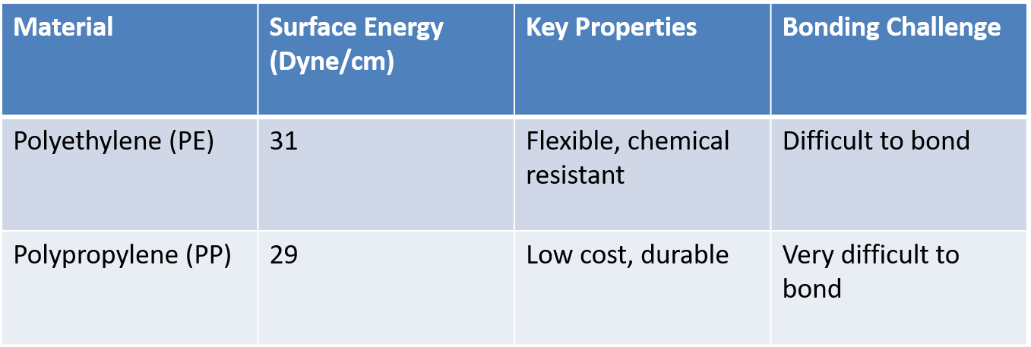
Difficult to Bond Plastics
Low surface energy = poor wet-out = requires treatment or specialty adhesives
Notes:
“In contrast, these materials fall into the low surface energy category, which makes bonding much more challenging.
Polyethylene and polypropylene are both below 31 dynes per centimeter. At this level, adhesives tend to bead up rather than spread across the surface.
Because of that, standard bonding approaches often fail unless additional steps are taken.
Typical solutions include:
Surface treatments like plasma or corona treatment
Primers
Specialized adhesives designed for low surface energy plastics
So the key takeaway here is that bonding these materials isn’t impossible—but it does require more process control and the right chemistry.”
The main takeaway across both slides is simple:
Surface energy is the primary driver of bondability, and understanding where your material falls helps determine whether bonding will be straightforward—or require additional engineering.”

Slide 8
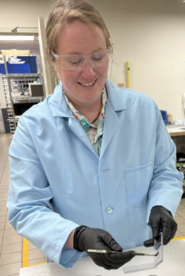
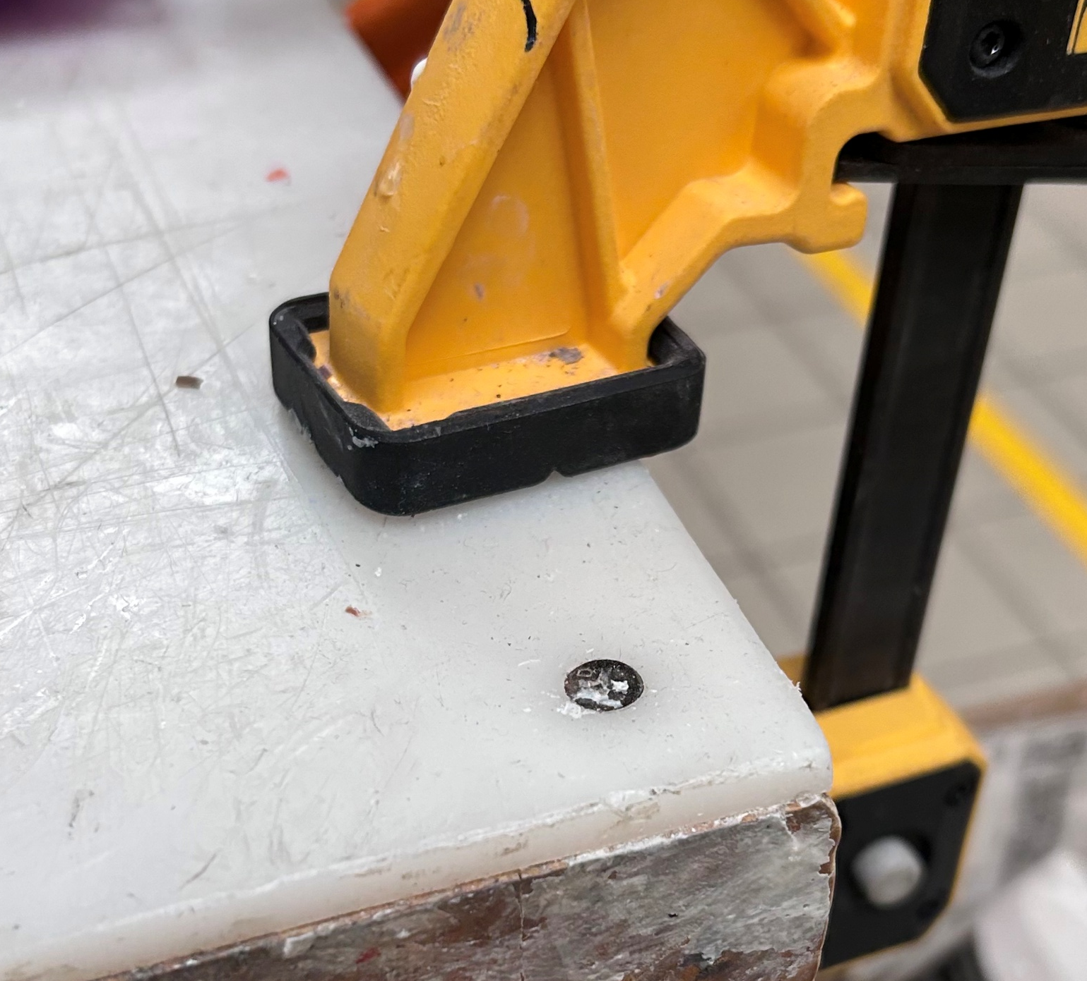
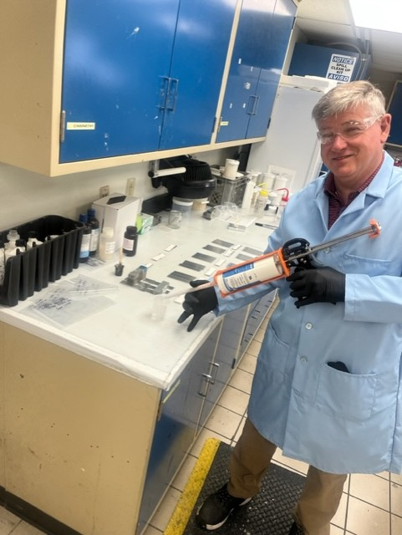
Plastic Joining
Mechanical Fasteners
+ Low cost, simple
– Damages substrate, weak joint, poor aesthetics, leak risk
Ultrasonic Welding
+ Fast, high strength, no consumables
– High capex, thermoplastics only, tight design constraints
Solvent Cement
+ Simple, one-part system
– Limited to similar plastics, environmental concerns
Adhesives
+ Bonds dissimilar materials, flexible design, lower equipment cost
– Slower cycle time, cleanup required
Notes:
Ultrasonic welding, where high-frequency vibrations heat up and fuse two pieces of plastic, requires high capital investments and complex designs. Below are the main reasons plastic molders switch from ultrasonic welding to Scigrip adhesives:
Tighter Tolerances – The vibrations from ultrasonic welding cause plastic parts to have alignment tolerances between parts. Bonding enables tighter tolerances for closer fitting plastic parts.
Lightweighting – Ultrasonic welding requires a minimum thickness to obtain structural parts. Bonding plastic parts with Scigrip adhesives allows thinner plastic, reducing the part’s mass.
Lower Capital expenditures – Dispensing equipment and fixtures usually cost less than ultrasonic welding equipment. Bonding cells can handle multiple parts, however ultrasonic welding needs separate equipment per part.
Simpler Designs – Ultrasonic welding requires weld-zones or ribs, increasing mold complexity. Scigrip enables simpler (and less expensive) molds and allows for bonding plastic to metal (see Dissimilar Bonding Guide).

Slide 9
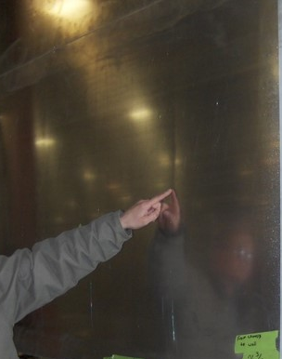
Challenges in Joining Plastics
Size, shape, thickness of parts
  Working times
  Flexibility of parts
  Inconsistent gaps in large parts
  Exotherm
  Surface challenges
    Shinny parts
    Mold release

Slide 10
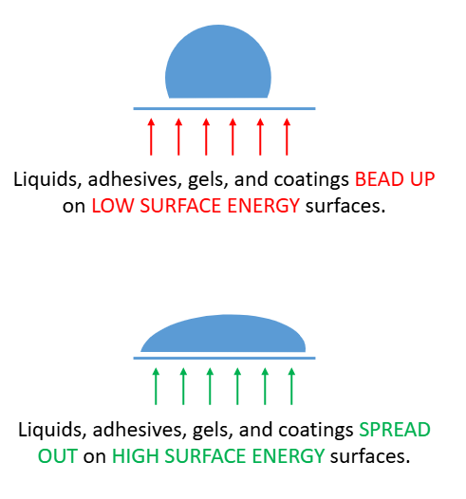
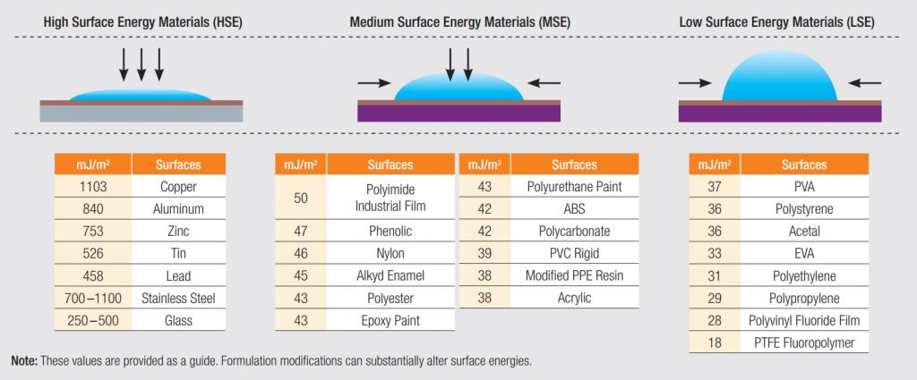
Challenges in Joining Plastics
Surface Energy and Dyne’s Levels and
  Low surface energy = 36dynes/cm and below
Notes:
Molecules on the surface of low-surface-energy materials are quite happy the way they are. There is very little attraction to any molecule, especially adhesive molecules. Materials with a surface energy below 36 dynes/cm are considered low surface energy and are very difficult to bond. These include polyolefin plastics such as polypropylene and polyethylene as well as “non-stick” surfaces such as polytetrafluorethylene (PTFE).

Slide 11
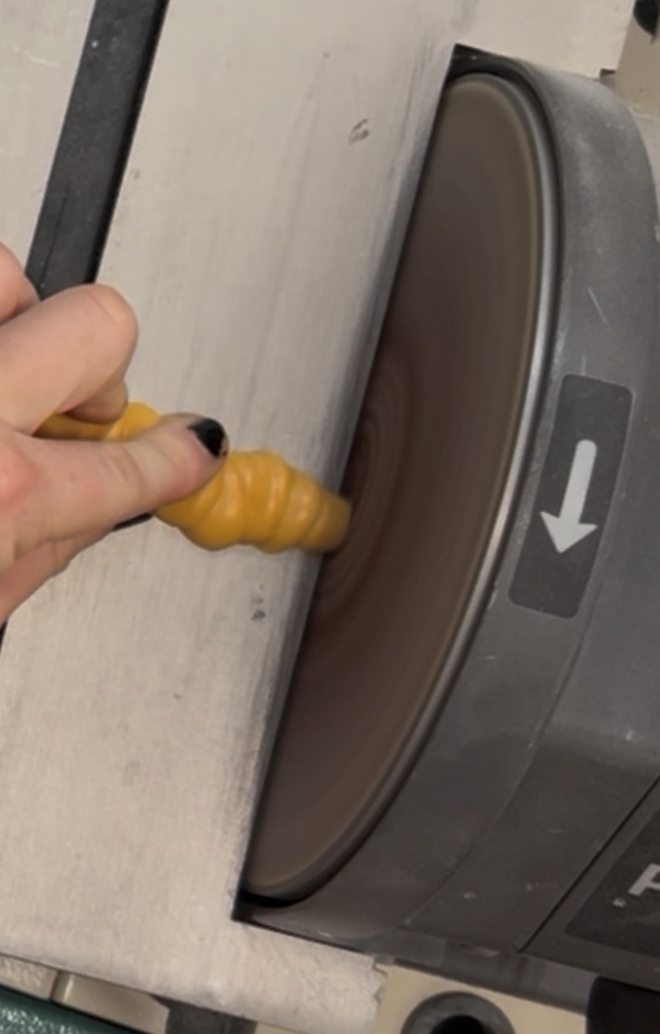
Types of Surface Treatment
No prep
Clean surface with solvent
Light abrasion
Physical Treatment
  Plasma, Corona, Flame
Primers
Notes:
Script
Contaminated surfaces reduce the contact between the adhesive and substrate, reducing wetout and overall bond strength. Wipe with IPA or other solvent to remove oils, dirt, and dust to provide a solid bond.
Abrading will significantly increase the surface area of the bonding area. Another benefit is :Injection molded plastics may contain traces of mold release that is difficult to remove with solvent wiping alone. Abrading the surface helps with the removal of this mold release. The main thing to remember here is to clean the surface with a solvent, then abrade, following up with another cleaning of the surface with a solvent. This will remove any dirt or dust released from the abrading.
Corona Discharge: The ionized air generated by a corona discharge, reacts with the surface of the substrate to form free radicals. They react with oxygen in the atmosphere and increase the surface energy of the substrate to be bonded.
Flame Treatment: Flame treatment involves exposing the surface to be bonded to a gas flame for a few seconds. The flame oxidizes the surface to be bonded and increases the surface energy by forming higher surface energy functional groups. Warping might be a potential hindrance during processing with this method.
Plasma Treatment: Plasma treatment differs from corona discharge and flame treatments in a sense that plasma treatment is typically carried out under partial vacuum. In plasma treatment, gas plasma is activated by the appropriate techniques to produce excited species that react with the plastic substrate. Often plasma treatment tends to provide substrates with better stability as compared to corona discharge, chemical treatment or flame treatment.
Since the shelf life of such surface treatment procedures can be short lived based on the substrate being treated, it might be a good processing procedure to treat the parts in line. Also expensive and takes time
Primers work by adding a thin coating of a functional material to the surface. Primers are chemically designed so that one end of the molecules bond very well to low-surface-energy materials while the free end bonds very well to adhesives.

Slide 12
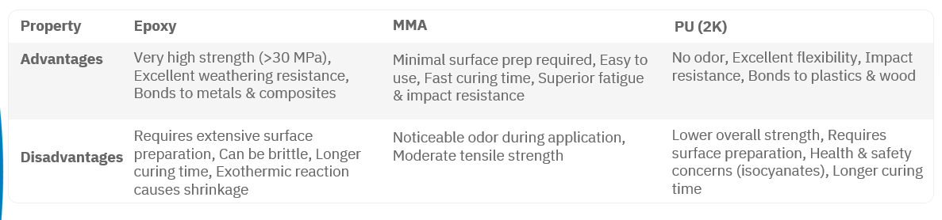
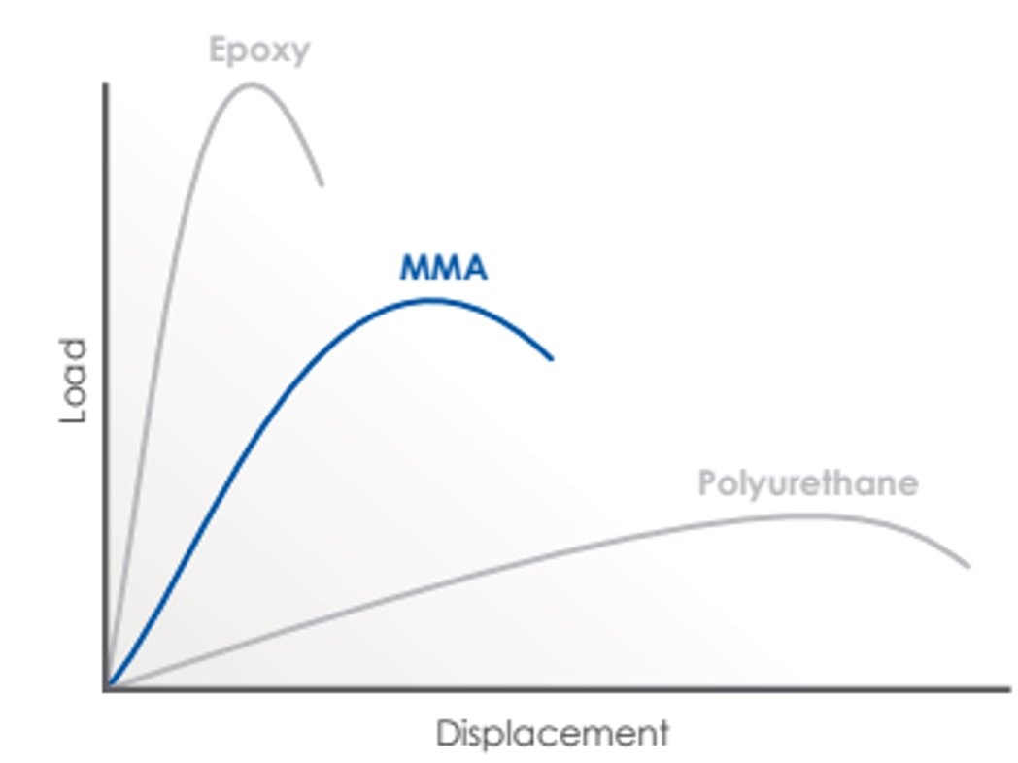
MMA vs Epoxy vs PU
Notes:
When comparing adhesive technologies, each has its place. Epoxies are strong but tend to be rigid and require more prep. Polyurethanes offer flexibility but can be slower. MMA adhesives provide a strong balance—they bond quickly, require minimal surface prep, and work well across a wide range of materials, including plastics.”

Slide 13
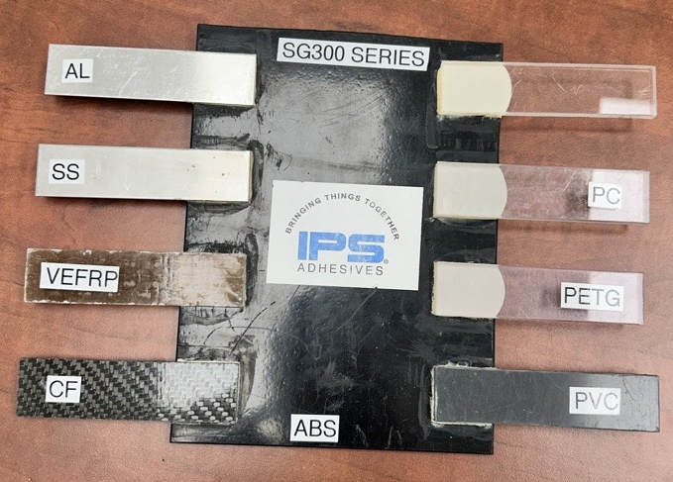
Scigrip 300 Series
2-component, non sag MMA (10:1 by volume)
Multiple Working Times (15-40 mins)
Two different colors – Black & Off-White
Cross-bonds a wide variety of substrates - Ideal for bonding dissimilar materials
Designed to meet specific requirements of the transportation industry, including reduced read through on visual surfaces.
Workhorse adhesive for industrial bonding

Slide 14
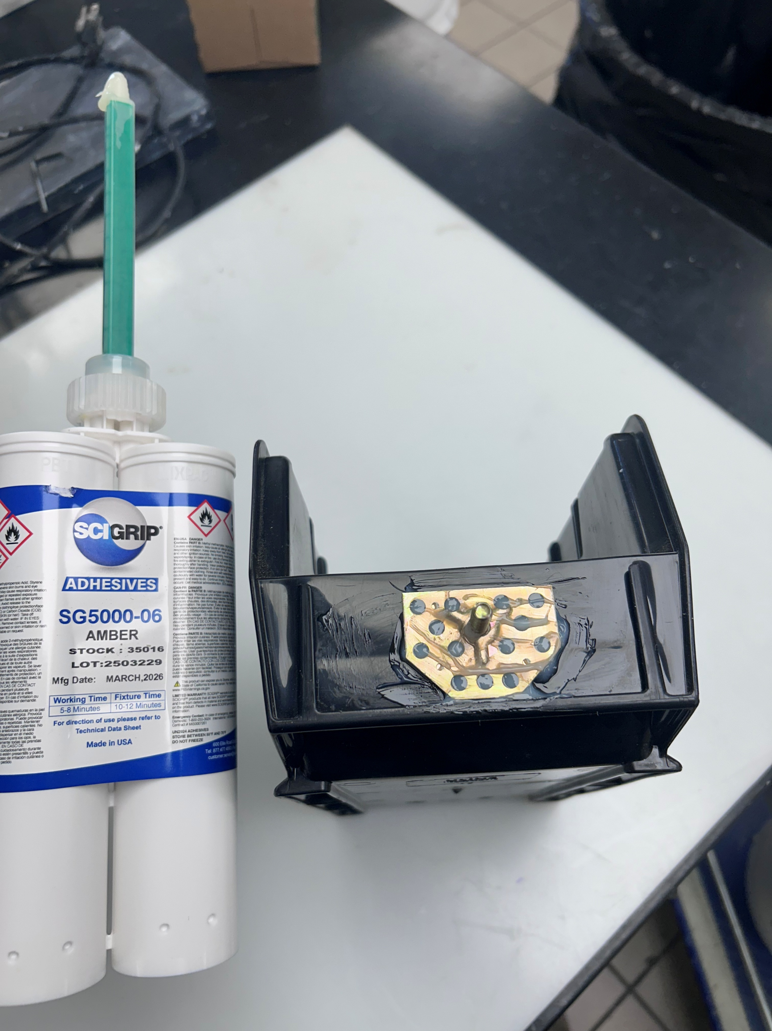
Scigrip 5000 Series
2-component, MMA (1:1 by volume)
6- & 13-minutes working times
Bond bonding plastics, ,metals and composites
Flowable viscosity, injectable
High tensile and shear strengths
Most metals, including steel and aluminum, can be bonded without surface pretreatment
A strong metal bonder that excels in plastic and cross bonding

Slide 15
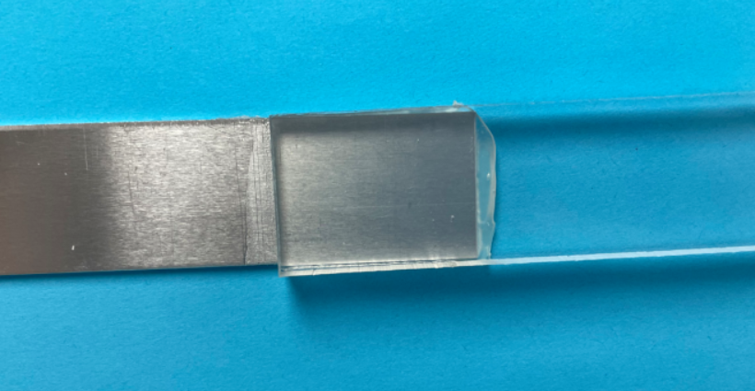
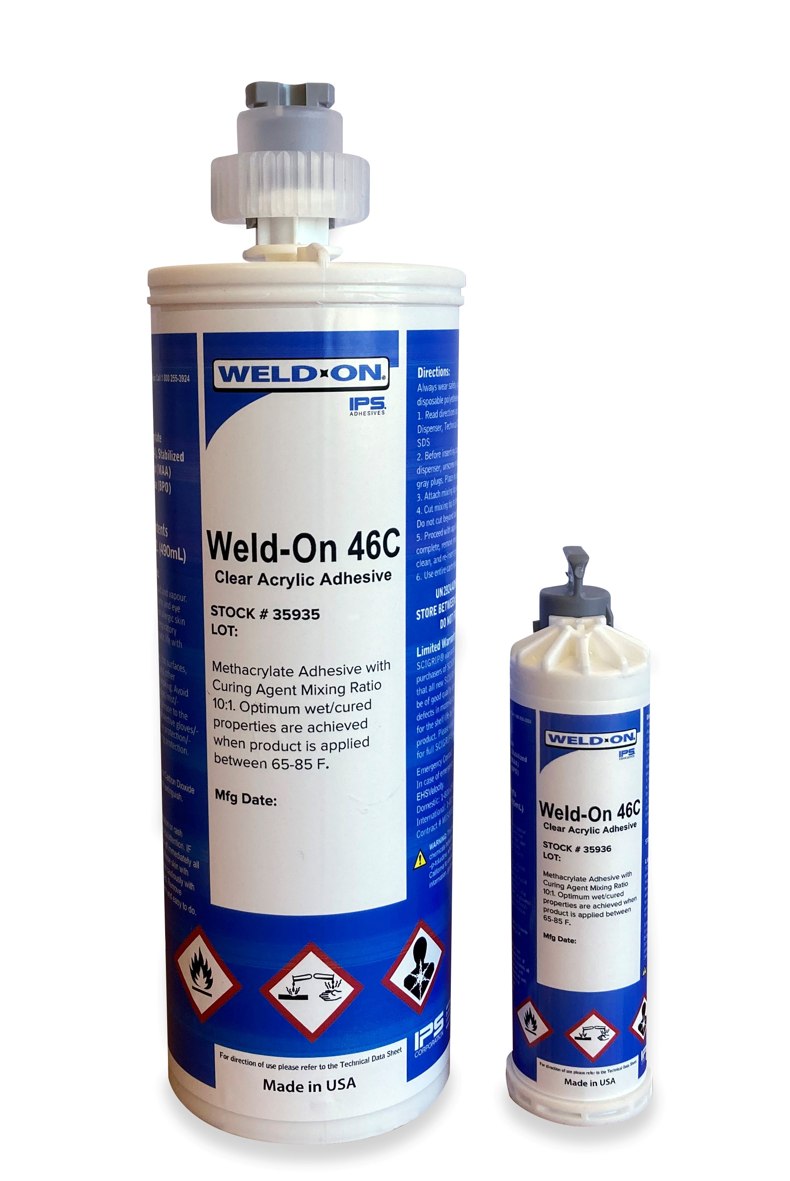
Weld-On 46 Clear
Optically Clear 2-Part MMA (10:1 by volume)
High Strength
Short Working and Fixture Time
  Working Time – 6-9 minutes
  Fixture Time – 15-25 minutes
UL Approved for Electrical Sign Assembly
Great for Trim Cap to Polycarbonate Lettering
Optically clear crossing bonding for structural bonds

Slide 16
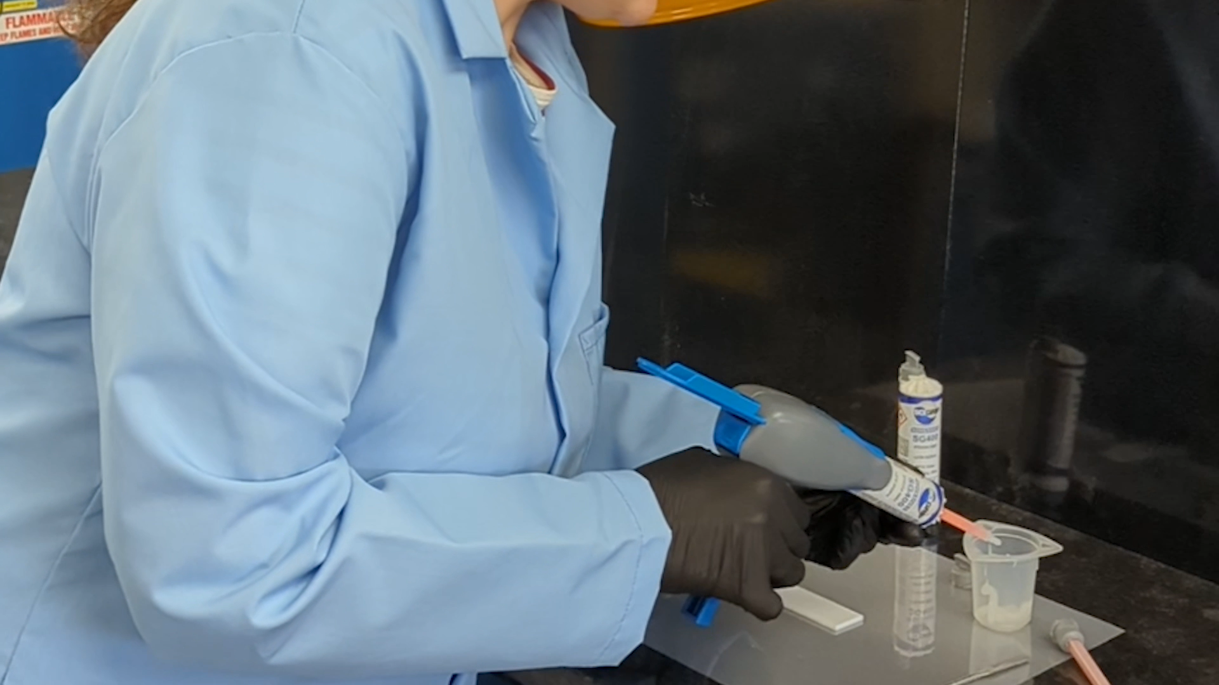
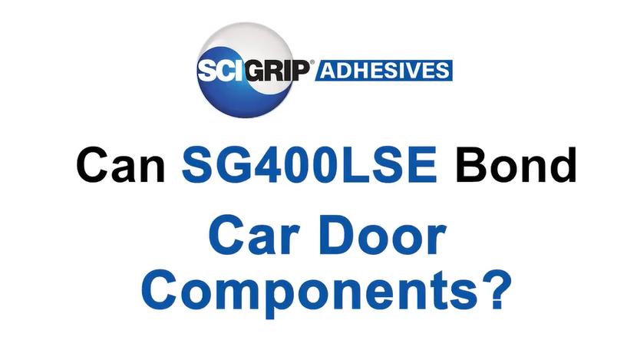
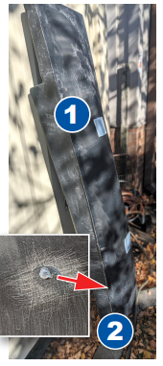
Scigrip 400 LSE
2-component MMA (10:1 by volume)
Bond low surface energy plastics including polypropylene and polyethylene without surface treatment.
Simplifies processes and saves on labor costs by eliminating need for flaming, plasma treatment or other methods
Bonds dissimilar materials, including plastics, FRP, and metals
Excellent fatigue, impact and shock load resistance
No surface prep, high strength LSE bonder

Slide 17
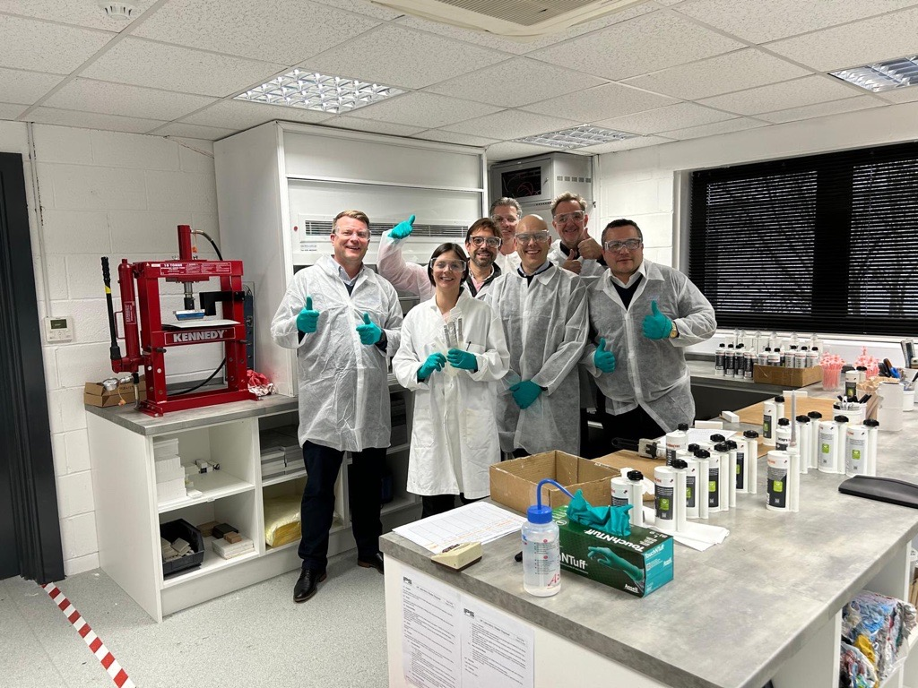
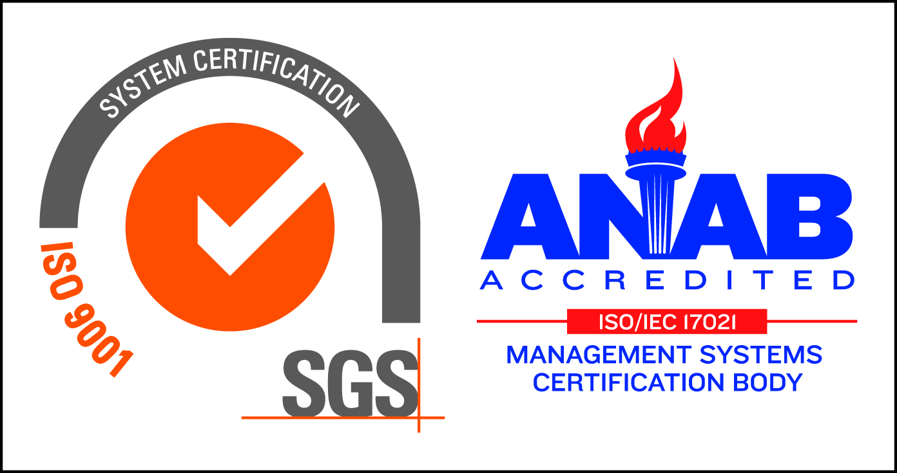

How We can Support You
Application Support
On-site training
Lab testing
Process optimization
ISO 9001 – Quality Management System
European Lab is certified to EN17460 for quality and safety in rail adhesive bonding.
Notes:
Make a note to remind everyone that due to the nature of plastic manufacturing, testing adhesives on your substrates is always best practice.

Slide 18


